Slide 2
THE LORD JESUS WARNED US THAT
DECEPTION WILL BE
A MAJOR SIGN
OF THE LAST DAYS
Matthew 24:3-5 & 24:23-24
So it is crucial that we develop our spiritual discernment in these Last Days for 2 REASONS

Slide 3
#1
WE NEED
INCREASING DISCERNMENT
TO COUNTER THE INCREASING DECEPTION OF THE LAST DAYS

Slide 4
There will be increasing deception
Until christ’s returnuntil Christ's return
a) Warned by Christ: Mt.24:3-5 & 24:23-26
b) Warned by Paul: 1 Tim.4:1 & 2 Thess.2:9-12
c) Warned by John: Rev.13:11-15 & 16:13-14

Slide 5
Our growing spiritual discernment must develop faster than the deepening deception of the Last Days. Otherwise we can be swept away by deception (Rev.12:5, Is.59:19) to become part of the false church (Mt.13:37-41), the harlot of Antichrist, Rev.18:1-4.
(There are two women in the book of Revelation: the Bride of Christ & the Harlot of Antichrist.)

Slide 6
#2
WE NEED TO develop
spiritual DISCERNMENT
To prepare a victorious, glorious church!
“I will build My church, and the gates of hell
will not prevail against it” -Mt.16:18
Is. 60:1-3, Eph. 5:27, & Rev. 19:7-8

Slide 7
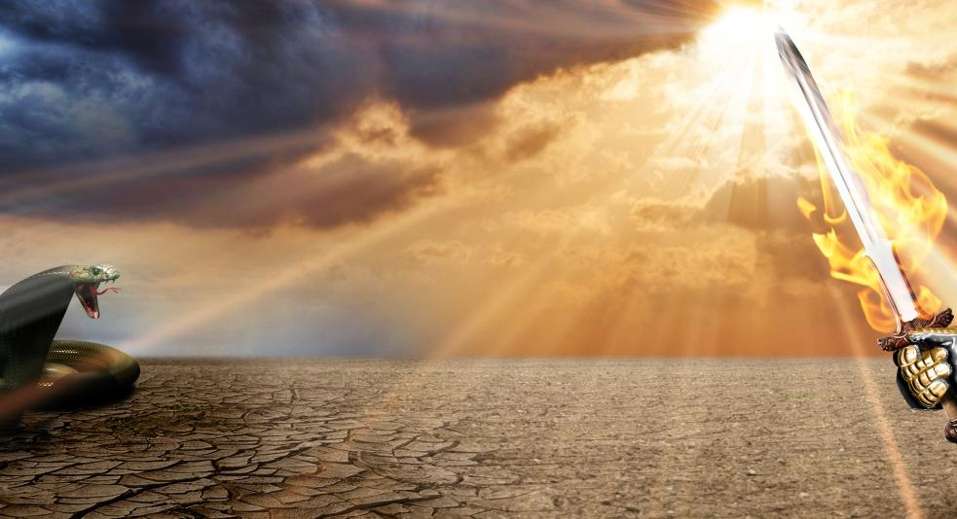
AREAS OF GROWING DECEPTION:
GROWING DECEPTION # 1
Deceiving
doctrines

Slide 8
3 LEAVENS
(false doctrines)
THAT JESUS WARNED ABOUT
Mt.16:12 “Then they understood that He did not tell them to beware of the leaven of bread, but of the doctrine of the Pharisees and Sadducees.”
LEAVEN = FALSE DOCTRINES
THAT SLOWLY, SILENTLY GROW & CORRUPT

Slide 9
3 LEAVENS
(false doctrines)
a) The Leaven of the Pharisees: LEGALISM
Outward appearance of holiness, but corrupt of heart: “you clean the outside or your cup and dish, but inside your hearts you are full of greed and wickedness,” Lk.11:39.
They legalistically obeyed the Sabbath, but did not follow the spirit of the Sabbath- so they rejected Christ, the Lord of the Sabbath!

Slide 10
3 LEAVENS
(false doctrines)
b) The Leaven of the Sadducees: LIBERALISM
The Sadducees did not believe
in angels, or the Resurrection, or
Heaven: they were SAD-U-SEE!
They only believed part of the Bible
-LIKE MODERN LIBERAL CHURCHES THAT REJECT MUCH OF THE BIBLE AND REJECT MIRACLES, HELL, THE SUPERNATURAL & BIBLICAL MORALS

Slide 11
3 LEAVENS
(false doctrines)
c) The leaven of Herod
“Then He charged them, saying, "Take heed, beware of the leaven of the Pharisees and the leaven of Herod." Mark 8:15
HEROD’S FALSE DOCTRINE:
A CORRUPT ALLIANCE OF POLITICS & RELIGION
MANY POLITICAL LEADERS WILL ACT
RELIGIOUS - TO DECEIVE THE RELIGIOUS!

Slide 12
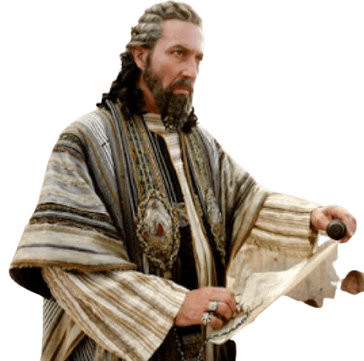
3 LEAVENS
(false doctrines)
c) The leaven of Herod
HEROD THE GREAT:
Said he wanted to worship
the king, but actually wanted to kill Him, Mt.2:7-16. He built the Temple of Herod, while murdering countless people!

Slide 13
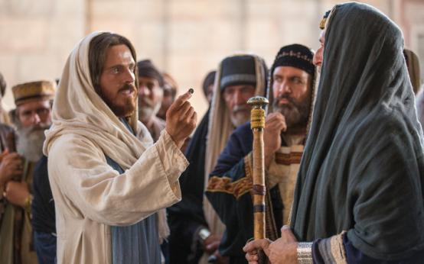
3 LEAVENS
(false doctrines)
c) The leaven of Herod
The HERODIANS
& Pharisees tried to trick Jesus
to destroy Him, Mk.12:13-15

Slide 14
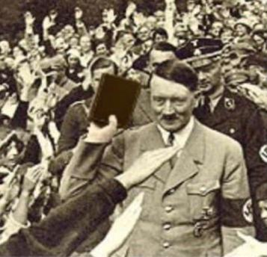
THE LEAVEN OF HEROD:
A CORRUPT ALLIANCE OF POLITICS & RELIGION
Adolf Hitler deceived most of the pastors in Germany when he told them the Bible was his guidebook and that he would make Germany a great Christian nation!

Slide 15
3 LEAVENS
(false doctrines)
d) DOCTRINES OF DEMONS, 1 Tim.4:1 “in the last times some will turn away from the faith by paying attention to deceitful spirits and demonic doctrines”
It is the responsibility of the Christian leaders to protect the immature Christians from false doctrines, and
help the body of Christ to come to full spiritual maturity, Eph.4:11-14.

Slide 16
From being spiritual babies we are to mature to become spiritual “young men.”
“I have written to you, young men,
because you are strong, and the word
of God abides in you, and you have overcome the wicked one,”
- 2 John 2:14

Slide 17
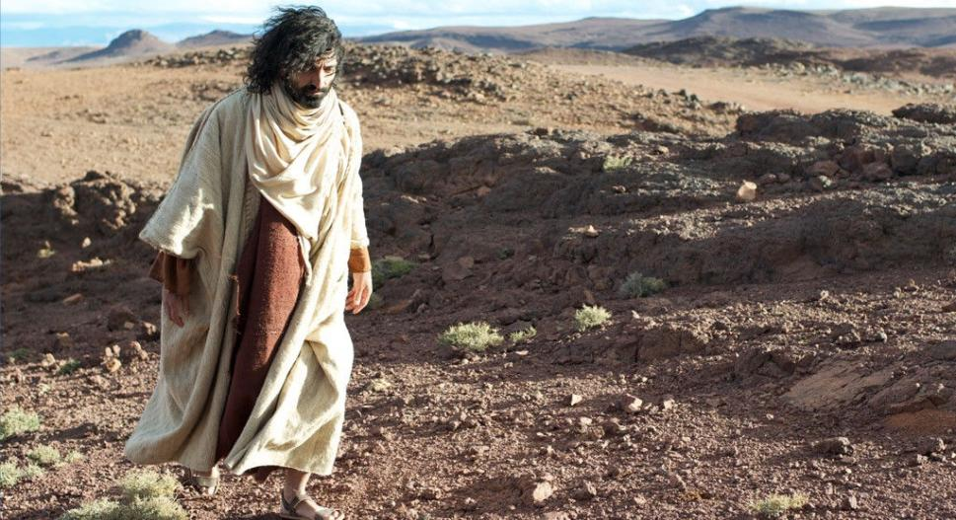
When Christ
was a young man
He overcame
the devil with
3 scriptures
from the Book
of Deuteronomy,
Lk.4:3-13

Slide 18
AREAS OF GROWING DECEPTION:
GROWING DECEPTION # 2
fake remedies and quack medicines
Eccles.7:17. “Do not be overly wicked, nor be foolish: Why should you die before your time?”

Slide 19
FACT:
It is good to eat healthy foods, supplements, and vitamins
- done with wisdom & discernment!
DEception:
Many fake and dangerous ‘remedies’ and ‘health cures’ are being sold by ignorant or corrupt people!
BEFORE YOU PROMOTE HEALTH PRODUCTS
TO OTHERS, MAKE SURE IT WORKS FOR YOU!

Slide 20
test #1
DOES IT WORK?
test #2
DOES IT WORK SAFELY?
(Is there medical proof it is safe to use long-term?) MANY QUACK CURES ARE DANGEROUS!

Slide 21
A newspaper in Pakistan tested all the quack medicines being sold in the nation: 60% contained illegal steroids
A medical study at Rawalpindi, India: 53% of the various quack pills sold contained at least
1 type of illegal steroid

Slide 22
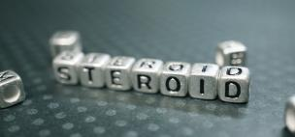
STEROIDS help many health problems if used short-term BY A WISE DOCTOR

Slide 23
STEROIDS help many health problems if used short-term BY A WISE DOCTOR
STEROIDS cause many health problems if used long-term WITHOUT A WISE DOCTOR!

Slide 26
QUACK REMEDIES FOR COVID-19
* Volcanic Ash from Taal volcano
* Drinking bleach
(WARNING: THIS CAN BE DEADLY)

Slide 27
QUACK REMEDIES FOR COVID-19
* Inhaling hot steam
(DANGEROUS- CAN DAMAGE & BURN YOUR SINUSES & HEAD)
Indian politicians were promoting drinking
cow urine to stop
covid-19!

Slide 28
Don’t be deceived that a quack cure
can protect you from covid-19! Get the help of a wise doctor (such as Dr. Lex ) as soon as you have any symptoms of covid-19.
Dr. LEX TORRES
CP# 09171844191
Messenger: Lex Torres
Viber: 09171844191

Slide 29
If you have the symptoms of covid-19, don’t be deceived that it is something else: “Its just a flu” Do not let fear keep you from getting help! Do not ignore it and hope it will get better.

Slide 30
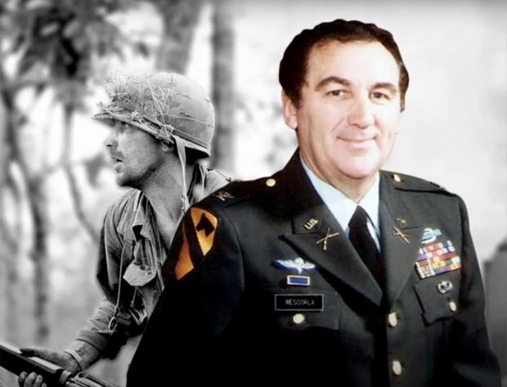
The Story of Rick Rescorla
A brave soldier who became the head of security for the large company, Morgan Stanley.
- Rick was in charge of the safety of 2,700 employees

Slide 31
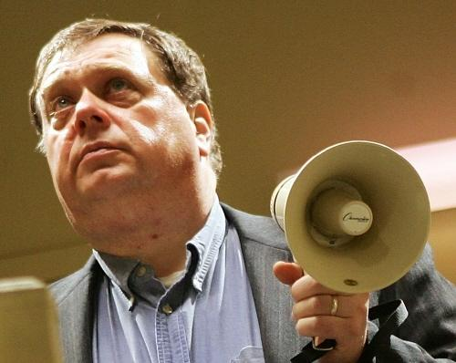
Others said the
Others said the building that was burning nearby was no problem, but Rick quickly commanded his employees to begin to exit the building

Slide 32
17 minutes later an airplane crashed into their own building- but Rick’s discernment and quick action led almost all of the company’s 2,700 employees to safety!

Slide 33
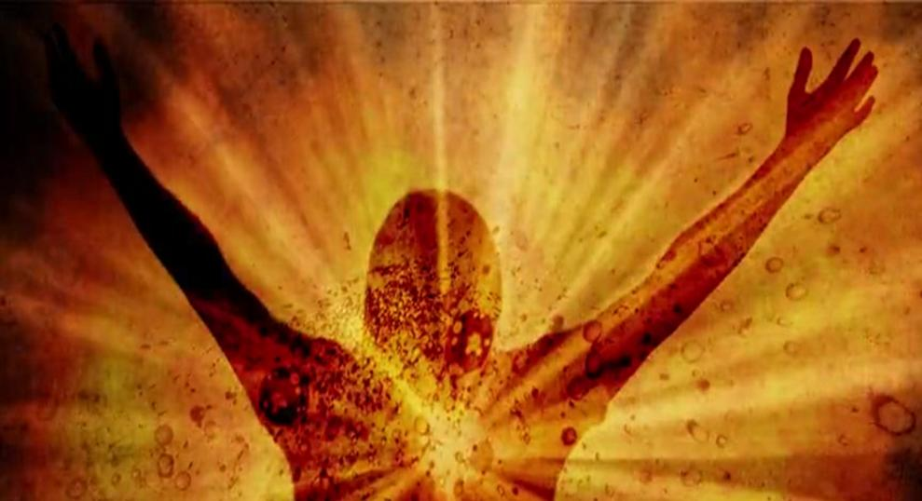
With DISCERNMENT we can avoid DECEPTION, and with COURAGE and FAITH guide the people of God through the Last Days to become a victorious, glorious Church!

