Slide 1
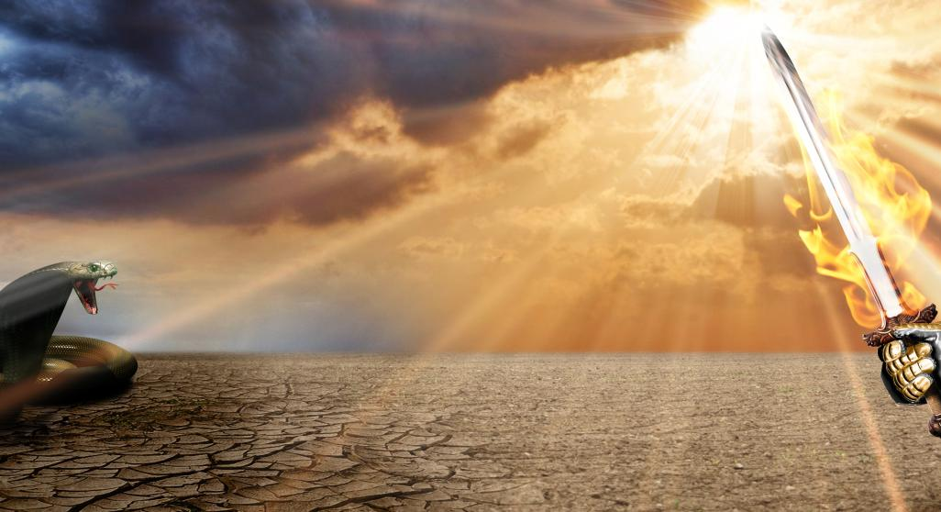
DEVELOPING
DISCERNMENT
TO OVERCOME
IN THE LAST DAYS

Slide 4
KEY # 1- Practice Develops Discernment
“Who by reason of use have their senses exercised to discern both good and evil” -Heb.5:14
Exercise & develop
your discernment!

Slide 5
When you encounter spiritual situations, seek to understand them- evaluate & test them
“Do not despise prophecies. Test all things;
hold fast what is good.” -1 Thess.5:20-21
“But he who is spiritual judges all things”
– 1 Cor.2:15

Slide 6
Key # 2- Evaluate Spiritual Ministry By Its Fruit, not Gifts
“Beware of false prophets…you can identify them by their fruit”-Mt.5:15-16

Slide 7
Many people are gifted and powerful- but are not pure!
Their ministry will produce bad fruit
in finances, marriage, doctrines, etc.

Slide 8
Key # 3 Test All Things by the Scriptures
“Look to God's instructions and teachings!
People who contradict His word
are completely in the dark,” Is.8:20 NLT

Slide 9
How Christ Overcame Satan, Lk.4:3-12
Temptation # 1 & 2 Lk.4:3-8. Is it Scriptural? NO!
‘It is written’- the ‘Logos’ written word contradicts
Temptation # 3, Lk.4:9-12 Is it Scriptural? YES!
-but is it Scripturally balanced? NO!
“It has been said”-the spoken ‘Rhema’ word corrects

Slide 10
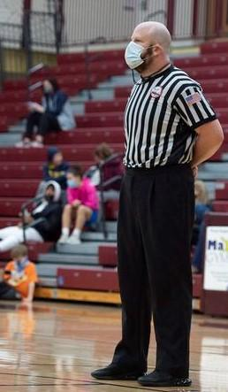
KEY # 4 The Witness of the Holy Spirit
“And let the peace of God rule
(referee) in your hearts,” Col.3:15
- The Holy Spirit gives us peace in our heart unless something is wrong- then like a referee, he will step up, blow his whistle or raise a red card: STOP!

Slide 11
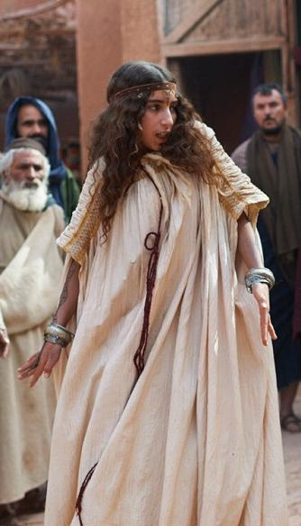
In Acts 16:16-18 Paul was followed by a slave girl with a spirit of divination
-Her words were correct, but Paul was troubled in his spirit- until he understood the problem and cast the evil spirit out of her!

Slide 12
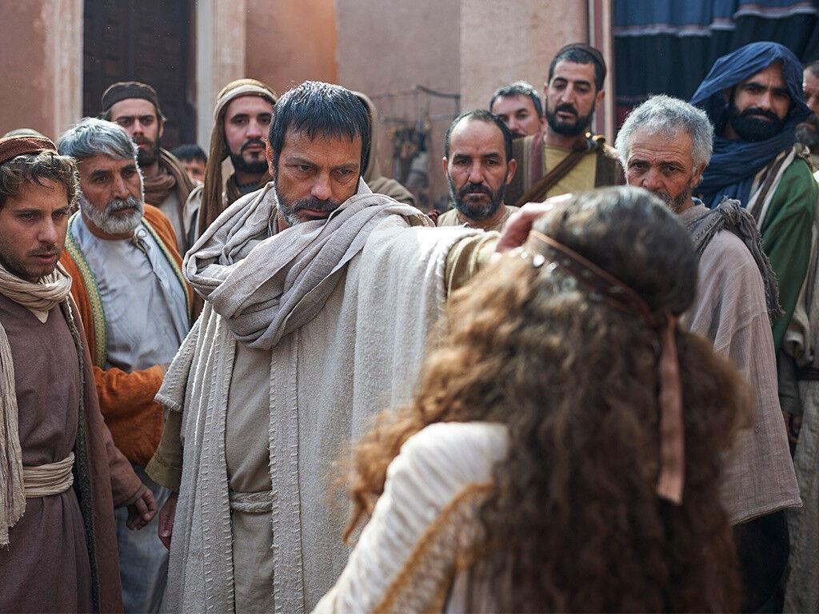

Slide 13
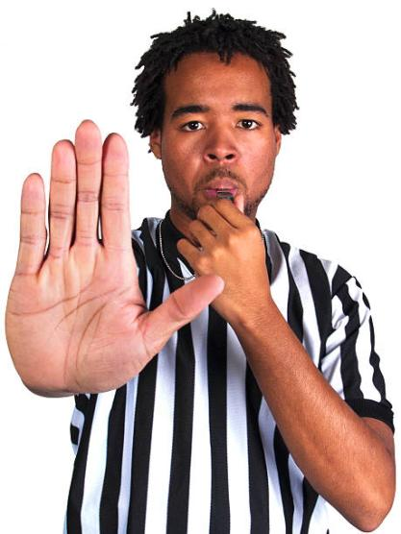
Discern if the Holy Spirit is no longer giving you peace in your heart, but a warning- then seek to understand what the warning is!

Slide 14
But when the peace of the Holy Spirit continues to lead us, we can flow deeper & deeper into the river of God- into revival!

Slide 15
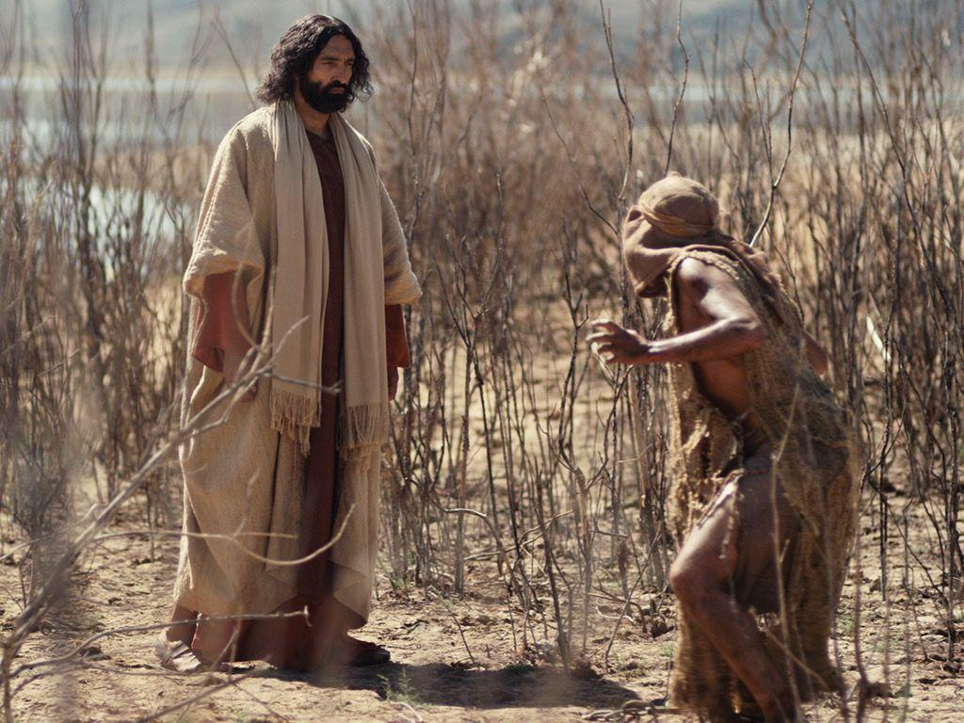
KEY # 5 CHALLENGE THE SPIRITUAL MANIFESTATION
Then Jesus asked him,
"What is your name?"-Mk.5:9

Slide 16
Key # 6. Let mature leaders guide with their collective discernment
“In the multitude of counselors there is safety,” Prov.11:14
“Let 2 or 3 prophets speak, and let the others judge.”-1 Cor.14:29
"And they shall teach My people the difference between
the holy and the unholy, and cause them to discern between
the unclean and the clean.”-Ezek.44:23

Slide 17
Spiritual people who are “independent” often get led away into deception

Slide 18
KEY # 7 The Discerning Of Spirits “…to another the working of miracles, to another prophecy, to another discerning of spirits,” -1 Cor.12:10
This gift of the Holy Spirit can reveal spiritual sources:
* Angels (good and fallen), Heb.1:14, Eph.6:12
* Anointings of the Holy Spirit, Is.11:2, Lk.5:17, Zech.12:10
* Demons, Acts 16:18, Rev.16:14
* The human spirit, Mk.1:8, Acts 5:3

Slide 19
KEY # 8 Don’t Major on the “Dark Side”
Don’t always be looking for demons-
always look for what God is doing!
“…there are more on our side than on theirs!" 2 Kgs.6:15-17
Whatever we look for, we will find:
will it be Jesus, or demons?

Slide 20
He who dwells in the secret place of the Most High shall abide under the shadow of the Almighty…. Surely He shall deliver you from the snare of the fowler and from the deadly pestilence.–Psalm 91:1 & 3
Our protection comes from abiding in God!

Slide 21
“Greater is He Who lives in you than he who is in the world.” -1 Jn.4:4

