Slide 2
DECEPTION # 1 Deceiving Doctrines DECEPTION # 2 Fake Remedies and Quack Medicines DECEPTION # 3 Impure Ministries & Polluted Anointings DECEPTION # 4 Inner Deceptions of the Heart

Slide 3
DECEPTION # 5- Financial Scams and Deceptive Products

Slide 4
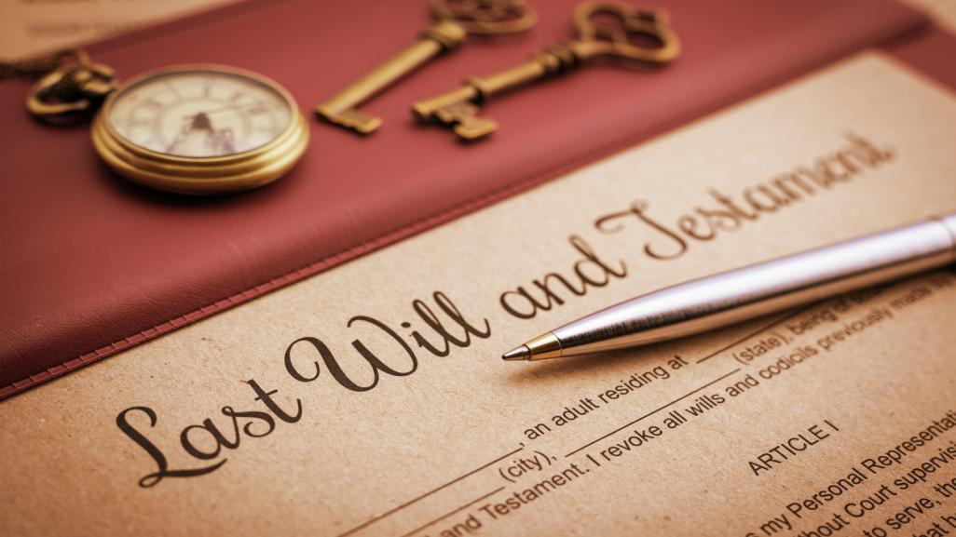

Slide 5
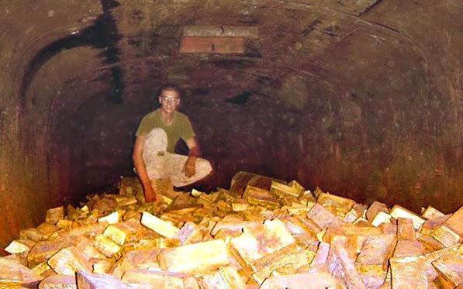

Slide 8
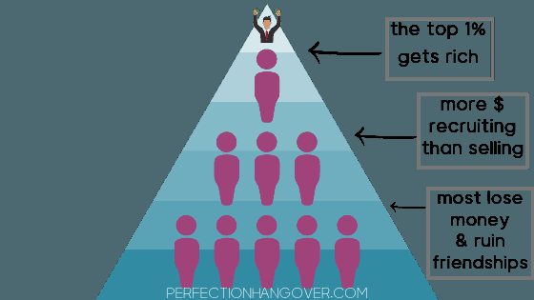

Slide 9
Don’t sell your reputation to gain money thru a business that fails and leaves behind dissatisfied customers!

Slide 10
DECEPTION #6: FAKE NEWS & CONSPIRACY THEORIES

Slide 11
PRACTICAL WISDOM TO DETECT FAKE NEWS: 1) Do I recognize the news organization that posted the story as being a stable, reputable news organization? 2) Does the information in the posted news seem professionally reported, and seem believable? 3) Is the news sensationalist or frightening, making you need the further help of the group spreading this news? 4) Check out the news at fact check websites, such as Snopes.com TruthOrFiction.com & FactCheck.org 5) Is the posted news politically motivated?

Slide 12
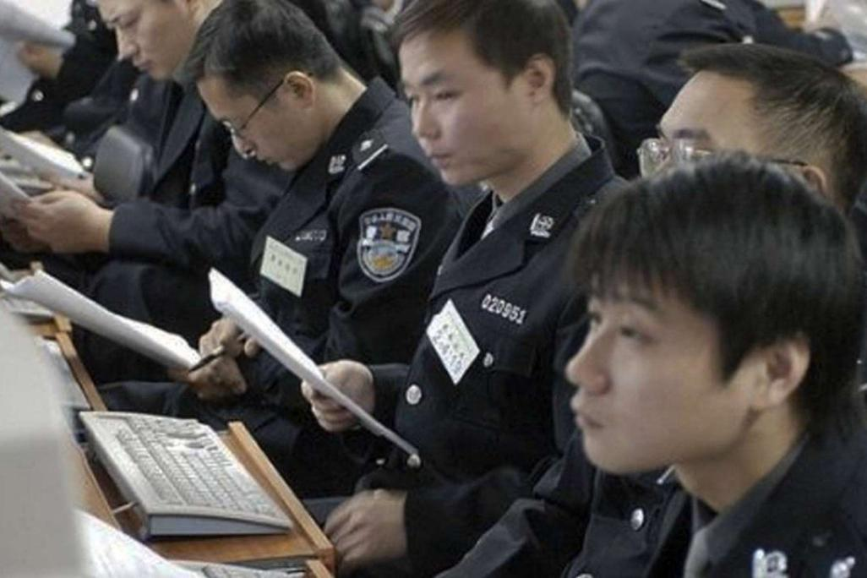
the Beijing News, Oct.2013: more than 2 million workers help police the news and social media

Slide 13
Harvard University professor
Gary King in 2016 revealed that
the Chinese government produces
488 million 'fake' social media posts a
year, to influence people: propaganda!

Slide 15
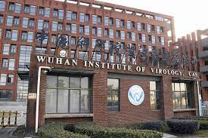

Slide 16
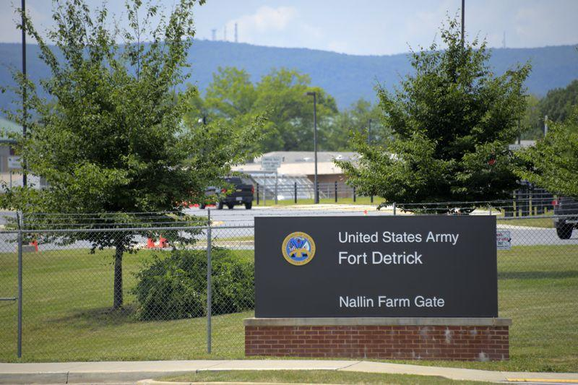

Slide 17
A Conspiracy Theory in Muslim Nations: Polio Vaccinations are a Western (or Jewish) plan to attack the Muslim nations!

Slide 19
MUSLIMS DECLARED: Trust in God’s power! Reject the (Polio) Jab!

Slide 20
5 Million + have died of Covid-19 -Over 97% of them would have lived if they had been vaccinated!

Slide 21
Yes, we are in the last days- the Antichrist will arise in the coming years- there will be the mark of the beast- but if we cannot discern error now, how will we be ready to discern the truth when the Antichrist and the mark of the beast arrive?

Slide 22
Let us gain wisdom and discernment, to become overcomers in these Last Days!

