Slide 1
THE PEOPLE WHO KNOW THEIR GOD
SHALL BE STRONG & WILL DO EXPLOITS FOR GOD

Slide 2
Daniel prophesied that God’s people will arise in difficult days to see the hand of God at work to bless them, protect them, and use them in mighty ways, Dan.11:31-35

Slide 3
The First Prophetic Fulfillment of Daniel 11:31 in 168 B.C.
…they shall take away the daily sacrifices, and place there the abomination of desolation.” This prophesy was about King Antiochus IV when he invaded Israel.

Slide 4
The 1st prophetic fulfillment of Dan.11:32a in 168 B.C. – The Greek King flattered the High Priest, and turned many Jews to follow the Greek ways & pagan gods

Slide 5
The First Prophetic Fulfillment of Dan. 11:32b in 168 B.C.- One family of priests rose up against this corruption – the Maccabees

Slide 6
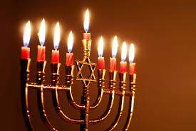
Dan.11:33a “And those of the people who understand shall instruct many”
The Maccabees and many other priests turned the corrupted Jews away from Greek immorality & idolatry- a national revival turned the Jews back to God & drove the Greeks away in 164 BC

Slide 7
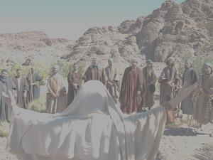
The Future Fulfillment of Daniel 11:31
Jesus taught that this prophecy of Daniel 11:31 will be fulfilled again in the Last Days when the ‘Abomination of Desolation’ spoken by Daniel will again be set up in the Temple, Mat.24:15

Slide 8
A PRESENT SPIRITUAL FULFILLMENT:
Jesus, Paul & Peter referred to the Temple as being the body of Christ.
Corrupt rulers and compromising religious leaders are again bringing abominations into the Temple,
the Church!

Slide 9
“Abortion is a woman’s choice… God approves of homosexuality”

Slide 10
Pope Francis: “Atheists do not need to believe in God to go to heaven. Just do good, and we will meet you there.”

Slide 11
Christians are being increasingly pressured to compromise their faith!

Slide 12
BUT THE PEOPLE WHO KNOW THEIR GOD SHALL BE STRONG- BE ESTABLISHED- AND WILL DO EXPLOITS- WILL DO HEROIC ACTS!
Hebrews 11 gives us a list of the Heroes of Faith: ordinary people, such as government employees, housewives, an orphan, overseas foreign workers, soldiers and farmers…

Slide 13
ANYONE CAN KNOW GOD AND TRUST HIM!

Slide 14
STAND UP FOR GOD -
– AND GOD WILL
STAND UP FOR YOU!

Slide 15
Eric Liddell, the famous Scottish runner and missionary, would not run on a Sunday

Slide 16
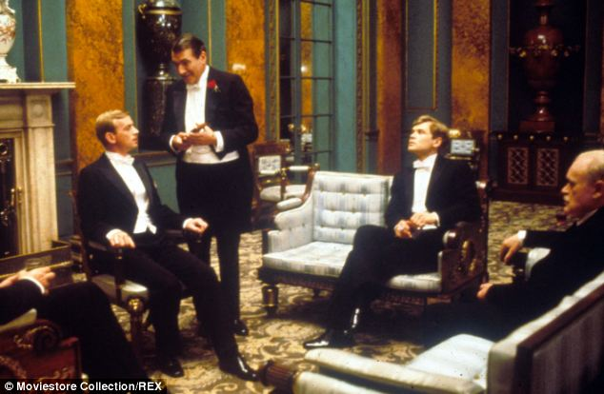
He was pressured by his future king to compromise – but he would not

Slide 17
Just before he ran his changed Olympic race he was handed this note. He won the gold medal.

Slide 18
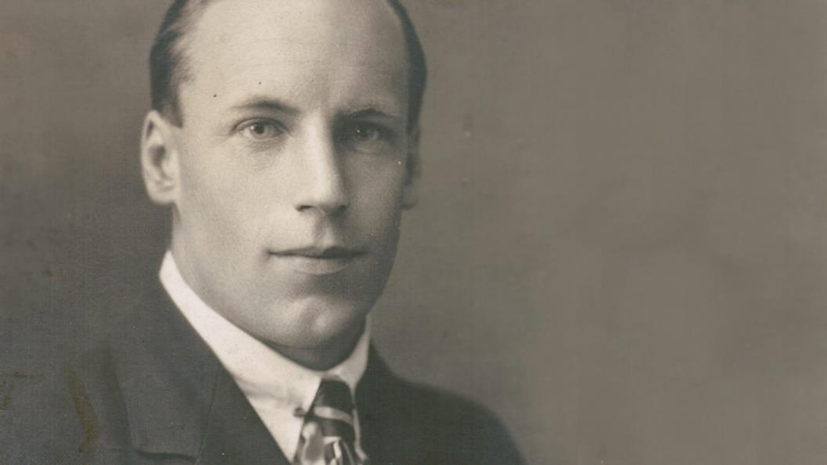
Eric Liddell said:
“You will only know as much of God as you are willing to put
into practice.”
Eric gave up his racing career to become a missionary to China. He died there as a Japanese POW in WW2.

Slide 19
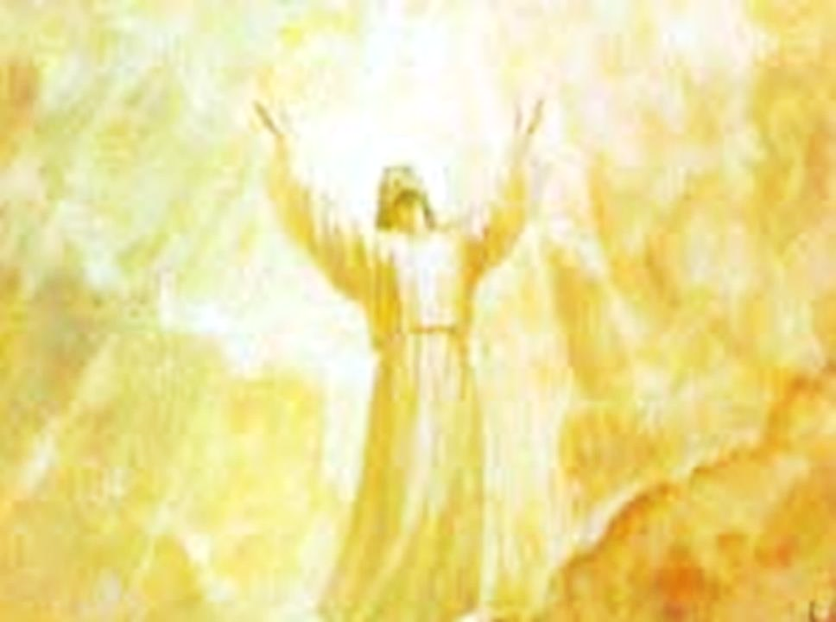
YOU CAN LEARN TO KNOW GOD- become a strong Christian who will do works of faith!
You can help turn many people back to God! You can become a part of revival in the Last Days!

Slide 20
In times of great darkness, God will
always raise up His people with great light YOU CAN BE EMPOWERED FOR THE LAST DAYS!

Slide 21
THE PEOPLE WHO KNOW THEIR GOD
SHALL BE STRONG & WILL DO EXPLOITS FOR GOD

