Slide 1
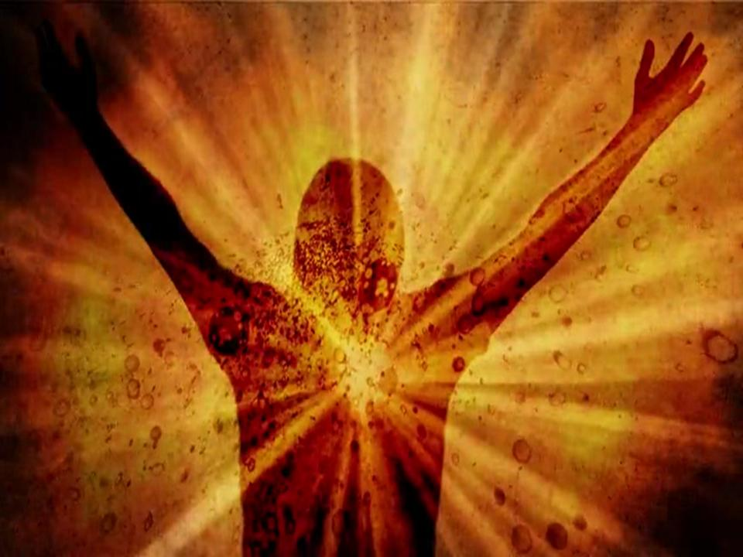
KINGDOM SOLDIERS
ARISE!

Slide 2
In this time of great darkness, God will
raise up His people with great light
“ARISE, SHINE, FOR YOUR LIGHT HAS COME”

Slide 3
Prepare for war! –Wake up the mighty men- beat your plows into swords. Let the weak say,
“I am strong!”- Joel 3:9-10

Slide 4
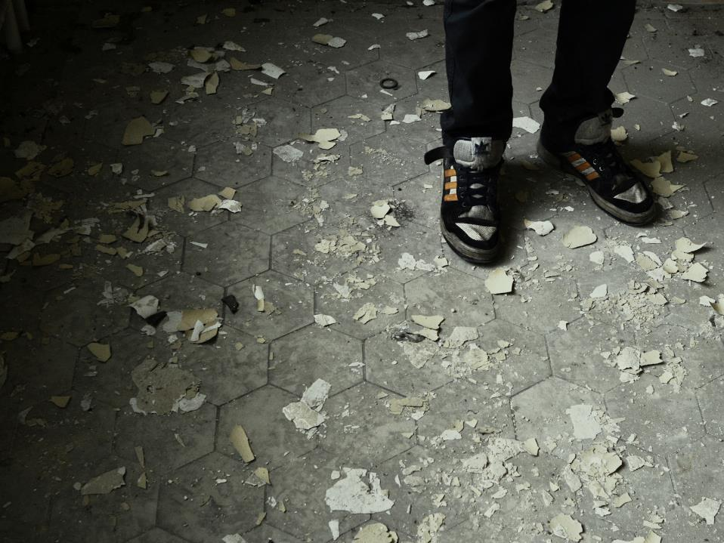
IN THIS EVIL,
FALLEN WORLD,
WE EACH HAVE
THE CHALLENGE,
THE OPPORTUNITY,
THE NECESSITY
OF FIGHTING
SIN & SATAN!

Slide 5
God wants His sons & daughters to
GROW UP
and not remain
like babies!

Slide 6
In 1 John 2:12
immature Christians are compared to babies,
but in 1 John 2:14
maturing Christians
are like young men
who are ready to fight
and overcome.

Slide 7
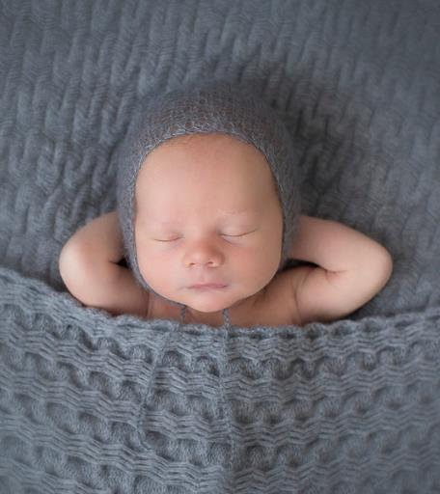
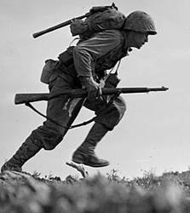
But a soldier must be able to endure great difficulties!
Babies can be lazy
- do nothing!

Slide 8
HOW COMMITTED ARE WE TO JOIN THE BATTLES?

Slide 9
The Victory Song recorded in Judges 5 tells us about the different responses to the call to go to war!

Slide 10
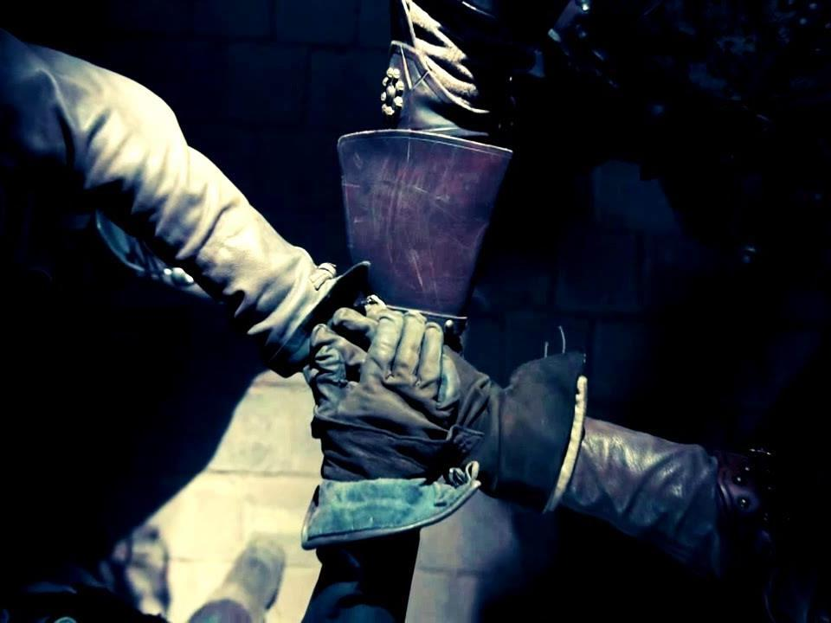
HOW COMMITTED ARE WE TO JOIN THE BATTLES?

Slide 11
THERE ARE GREAT REWARDS FOR THE VICTORIOUS KINGDOM WARRIORS!

Slide 12
REWARD #1 - THEY WILL BECOME MORE LIKE CHRIST!

Slide 13
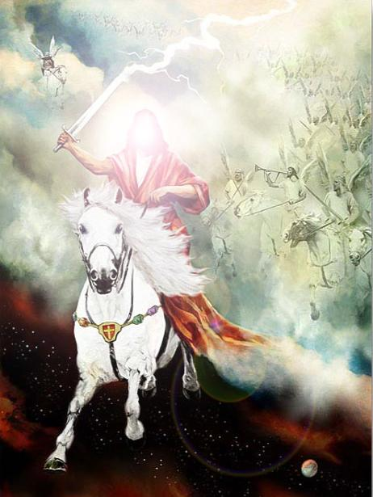
Exodus 15:3
“The Lord is a Man of War”
–to become more like God, we need to become good soldiers of Christ!

Slide 14
REWARD #2 - The Kingdom Warriors eternally have closer fellowship with Christ and with each other!

Slide 15
REWARD # 3 - THEY WILL
REIGN WITH CHRIST
“They will reign with Him for 1000 years” –Rev.20:6

Slide 16
“Well done, good servant! Have authority over 10 cities!” –Lk.19:17

Slide 17
REWARD #4- THEY WILL FOREVER BE FILLED WITH MORE OF THE GLORY OF GOD!
“For our light affliction, which is but for a moment,
is working for us a far more exceeding and eternal weight of glory” – 2 Cor.4:17

Slide 19
IN THE NEW HEAVENS & EARTH, ALL THE SAINTS WILL ENTER A NEW AGE - A NEW WORKING OF GOD! NO SIN! NO SATAN! NO SUFFERING! NO DEATH!
“And there will be no more death, nor mourning, nor crying, nor pain; for the former things have passed away. And He that sat on the throne said, ‘Behold, I make all things new.” -Rev. 21:4-5

Slide 20
NO MORE OPPORTUNITY TO BECOME MORE LIKE CHRIST, THE WARRIOR!
2) NO MORE OPPORTUNITY TO GAIN THE
FELLOWSHIP OF CHRIST’S SUFFERINGS!
3) NO MORE OPPORTUNITY TO PREPARE
TO REIGN WITH CHRIST!
4) NO MORE OPPORTUNITY TO PREPARE
FOR MORE OF THE GLORY OF GOD!

Slide 21
NOW IS THE TIME FOR THE KINGDOM WARRIORS TO ARISE!
NOW IS THE TIME TO GAIN GREAT VICTORIES & REWARDS FOR ETERNITY!

