Slide 1
LEARNING
THE
WAYS
OF GOD

Slide 2
“Show me Your ways, O LORD; Teach me Your paths.”
Psalm 25:4

Slide 3
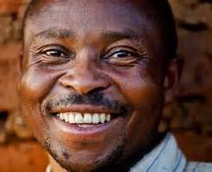
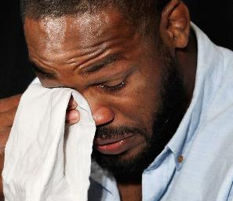
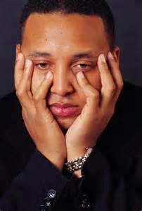
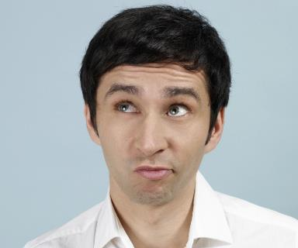
Everyone has certain ways
that they think and act

Slide 4
Moses knew God’s heart and mind,
so he could work in harmony with God
“He made known His ways to Moses, His acts to the Israelites” –Ps.103:7

Slide 5
“For 40 years I was grieved with that generation, and said, ‘It is a people who go astray in their hearts, and they do not know My ways.’”

Slide 6
Our human thoughts & ideas will often oppose God’s ways: "‘For My thoughts are not your thoughts, nor are your ways My ways,’ says the Lord.“ –Is.55:8

Slide 7
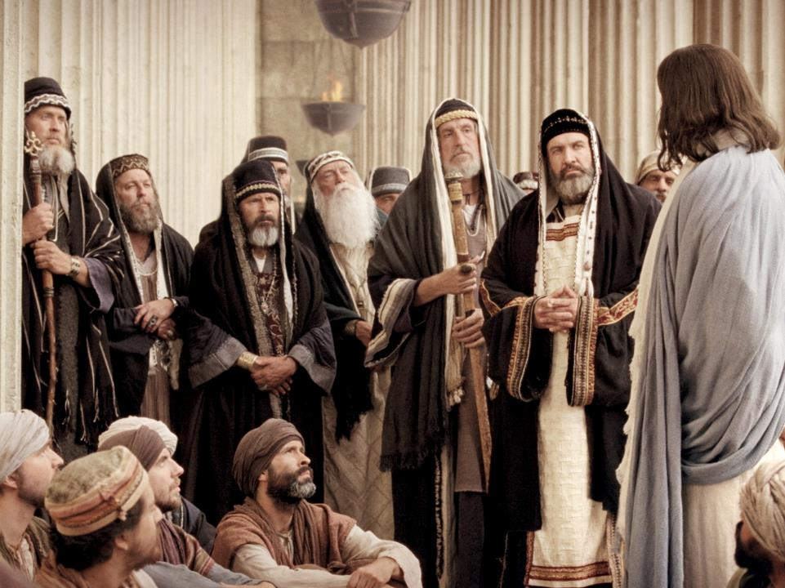
The Pharisees opposed Jesus- they had legalistic
religion, but did not know God’s ways

Slide 8
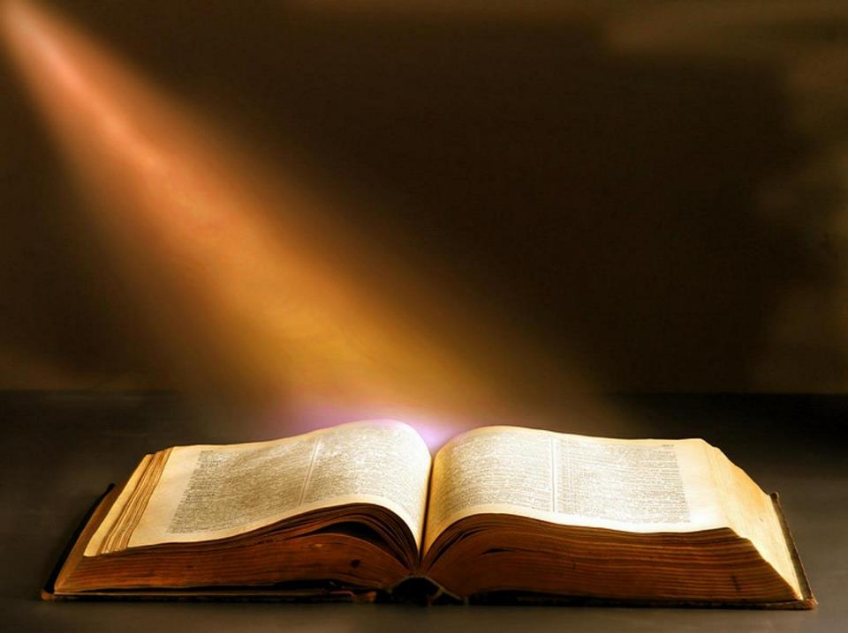
SIX WAYS
THAT GOD
REDEEMS
(PSALM 107)

Slide 9
SIX WAYS THAT GOD REDEEMS
INTRO: PSALM 107:1-3 GOD REDEEMS, THANK HIM!
1st WAY: WANDERERS IN A WILDERNESS, vs.4-9
2nd WAY: REBELS IN CHAINS, vs.10-16
3rd WAY: FOOLS IN SICKNESS, vs.17-22
4th WAY: MERCHANTS IN STORMS, vs.23-32
5th WAY: WILDERNESS BECOMES A CITY, vs.33-38
6th WAY: PRINCES HUMBLED, POOR EXALTED, vs.39-42
CONCLUSION: BE WISE AND UNDERSTAND, v.43

Slide 10
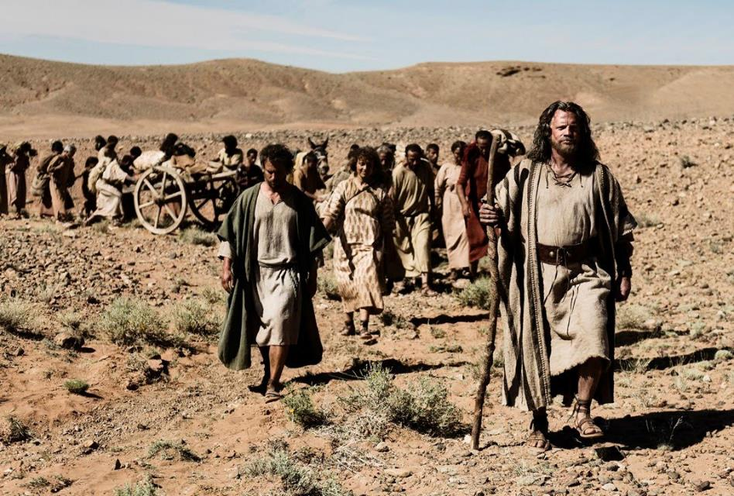
(
SIX WAYS GOD WORKS TO REDEEM (PSALM 107)
#1 Wanderers in a Wilderness
(Spiritual Wanderers with No Church)

Slide 11
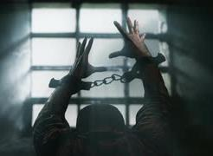
SIX WAYS GOD WORKS TO REDEEM (PSALM 107)
#2 Rebels in Chains
(Backsliders Enslaved to Sin)

Slide 12
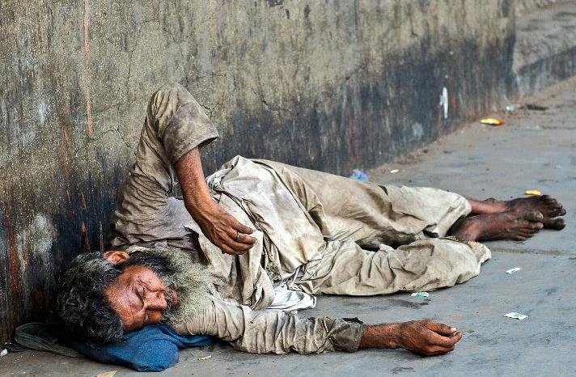
SIX WAYS GOD WORKS TO REDEEM (PSALM 107)
#3 Fools in Sickness
(Sinners are Afflicted)

Slide 13
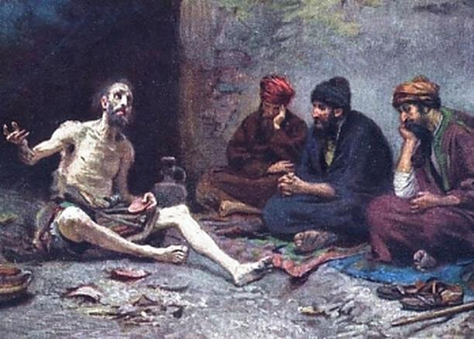
But as with Job, sickness can also
come because of other reasons
Job’s 3 friends did not understand God’s ways-
they assumed Job must be a great sinner, for
God to allow him such trials and sickness!

Slide 14
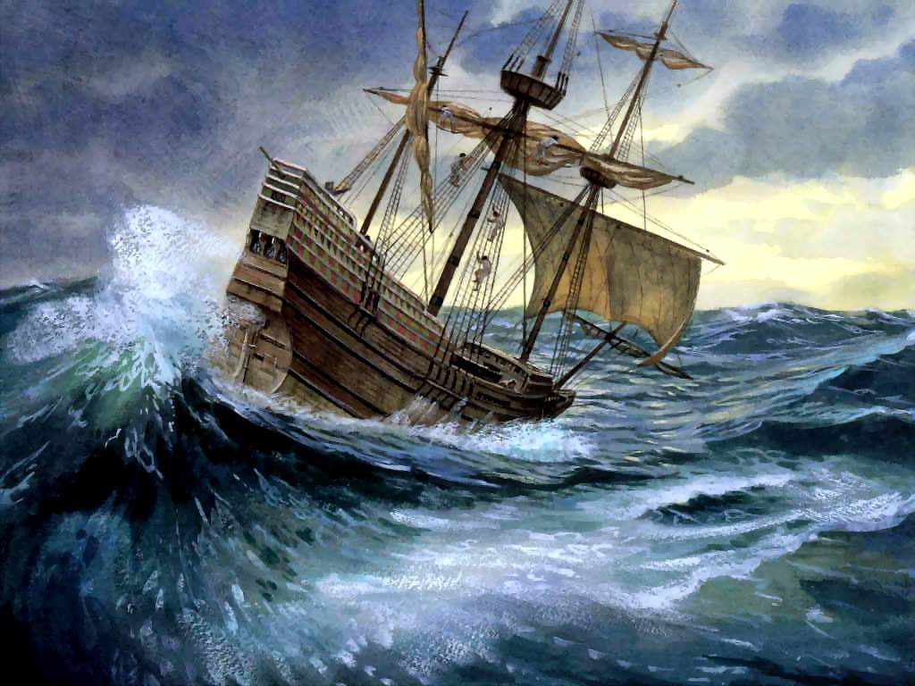
SIX WAYS GOD WORKS TO REDEEM (PSALM 107)
#4 Merchants in Storms
(Ministry Through Trials)

Slide 15
“The Kingdom of God is like a merchant seeking beautiful pearls” -Mt.13:45 Mt.13:45

Slide 16
Christ went through a storm on His first missionary trip to the Decapolis
There He delivered the demoniac (Lk.8:26-39), which prepared for His welcome there on His 2nd trip, Mk.7:31-8:10

Slide 17
“Give me the ugly baby”

Slide 18
The Baby Box- for abandoned children
“When my father and my mother forsake me,
the Lord will take me in.” - Psalm 27:10

Slide 19
Another Baby left in the Box

Slide 20
Pastor Lee & Chun-ja have rescued 100s of babies- and have adopted ten of them!

Slide 21
The Love of God in Pastor Lee has
changed countless thousands of lives

Slide 22
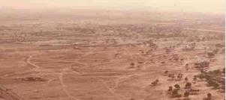
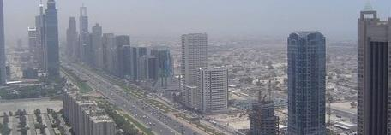
SIX WAYS GOD WORKS TO REDEEM (PSALM 107)
#5 Barren Wilderness
becomes a Prosperous City
(Shrinking Congregations become Large)

Slide 23
In the late 1800s the Brooklyn Tabernacle had 6000 church members

Slide 24
By the 1930s the church was
becoming empty- then they had to sell their church building to pay their debts!

Slide 25
Jim & Carol Cymbala became the pastors in 1971 when the church had 25 members- but they prayed!

Slide 26
Today the church has over 16,000 members- more than ever before!

Slide 27
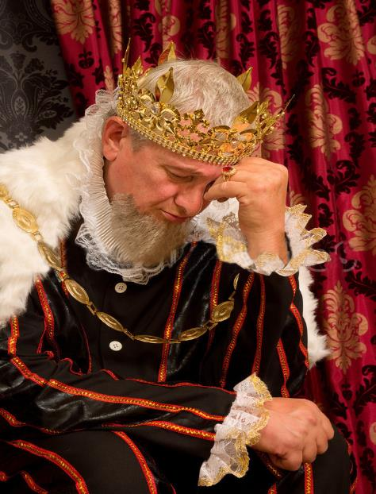
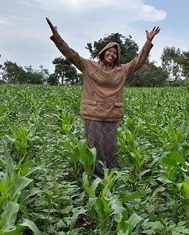
SIX WAYS GOD WORKS TO REDEEM (PSALM 107)
Poor Exalted
#6 Princes Humbled
Many who are first will be last, and the last first

Slide 28
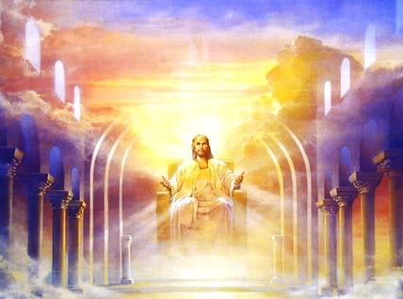
“You have no reward here”

Slide 29
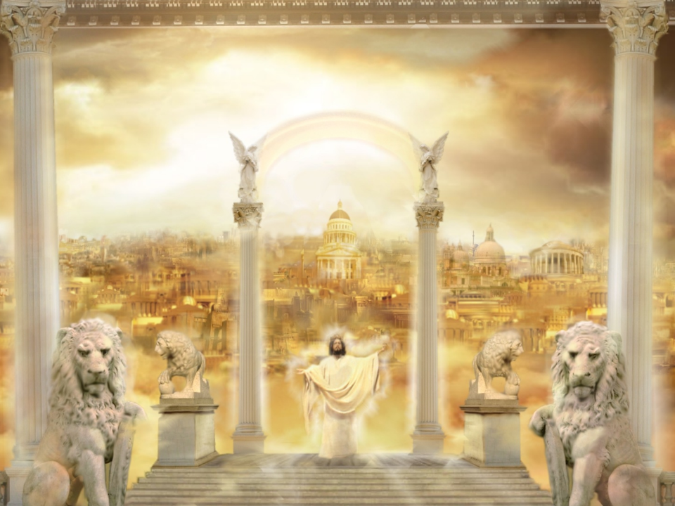
“Who lives in that large mansion?”

Slide 30
The poor widow who gave
her only two coins, Lk.21:2

Slide 31
"Whoever is wise will observe these things,
and they will understand
the lovingkindness
of the LORD.” –Ps.107:43

Slide 32
Become a co-laborer with Christ: learn God’s ways, and follow them!
“My son, give me your heart, and let your eyes observe my ways” - Pr.23:26

