Slide 1
MISSIONS DOWN THROUGH CHURCH HISTORY

Slide 2
The Resurrected Christ gave a Great Commission to His disciples before He returned to heaven:
“Go ye into all the world and preach the gospel” – Mark 16:15
The course of World Missions down through Church History tells us the story of how this Great Commission is becoming fulfilled.

Slide 3
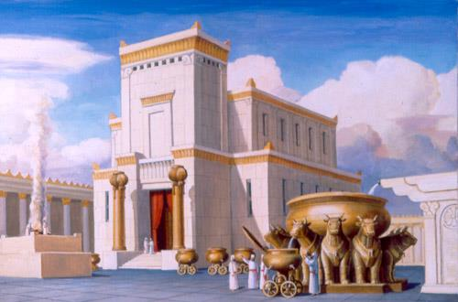
The Temple of Solomon gives us a
prophetic picture of the history of World Missions

Slide 4
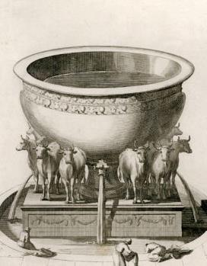
In the court of the temple was a huge brass bowl filled with water, 1 Kgs.7:23-26

Slide 5
The PRIESTS= every born-again Christian
The WATER= the Word of God, Eph.5:25-26
The 12 OXEN: OXEN= the Ministry, 1 Cor.9:9-10
12= Government
From Solomon’s Temple at Jerusalem these 12 oxen faced out to the 4 corners of the earth: This began to be prophetically fulfilled when Jesus sent His 12 Apostles out from Jerusalem, Acts 1:8

Slide 6
THE OXEN FACED NORTH,
WEST, SOUTH, & EAST:
This was prophetic of how the Word of God will be carried to the ends of the world!

Slide 7
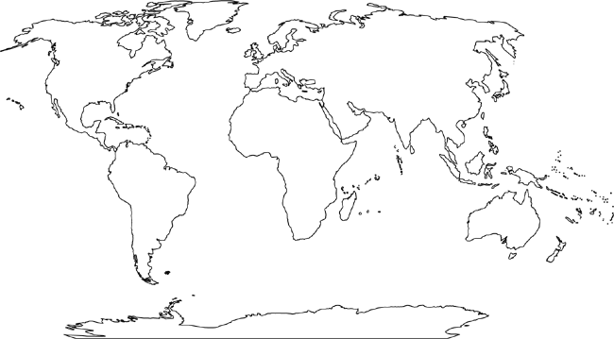
1. EUROPE
2. AMERICAS
4. ASIA
3. AFRICA
NORTH (Europe)
2) WEST (Americas)
3) SOUTH (Africa)
4) EAST (ASIA)

Slide 8
1. EUROPE
1) NORTH (Europe) - Christianized by 1100 A.D.

Slide 9
1. EUROPE
2. AMERICAS
1) NORTH (Europe) - Christianized by 1100 A.D.
2) WEST (Americas) - Christianized by 1700 A.D.

Slide 10
1. EUROPE
2. AMERICAS
3. AFRICA
1) NORTH (Europe) - Christianized by 1100 A.D.
2) WEST (Americas) - Christianized by 1700 A.D.
3) SOUTH (Africa) - Christianized by 2000 A.D.

Slide 11
1. EUROPE
2. AMERICAS
4. ASIA
3. AFRICA
1) NORTH (Europe) - Christianized by 1100 A.D.
2) WEST (Americas) - Christianized by 1700 A.D.
3) SOUTH (Africa) - Christianized by 2000 A.D.
4) EAST (ASIA) - Christianized by 20?? A.D.

Slide 12
Languages with Bible Translations The New Testament has been translated into the mother tongue of over 87% of the world’s population.

Slide 16
May We Each Help Complete
the Great Commission, the Great Responsibility of the Worldwide Church!

