Slide 1
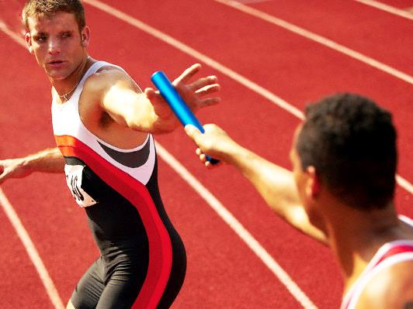
GAIN THE MANTLE, PASS THE BATON

Slide 3
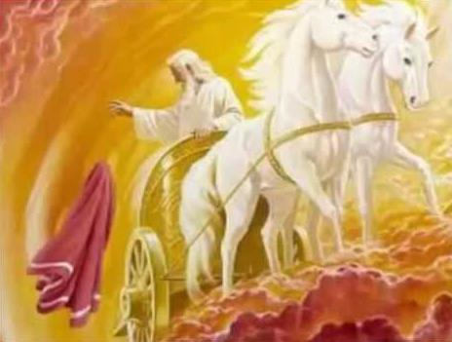
Elijah Leaving
His Mantle

Slide 4
2008 Beijing Olympics: Baton Dropped!

Slide 5
Elijah placed his mantle on a young farmer named Elisha

Slide 8
George Jeffries brought revival to England in the 1930s

Slide 9
Reinhard Bohnke bringing revival to Africa

Slide 10
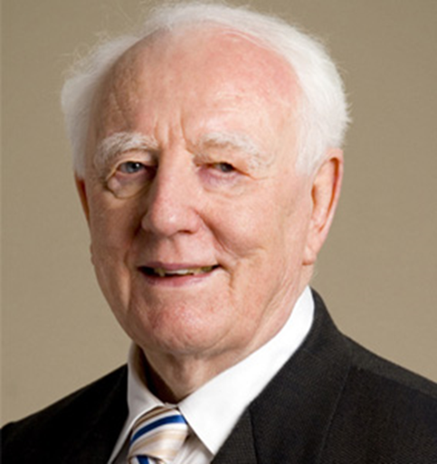
Brian Bailey brought renewal & revival to many nations around the world

Slide 12
HAVE YOU BEEN TOUCHED BY A MANTLE? PREPARE!

Slide 13
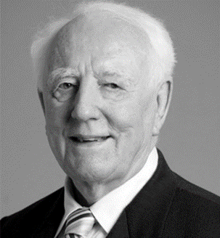
BRIAN
BAILEY
ARE YOU PREPARING FOR A MANTLE? RECEIVE!

