Slide 1
Invited Into the Holy of Holies
Pressing on into the Holy of Holies
“Therefore, brethren, having boldness to enter the Holy of Holies by the blood of Jesus ...let us draw near with a true heart of faith”
-Hebrews 10:19 & 22

Slide 2
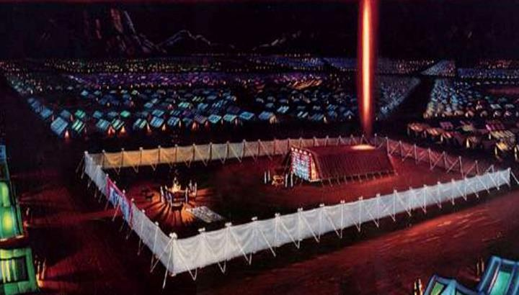
Moses built a tabernacle as a dwelling place for God. Learning about this tabernacle teaches us spiritual truths about how we can draw nearer to God.

Slide 3
Moses’ Tabernacle had 3 Parts:
#1 The OUTER COURT
#2 The Holy Place
#3 The
Holy of
Holies

Slide 4
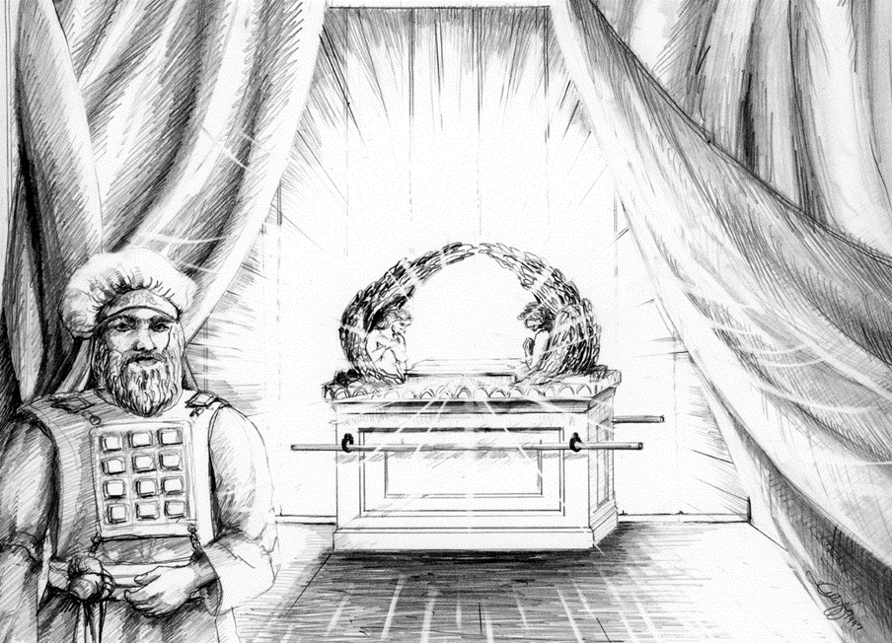
As we learn how to spiritually enter into the Holy Place and then the Holy of Holies, we will step by step draw nearer to God & experience more of His mercy, glory, and power!

Slide 5
The Outer Court was the large outer section of the Tabernacle

Slide 6
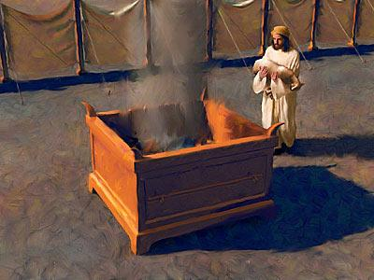
All of God’s people were invited to enter the Outer Court and offer sacrifices to God

Slide 7
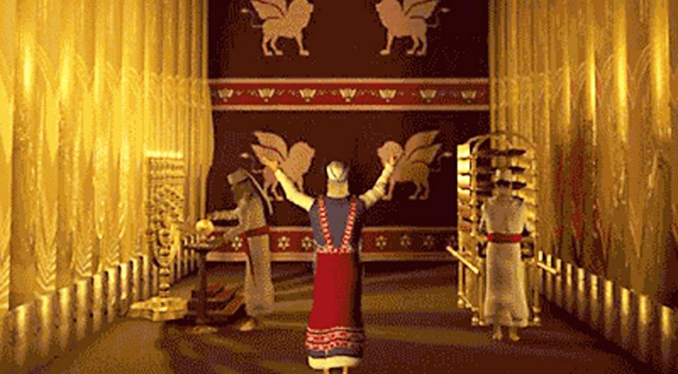
The Holy Place was the second section of the Tabernacle. Only the Priests were allowed to enter it, where they performed their ministries.

Slide 8
If fully dedicate our lives to Christ, we
can be like the priests that entered the Holy Place to perform 3 ministries:

Slide 9
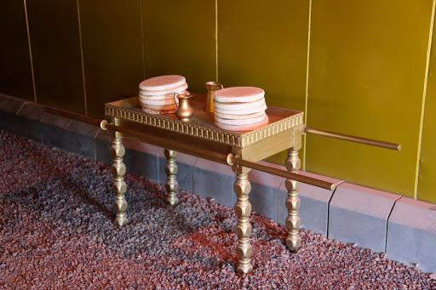
# 1. The Table of Showbread- Every day fresh bread was placed on this table in the Holy Place. This symbolizes how the servants of God should study the Bible every day and have “fresh bread”

Slide 10
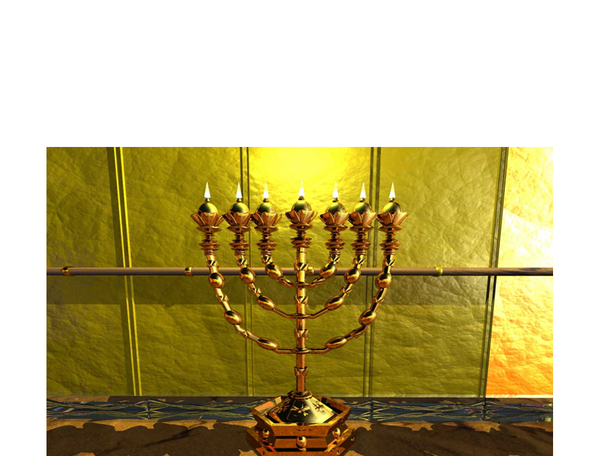
# 2. The Golden Lampstand: This speaks of the anointings of the Holy Spirit, Rev.4:5, Is.11:2

Slide 11
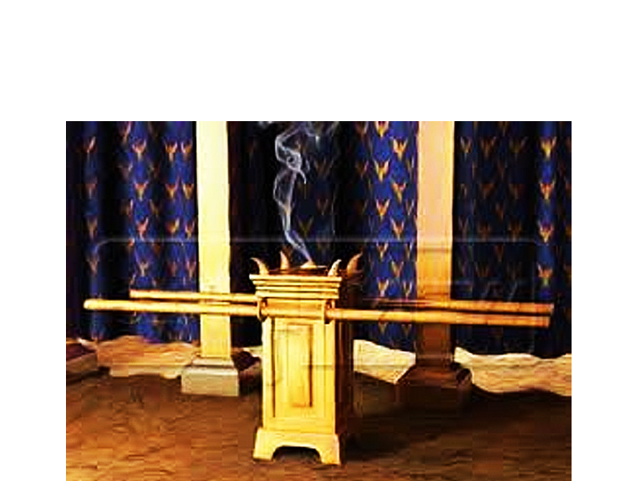
# 3. The Altar of Incense: Incense speaks of our prayers, Ps.141:2

Slide 13
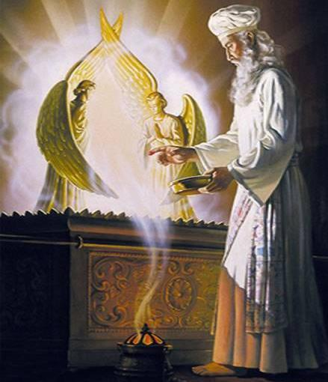
Once a year the High Priest went in with incense to sprinkle
the blood of the sacrifice on the Mercy Seat

Slide 14
This brought forgiveness of sins for all of God’s people, Lev.16:29-34

Slide 15
Each Section of the Tabernacle Brings us Deeper into God’s Workings
PART OF THE TABERNACLE: | \ # 1. OUTER COURT | # 2. HOLY PLACE | # 3. HOLY OF HOLIES
WHO CAN ENTER: | All of God’s People | Only the Priests, Daily | Only the High Priest, Yearly
SOURCE OF LIGHT: | Natural Sunlight | Candlesticks (Holy Spirit) | Glory of God (Supernatural)
POWER OF THE BLOOD: | Cleanses a person/family | Cleanses the ministry | Cleanses the Nation!

Slide 16
How can we draw nearer to God and experience His great Glory and Power?

Slide 17
How can we be invited into the Holy of Holies?

Slide 18
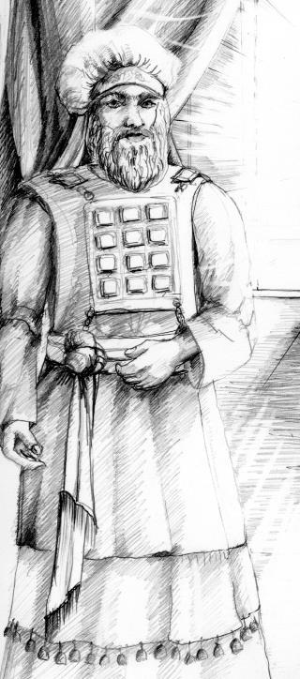
A. We Must Be Hidden in Christ, our High Priest
Only the High Priest was allowed to enter the Holy of Holies!
Christ is our New Testament great High Priest, Heb.9:11-12
We can be hidden with Christ in God, Col.3:2-3, Gal.2:20
Our life must no longer be our own- it must belong to Christ!

Slide 19
B. Three things were needed to enter the Holy of Holies: # 1) Incense (prayer & worship) # 2) The Blood (of Jesus) to place on the Mercy Seat

Slide 20
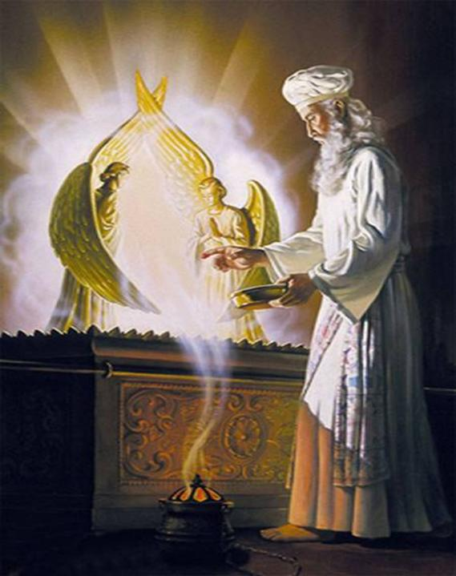
# 3 The High Priest could only enter on the Day of Atonement, the day of mercy & cleansing for all of God’s people!

Slide 21
The Day of Atonement was near the end of the year, which prophetically for us means this will be fulfilled near the end of the Church Age

Slide 22
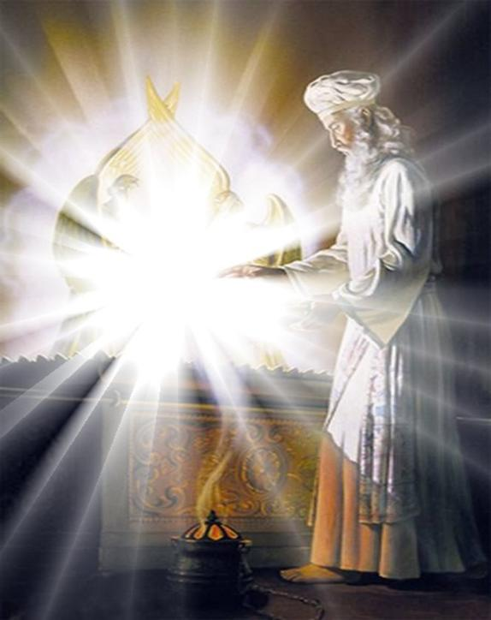
As the world grows more spiritually dark and sinful, God’s people need to press into the Holy Of Holies to enter and reveal the glory of God, Isaiah 60:1-3

Slide 23
God is inviting us to press into the Holy of Holies- this is a season for prayer and worship; for mercy and cleansing! “Therefore, brethren, having boldness to enter the Holy of Holies by the blood of Jesus ...let us draw near with a true heart of faith” -Heb 10:19 & 22

Slide 24
The closer we approach God- into the Holy Place and then into the Holy of Holies- the more power, glory, and revival will be released!

Slide 25
Queen Esther, in prophetic foreshadow, entered the Holy of Holies (The King’s Throne room) to the Mercy Seat (to touch the King’s scepter) & obtain deliverance for all of God’s people!

Slide 26
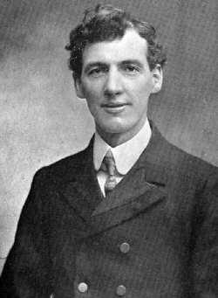
Evan Roberts was a man who entered the Holy of Holies in 1904, and brought a mighty revival to his nation

Slide 27
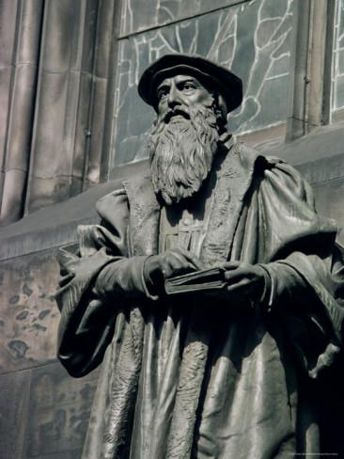
John Knox pressed in to the Mercy Seat- and changed his nation! His lifelong prayer was “Lord, give me Scotland or I die!”

Slide 28
HOW MUCH WILL WE PRESS IN? Will we be content in the Outer Court, where the blood will cleanse our sin and our families?

Slide 29
HOW MUCH WILL WE PRESS IN? Do we desire to have the Fresh Word of the Lord, and the anointings of the Holy Spirit in the Holy Place?
“Turn at My reproof, surely I will pour My Spirit on you, I will make My words known to you” –Prov.1:23

Slide 30
How much will we press in?
“God is a rewarder of those who diligently seek Him” –Heb.11:6
“Therefore, brethren, having boldness to enter the Holy of Holies by the blood of Jesus ...let us draw near with a true heart of faith” -Hebrews 10:19 & 22

Slide 31
In these Last Days we are now being invited into the Holy of Holies!

