Slide 1
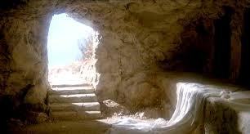
HE IS RISEN!

Slide 2
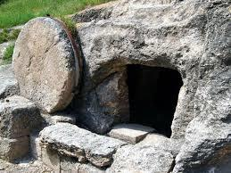
The meaning of Christ’s death- and the power of His resurrection- are the foundation of our Christian faith! 1 Cor. 15:14 & 20

Slide 3
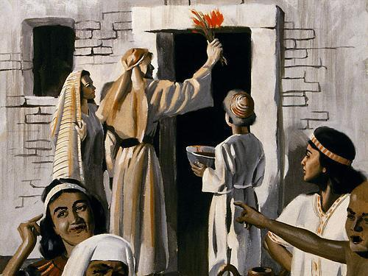
The Day Christ was crucified on the cross was a Passover- that was the day when the blood of the lamb had saved the Jews in the time of Moses

Slide 4
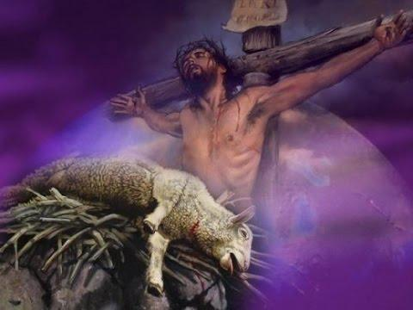
But Christ had come to be the final sacrifice for sin, the Lamb of God who would take away the sin of the world!

Slide 5
Before the Passover, the Jews selected a lamb without spot or blemish- the lamb was inspected very carefully!

Slide 6
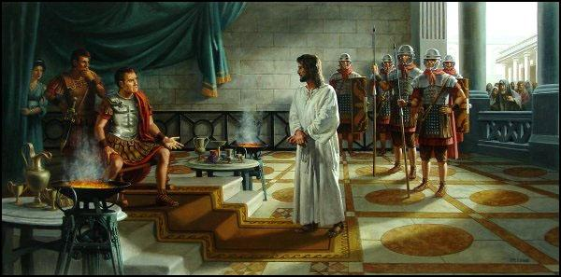
Before the death of Christ, He was inspected by Pontius Pilate and King Herod, who both found Him innocent, Lk.23:13-15.

Slide 7
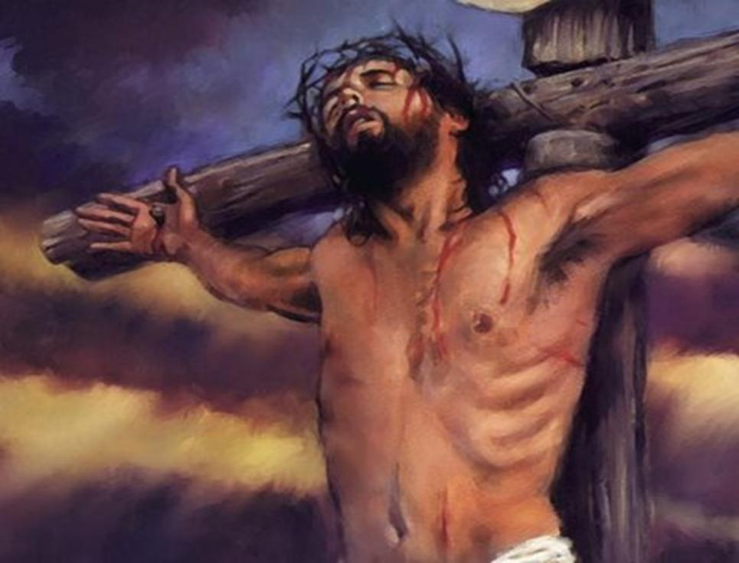
The Sinless Christ took our sins:
“God made Christ, who knew no sin, to become sin for us, that we might become the righteousness of God in Him”
-2 Cor. 5:21

Slide 8
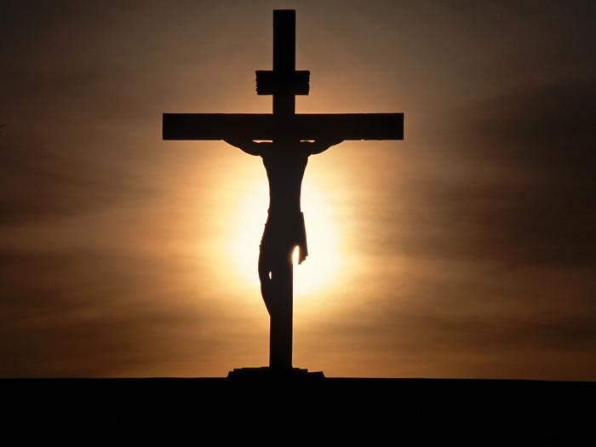
“My God, my God, why have You forsaken Me?”
Even the sun became dark and refused to shine
when Christ became sin for us on the cross!

Slide 9
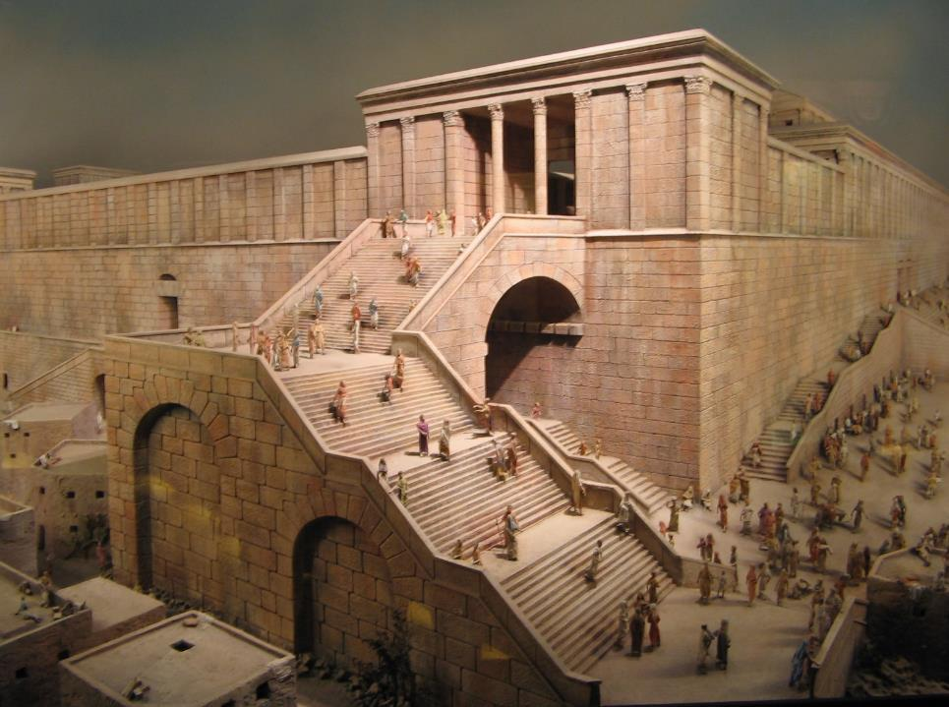
While Jesus was dying, multitudes of Jews were coming into Jerusalem to attend the Passover-
many of them passing by Christ on the cross

Slide 10
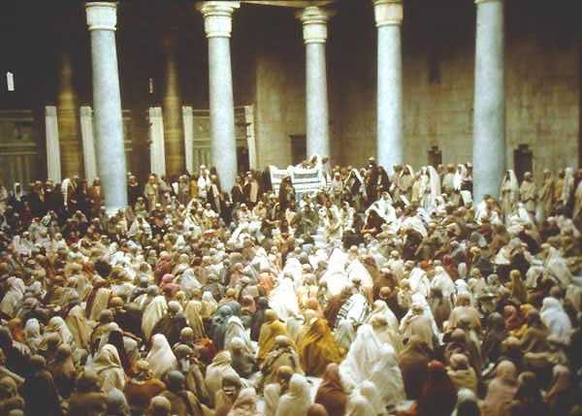
The Jews had filled the Temple, and at 3:00 PM the High priest was going to kill the Lamb- this is when Christ died!

Slide 11
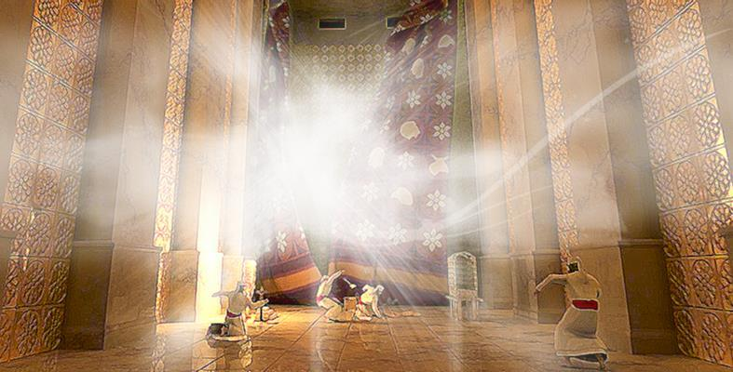
Then as Christ died, there was an earthquake, and the veil in the temple was torn apart
from the top to the bottom!

Slide 12
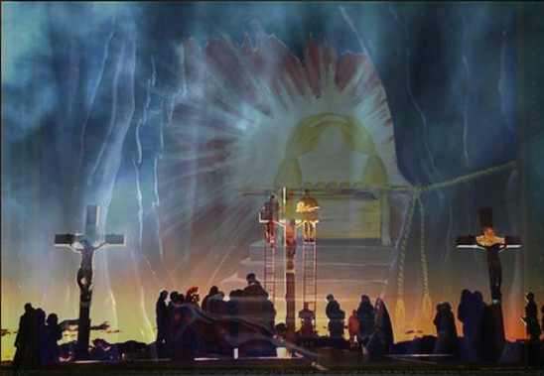
Christ had died as the sinless Lamb to complete all sacrifice, and open the way into the true Holy of Holies- the way into heaven!

Slide 13
The priests knew this, and many turned to Christ! “And the number of the disciples multiplied, and a great many of the priests were obedient to the faith”
–Acts 6:7

Slide 14
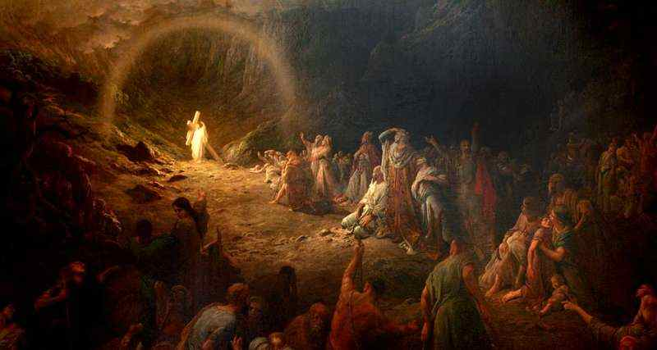
Before going to heaven, Christ first had a work to complete- in Hell!
Therefore He says: "WHEN HE ASCENDED ON HIGH, HE LED CAPTIVITY CAPTIVE, AND GAVE GIFTS TO MEN."
(Now this, "HE ASCENDED"—what does it mean but that He also first descended into the lower parts of the earth?) – Eph.4:8-9

Slide 15
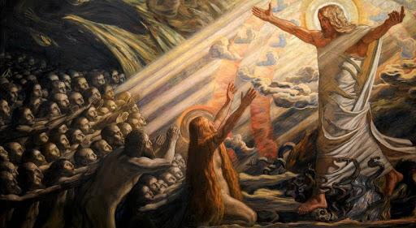
Christ descended into hell-not as a captive- but to set the captives free!
“I lay down my life that I may take it again. No one takes it from Me…I have the power to lay it down and I have power to take it again.” –John 10:17-18

Slide 16
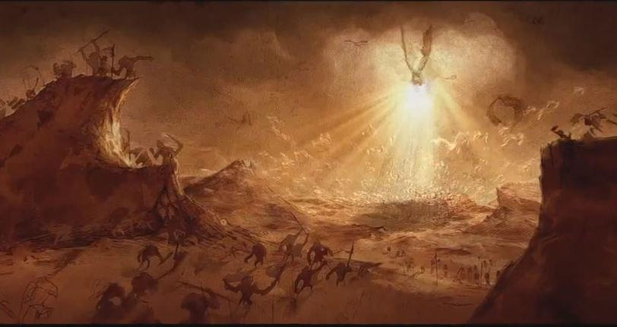
For Christ also suffered once for sins, the just for the unjust, that He might bring us to God, being put to death in the flesh but made alive by the Spirit, by whom also He went and preached to the spirits in prison… 1 Pet.3:18-19

Slide 17
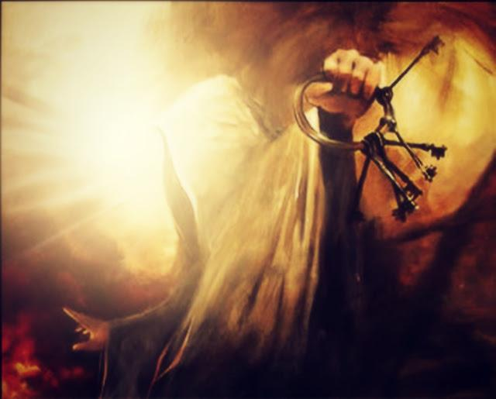
Proclaiming His victory, Jesus arose with the keys of death and hell!

Slide 19
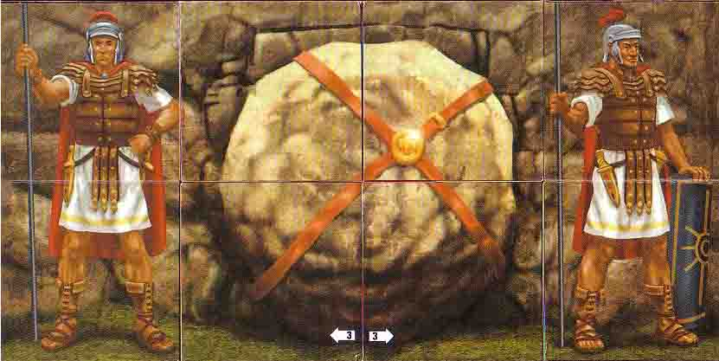
Pontius Pilate had a guard of Roman soldiers secure the tomb with a seal
of the Roman Empire

Slide 20
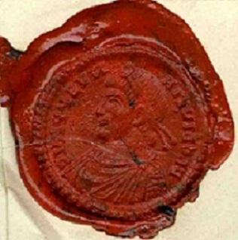
With that seal, the power of the Roman Empire was pledged to keep Jesus’ tomb shut!

Slide 21
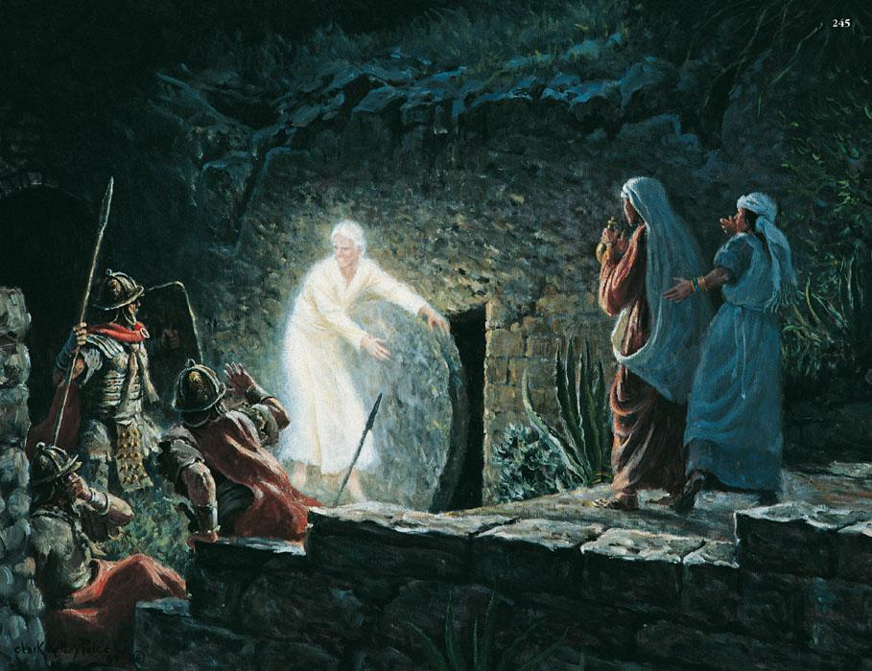
But on that Easter morning, a shining angel
rolled away the stone and declared,
“He is not here, for He has risen!

Slide 22
The Tomb was empty-
except for Jesus’ burial clothes

Slide 23
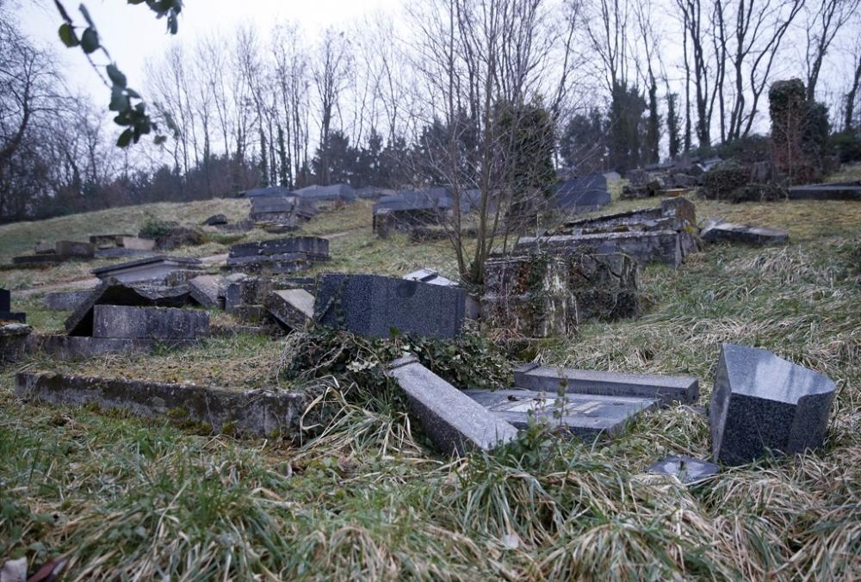
“And the graves were opened,
and many bodies of the saints were raised,
and coming out of the graves after His resurrection, they appeared to many.” Mt.27:53

Slide 24
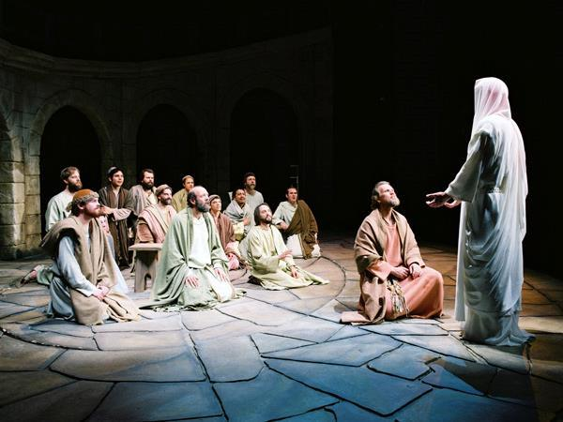
The Risen Christ showed Himself many times to His disciples for 40 days
Over 500 disciples saw the
resurrected Christ, 1 Cor. 15:6

Slide 25
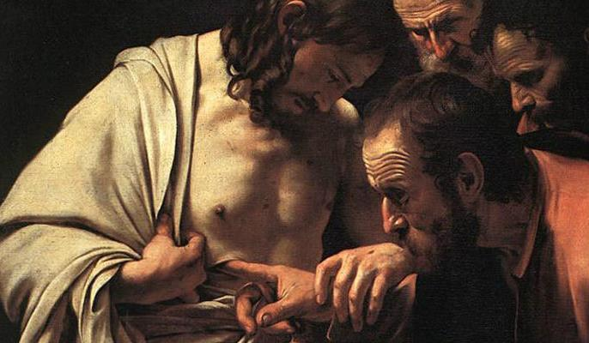
Jesus invited doubting Thomas to stick his fingers in the nail holes- and Thomas doubted no longer!

Slide 26
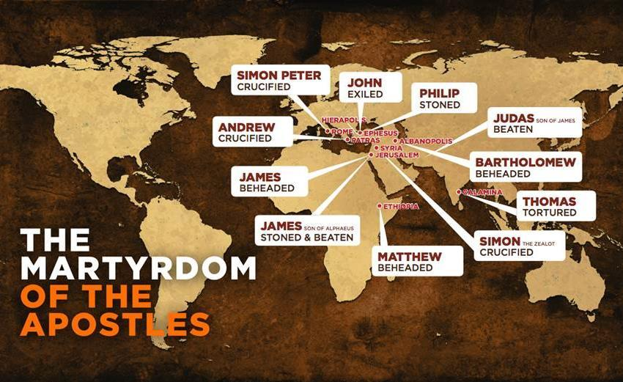
All the apostles – except John
- died for their faith
in the resurrected Christ!

Slide 27
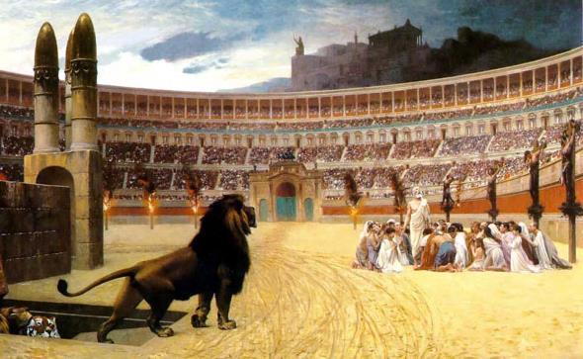
Death could not stop Christ and death cannot stop His disciples!

Slide 28
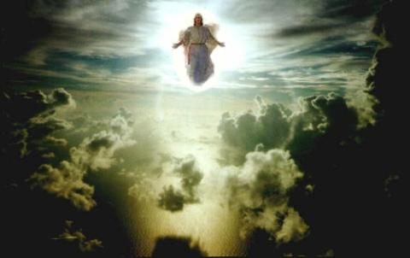
40 days after His resurrection,
Christ ascended back to heaven

Slide 29
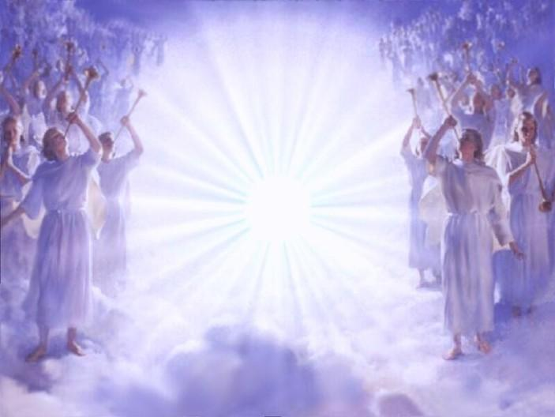
There was a great celebration when
their victorious King returned home!

Slide 30
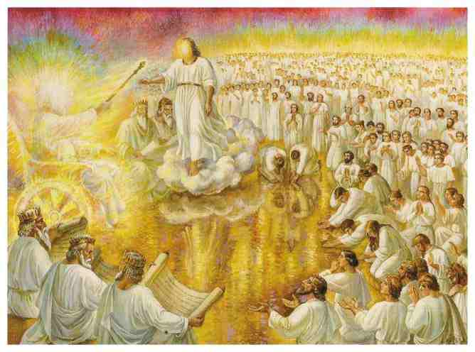
Daniel 7:13-14 tells us of when Christ returned to the Father, to receive His eternal kingdom

Slide 31
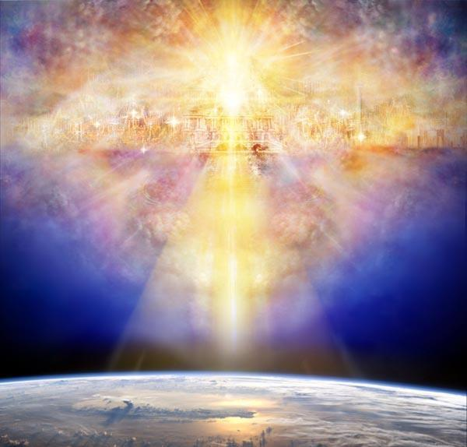
Christ now reigns in His heavenly kingdom
until the time of His soon return

Slide 32
Welcoming home
each of His
faithful servants

Slide 33
HE IS RISEN!
“All power has been given to Me
in heaven and in earth… go into all
the world and preach the good news!”

