Slide 1
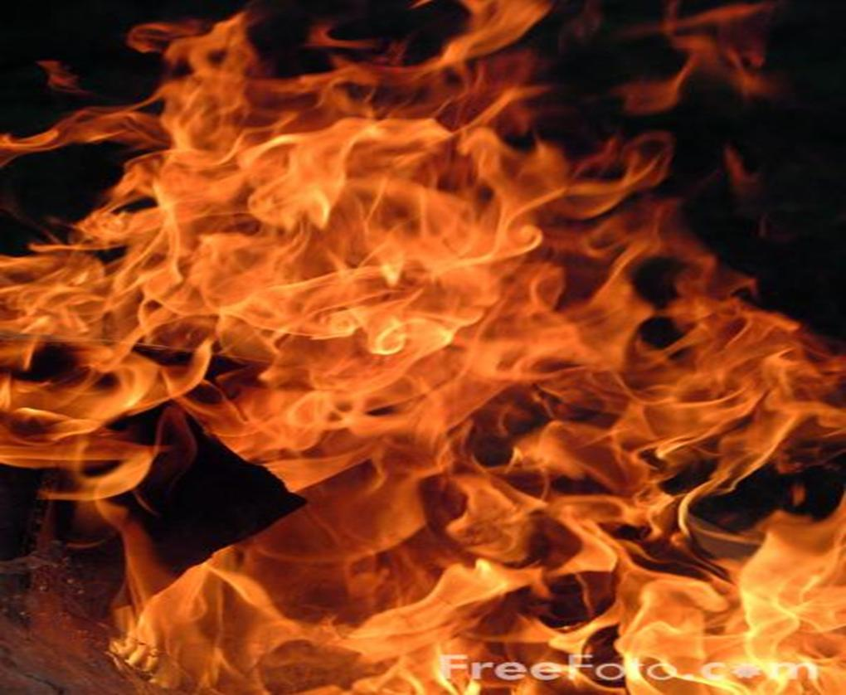
SINNERS & SAINTS IN ZION
“The sinners in Zion are afraid; fearfulness has seized the hypocrites: "Who among us shall dwell with the devouring fire? Who among us shall dwell with everlasting burnings?”–Is.33:14
FOR OUR GOD IS A CONSUMING FIRE
-Hebrews 12:29

Slide 2
QUESTION: Who can dwell with the God who is a consuming fire? ANSWER: Only the pure, nothing to be burned up!
"And the Lord, whom you seek, will suddenly come to His temple….
But who can endure the day of His coming?...
For He is like a refiner's fire….
He will purify the sons of Levi, and purge them as gold & silver, that they may offer to the Lord an offering in righteousness.”
-Malachi 3:1-3

Slide 3
FIRE CAN HAVE 2 PURPOSES: #1- Fire can burn away and cleanse. #2- Fire can also empower.

Slide 4
THE REQUIREMENTS TO DWELL WITH GOD THE CONSUMING FIRE:
“He who walks righteously and speaks what is right, who rejects gain from oppression and keeps his hand from accepting bribes, who stops his ears from hearing of bloodshed and shuts his eyes to avoid seeing evil,”
-Is.33:15 NIV

Slide 5
THE BLESSINGS FOR THOSE WHO DWELL WITH GOD THE CONSUMING FIRE “He will dwell on high; his refuge will be the mountain fortress; bread will be given him, his water will not fail. Your eyes shall see the King in His beauty, you will see the land that is afar off.” -Isaiah 33:16-17

Slide 6
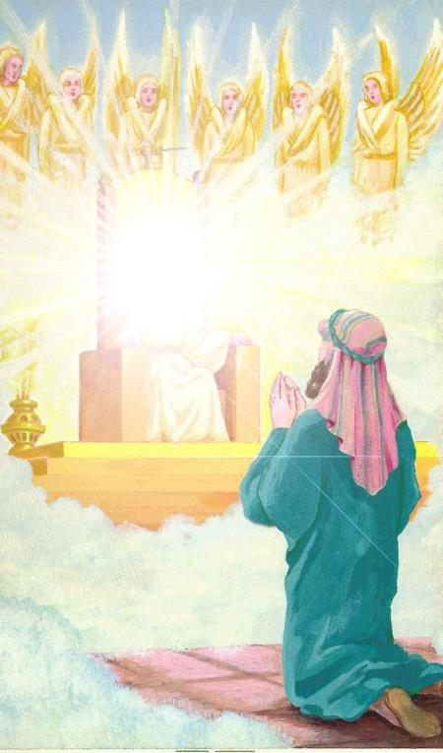
“In the year that King Uzziah died, I saw the Lord seated on a throne, high and exalted, and the train of his robe filled the temple. Above him were seraphs (Fiery Ones), and they were calling to one another: "Holy, holy, holy is the Lord Almighty; the whole earth is full of his glory." "Woe to me!" I cried. "I am ruined! For I am a man of unclean lips, and I live among a people of unclean lips, and my eyes have seen the King, the Lord Almighty."

Slide 7
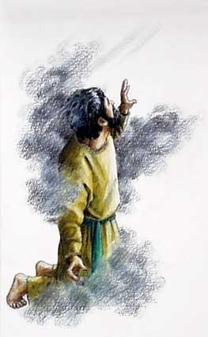
Isaiah saw the King, but he did not see the King in His beauty- Isaiah saw the King in His fiery holiness, and it confronted his sinfulness!

Slide 8
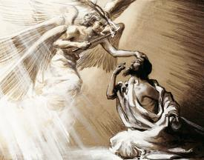
Then one of the seraphs (Fiery Ones) flew to me with a live coal in his hand, which he had taken with tongs from the altar. With it he touched my mouth and said, "See, this has touched your lips; your guilt is taken away and your sin atoned for.“-Isaiah 6:6-7

Slide 9
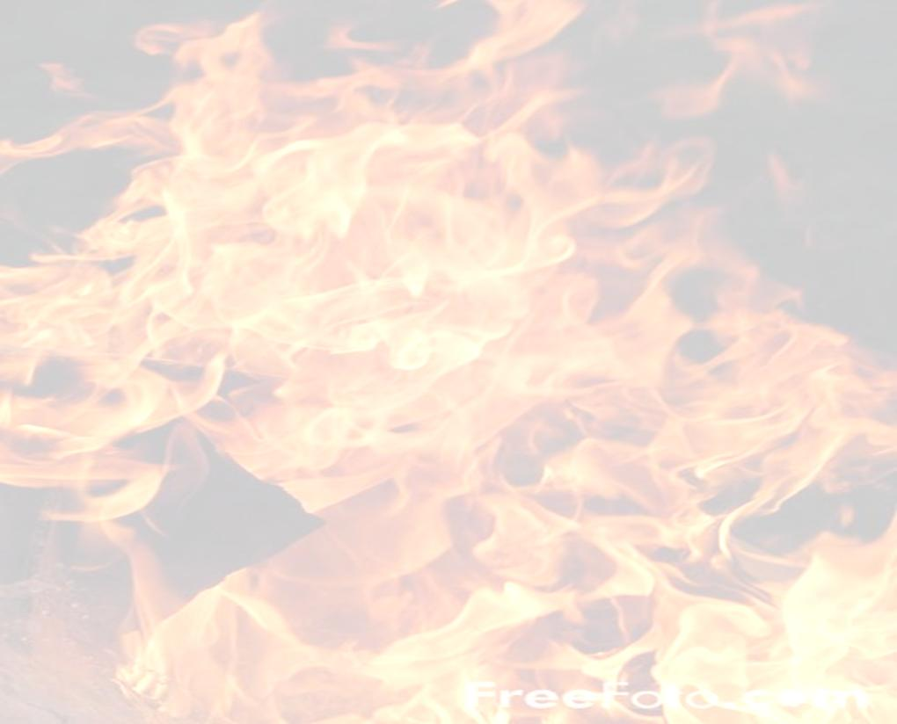
Then I heard the voice of the Lord saying, "Whom shall I send? And who will go for us?" And I said, "Here am I. Send me!“ -Isaiah 6:8 Isaiah was no longer confronted by the holiness of God- as a cleansed saint, he could now dwell with the Consuming Fire! Isaiah could then see the King in His beauty as he heard the heart cry of God.

Slide 10
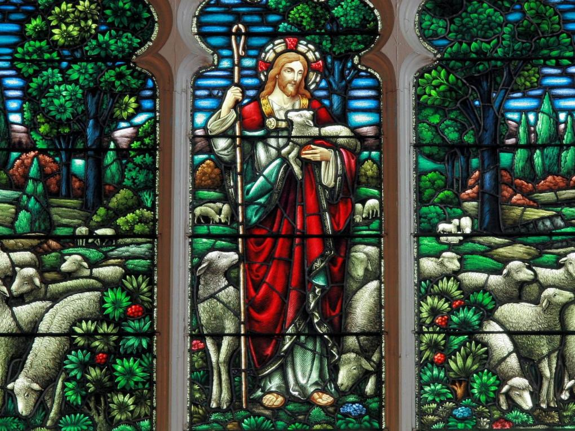
Isaiah often saw the King in His beauty as he prophesied about the life & ministry of Christ

Slide 12
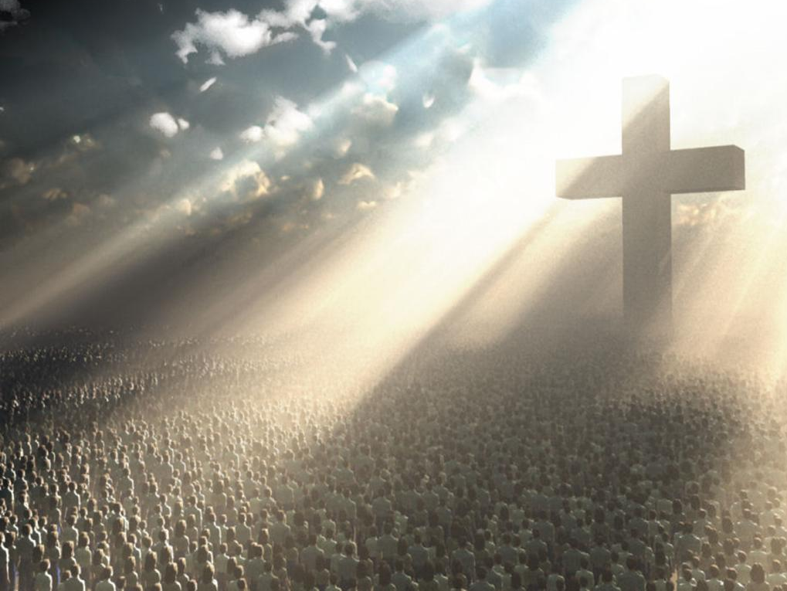
I will give you as a light to the Gentiles, so that You shall be My salvation
to the ends of the earth,” – Is.49:6

Slide 13
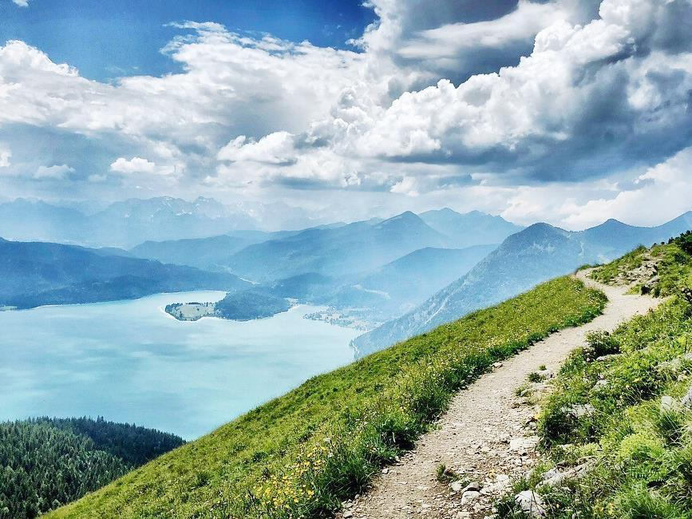
“YOU WILL SEE THE LAND THAT STRETCHES AFAR”
Isaiah saw by the Spirit what God was yet going to do for their land in the distant future. Isaiah could look far into the future to reveal what God was going to yet do for His people in Zion!

Slide 14
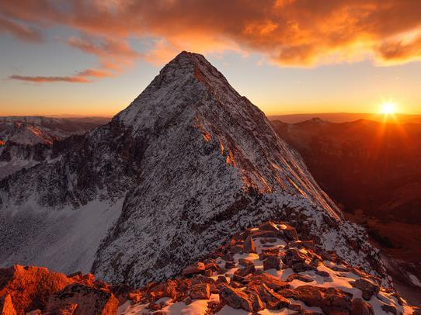
“Now it shall come to pass in the latter days that the mountain of the LORD's house shall be established on the top of the mountains… and all nations shall flow to it.

Slide 15
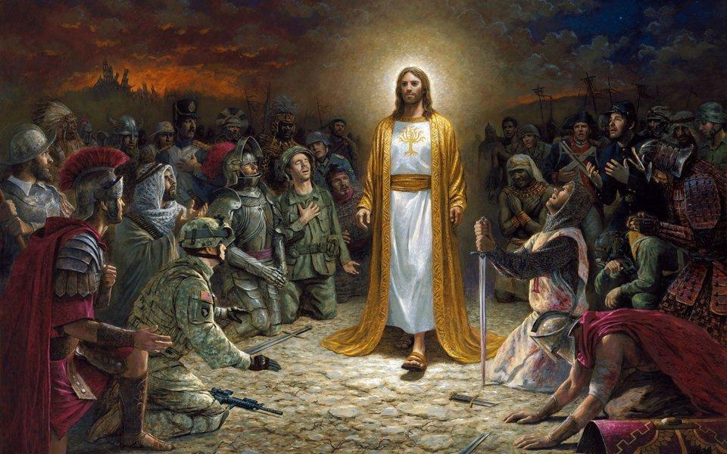
They shall beat their swords into plows…
Nation will not lift up sword against nation,
neither shall they learn war anymore.” -Is.2:4

Slide 16
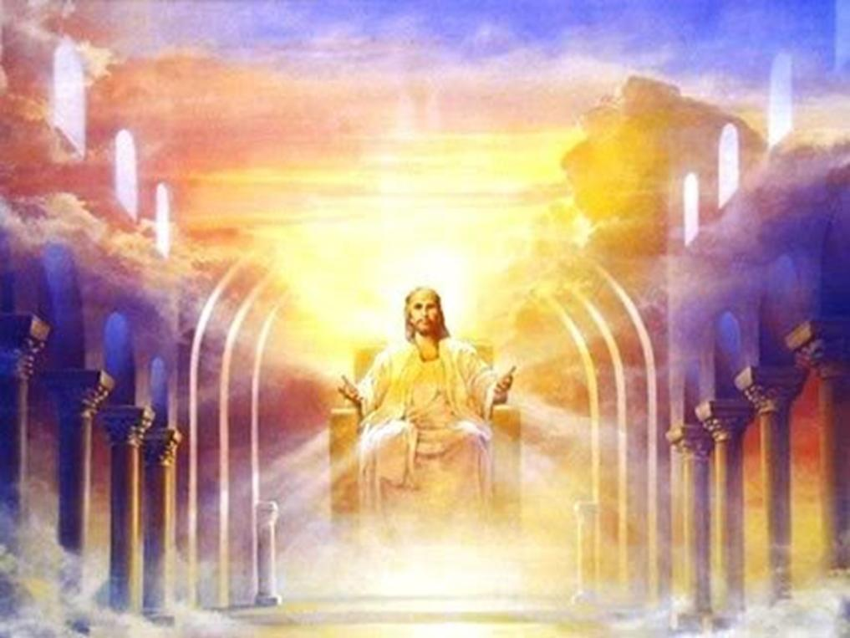
“…for the Lord Almighty will reign on Mt. Zion and in Jerusalem, and before His elders gloriously,” –Is.24:23

Slide 17
“When the Lord has washed away the filth of the daughters of Zion, and purged the blood of Jerusalem from her midst, by the spirit of judgment and by the spirit of burning, then the Lord will create above every dwelling place of Mount Zion, and above her assemblies, a cloud and smoke by day and the shining of a flaming fire by night. For over all the glory there will be a covering.”
–Is.4:4-5

Slide 19
# 1) - FACE THE FIRE NOW
- to be cleansed & empowered, to gain great eternal reward!
# 2) - OR FACE THE FIRE LATER when we stand before the Lord to have our life judged- with all the compromise and worldly works of our life burned up!
SAVED, BUT LITTLE ETERNAL REWARD

Slide 20
# 3) – OR FACE THE LAST ETERNAL FIRE!
For those who completely avoid & reject God, they will still stand before God at the very end, at the Great White Throne, and face eternal fire, Rev.20:11-15

Slide 21
LET US EMBRACE
THE FIRE OF GOD’S HOLINESS
IN OUR HEARTS
AS SOON AS WE CAN!
DON’T WAIT!
God’s fire can confront us-
or empower us!

Slide 22
OUR EYES WILL SEE THE KING IN HIS BEAUTY!
WE SHALL SEE THE FUTURE PURPOSES OF GOD!
“THE LORD’S FIRE IS IN ZION,
AND HIS FURNACE
IS IN JERUSALEM”– Isaiah 31:9

