Slide 1
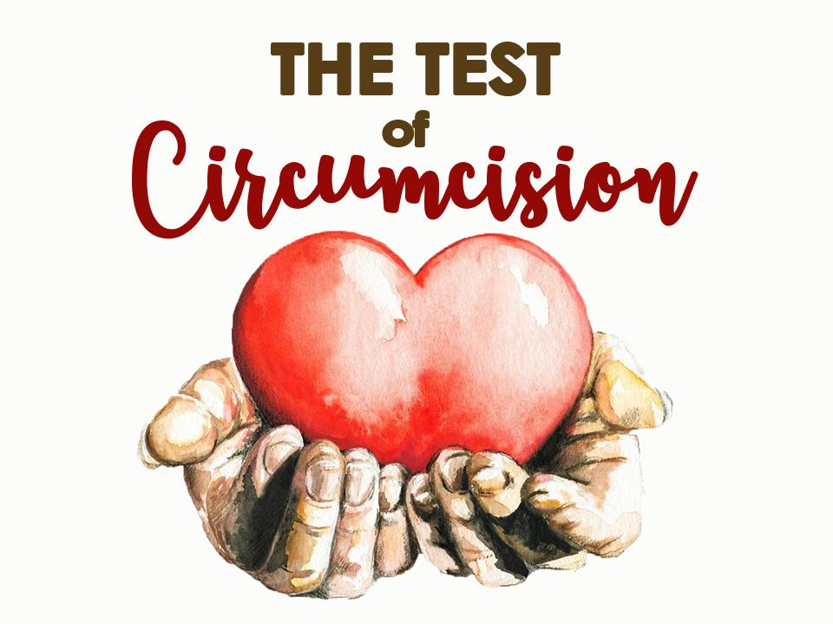

Slide 2
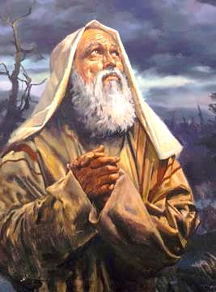
CIRCUMCISION WAS THE FIRST AND MAIN REQUIREMENT OF GOD FOR HIS OLD TESTAMENT PEOPLE:
This is My covenant which you shall keep… Every male child among you shall be circumcised…. And the uncircumcised male child….that person shall be cut off from his people; he has broken My covenant.“ -Gen.17:10 & 14

Slide 3
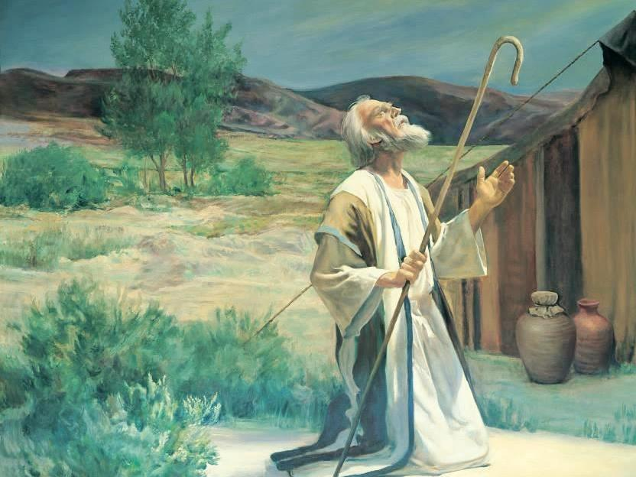
FROM THE BEGINNING OF GOD’S PROMISES
TO ABRAHAM, CIRCUMCISION
WAS THE SIGN
THAT A PERSON
WAS IN A
COVENANT
RELATIONSHIP
TO GOD.

Slide 4
Thus says the Lord GOD: "No foreigner, uncircumcised in heart or uncircumcised in flesh, shall enter My sanctuary...
– Ezekiel 44:9
And when a stranger dwells with you and wants to keep the Passover to the LORD, let all his males be circumcised... and he shall be as a native of the land...
– Exodus 12:48

Slide 5
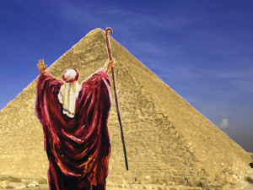
GOD SEVERELY
WARNED MOSES
ABOUT THE
IMPORTANCE OF CIRCUMCISION
WHEN HE WAS
GOING DOWN
TO EGYPT
TO DELIVER
THE ISRAELITES:

Slide 6
And it came to pass on the way, at the encampment, that the LORD met Moses and sought to kill him. Then Zipporah took a sharp stone and cut off the foreskin of her son and cast it at Moses' feet, and said, "Surely you are a husband of blood to me!" So God let Moses go.
– Exodus 4:24-26

Slide 7
God could have killed Moses
if He wanted to, but he taught Moses the importance of circumcision:
It was the sign of God’s covenant people
We must practice what
we preach!

Slide 8
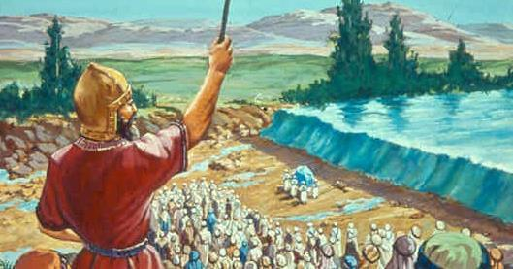
THE FIRST THING THAT GOD COMMANDED JOSHUA WHEN THEY HAD CROSSED
THE JORDAN RIVER WAS TO HAVE ALL
THE ISRAELITE MEN BE CIRCUMCISED:

Slide 9
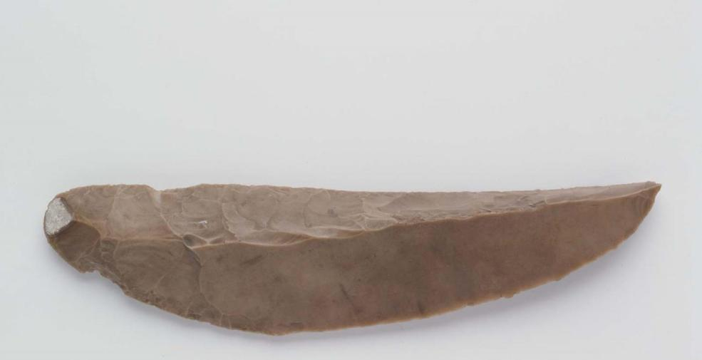
At that time the LORD said to Joshua, "Make flint knives for yourself, and circumcise the sons of Israel”….So it was, when they had finished circumcising all the people….the LORD said to Joshua, "This day I have
rolled away the reproach of Egypt from you." Therefore the name of the place is called Gilgal to this day.-Josh. 5:2 & 8-9

Slide 10
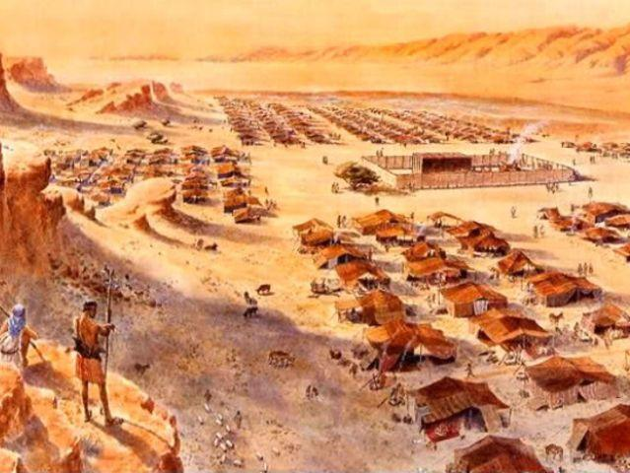
Joshua’s army continued to camp
at Gilgal for the 7 years they were conquering the Promised Land
if we want
to conquer
the promises
of God
for our lives,
we have to live at Gilgal,
or the place of circumcision!

Slide 11
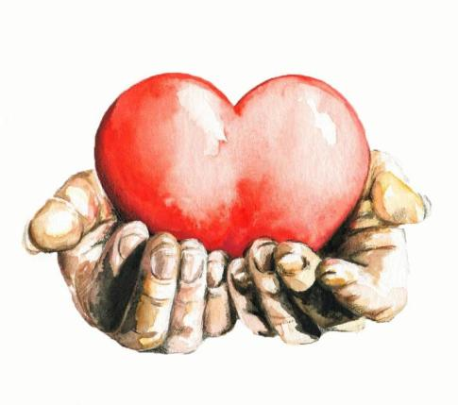
FROM THE BEGINNING,
THE JEWS RECOGNIZED
THAT CIRCUMCISION
HAD A SPIRITUAL MEANING:
And the LORD your God
will circumcise your heart and
the heart of your descendants,
to love the LORD your God with all your heart and with all your soul, that you may live.
-Deuteronomy 30:6

Slide 12
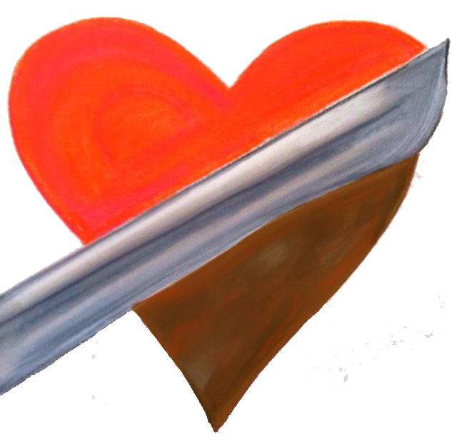
THE CUTTING AWAY OF FLESH IN THE SURGERY OF CIRCUMCISION SIGNIFIED THAT WE NEED TO HAVE OUR FLESHLY DESIRES AND LUSTS REMOVED FROM OUR LIVES!
“Therefore circumcise the foreskin of
your heart, and be
stiff-necked no longer.”
-Deuteronomy 10:16

Slide 13
THE CUTTING AWAY OF FLESH IN THE SURGERY OF CIRCUMCISION SIGNIFIED THAT WE NEED TO HAVE OUR FLESHLY DESIRES AND LUSTS REMOVED FROM OUR LIVES!
“…putting off the body of the sins of the flesh, by the circumcision
of Christ,”
-Colossians 2:11

Slide 14
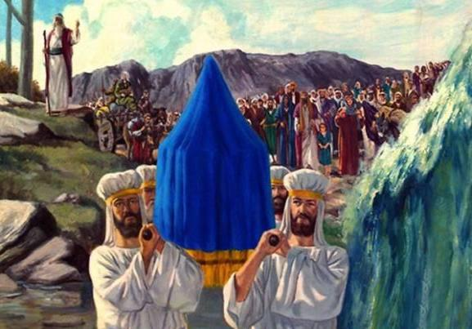
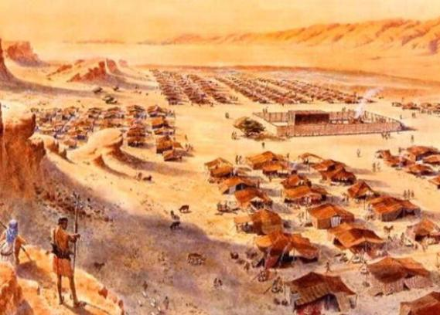
Just after the Israelites crossed the Jordan River they were all circumcised. Crossing the Jordan spiritually signifies that we are crucified with Christ, and that
will produce a circumcised heart!
CROSSING THE JORDAN
CIRCUMCISED AT GILGAL

Slide 15
IN THE OLD TESTAMENT
every male Jew had to be circumcised to be one of God’s people
IN THE NEW TESTAMENT
every Christian needs to be spiritually circumcised!
“For he is not a Jew who is one outwardly, nor is circumcision that which is outward in the flesh; but he is a Jew who is one inwardly; and circumcision is that of the heart, in the Spirit, not in the letter; whose praise is not from men but from God.”
– Romans 2:28-29

Slide 16
IN THE OLD TESTAMENT
every male Jew had to be circumcised to be one of God’s people
IN THE NEW TESTAMENT
every Christian needs to be spiritually circumcised!
“…putting off the body of the sins of the flesh by the circumcision of Christ”
– Colossians 2:11

Slide 17
Does our carnal, adamic nature like to have the sins of the flesh cut away? -No more than a baby likes to have his flesh cut away in circumcision!

Slide 18
CIRCUMCISION OF THE HEART
putting off the sins of the flesh
- is not optional for the Christian:
it is a requirement of Christ!
“…without holiness no one will see
the Lord.” – Hebrews12:14
“If you love Me,
keep My commandments.” – John 14:15
“Be perfect, therefore, as your heavenly Father
is perfect.” – Matthew 5:48

Slide 22
A “Perfect” baby has no responsibilities- just drink and sleep!
Yet a growing young child will have to learn self-control, and how to handle growing responsibilities

Slide 23
…but if a grown man still lives like a baby, something is very wrong!
When I was a child, I spoke as a child, I thought as a child; but when I became
a man, I put away childish things” – 1 Cor.13:11

Slide 24
A Perfect Scholar (at age 6)
2x6=….12?
2x6=….12?
No Longer a
Perfect Scholar
(at age 20)

Slide 26
Paul taught about Progressive Perfection:
Php 3:12 Not that I have already attained, or am already perfected; but I press on, that I may lay hold of that for which Christ Jesus has also laid hold of me.
Php 3:13 Brethren, I do not count myself to have apprehended; but one thing I do, forgetting those things which are behind and reaching forward to those things which are ahead,
Php 3:14 I press toward the goal for the prize of the upward call of God in Christ Jesus.
Php 3:15 Therefore let us, as many as are mature [perfect], have this mind; and if in anything you think otherwise, God will reveal even this to you.

Slide 27
THERE IS AN UNBALANCED AND DANGEROUS DOCTRINE BEING SPREAD, THAT WE CAN CONTINUE TO REPEATEDLY SIN, BECAUSE GOD’S GRACE WILL ALWAYS FORGIVE US.
Rom 6:15-16 What then? Shall we sin because we are not under law but under grace? Certainly not! Do you not know that to whom you present yourselves slaves to obey, you are that one's slaves whom you obey, whether of sin leading to death, or of obedience leading to righteousness?

Slide 28
Many Jews in the time of Christ were deceived that they were God’s children because they were circumcised
The Jews said to Jesus: “We are Abraham’s children” -we are God’s children, we are saved! (Jn.8:39-41)
-They trusted in natural circumcision!
Jesus replied to them: “You are of your father the devil, because you do the works of the devil,” v.44
-They needed to be spiritually circumcised!

Slide 29
Many people today are deceived that they are saved because they are religious, or had a former spiritual life
Once saved,
Always saved!

Slide 30
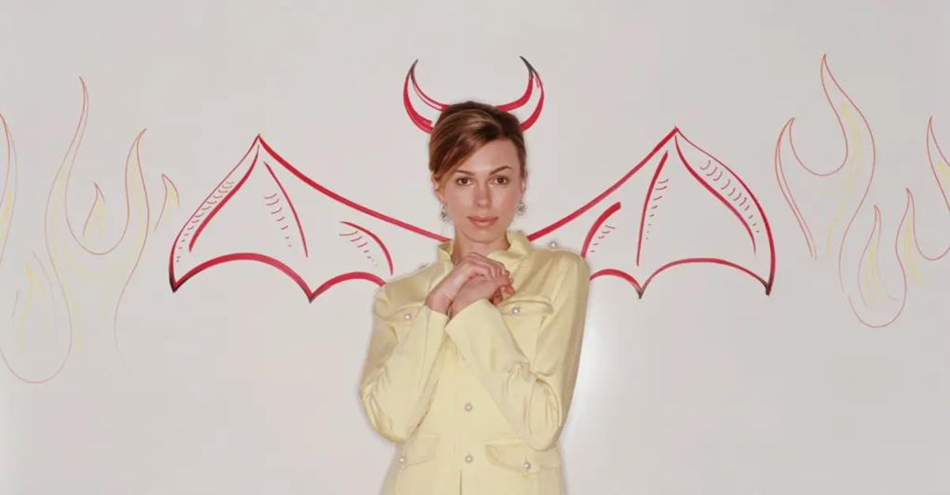
I’m a good Christian-
-When I want to be!

Slide 31
By grace I am saved
through faith, not of
works – I claim
Ephesians 2:8-9!
“Do you not know that the unrighteous will not inherit the kingdom of God? Do not be deceived. Neither fornicators, nor idolaters, nor adulterers, nor homosexuals, nor sodomites, nor thieves… will inherit the kingdom of God.” -1 Cor.6:9-10

Slide 32
BUT WITH A CIRCUMCISED HEART, WE WILL FULLY LOVE THE LORD AND WILL LEARN HOW TO LIVE A FULLY RIGHTEOUS LIFE!
And the LORD your God will circumcise your heart and the heart of your descendants,
to love the LORD your God with all your
heart and with all your soul… Deut. 30:6

Slide 33
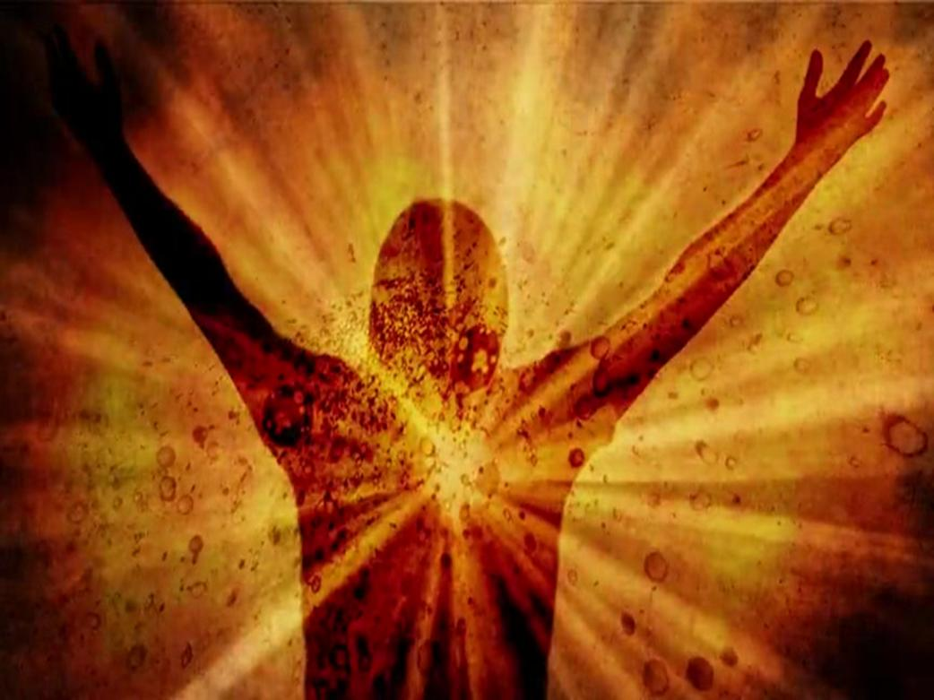
With a Circumcised Heart, We will gain Victory over Sin!
“…putting off the body of the sins of the flesh by the circumcision of Christ” – Col.2:11

Slide 34
With a Circumcised Heart, We will seek God’s Praise, not Man’s Praise!
“…and circumcision is that of the heart…whose praise is not from men but from God.” -Rom.2:29
-Singers & Musicians, do you sing & play to be admired by people, or praised by God?
-Are you entertaining the people, or are your heart & mind always focused on God?

Slide 35
With a Circumcised Heart, We will Practice what We Preach!
Leaders, do we do things in secret that we tell other people not to do?
Do we allow compromise & mixture so we can gain more money, or approval, or control?
Do our lives inspire others to be more like Christ, or motivate them to leave the church?

Slide 36
How can we gain a circumcised heart?
By carrying our cross daily, dying to sin daily, we progressively enter into being crucified with Christ- so that His life, and His heart, will live in us!
Jesus said to them, "If anyone desires to come after Me, let him deny himself, and take up his cross daily, and follow Me.” –Lk.9:23
“And whoever does not bear his cross and come
after Me cannot be My disciple.” -Lk.14:27

Slide 37
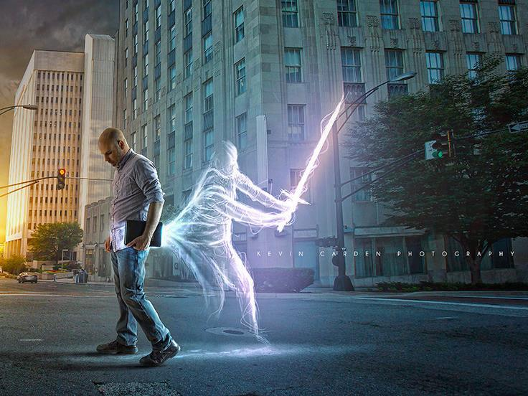
Let the sword of the Spirit cut and expose the sin in our heart & life –
then cry out for cleansing!
For the Word of God is sharper than any two-edged sword…and is a discerner of the thoughts and intents of the heart

Slide 38
The Jewish priests used a sword or large knife to cut up the parts of the offerings before they would be burned at the altar- we need the sword of the Spirit to cut up and expose the areas of sinful flesh in our lives that need to be burned at the altar of consecration!

Slide 39
Always walk in the Light-
and any remaining darkness
is only shadows behind us!
If we walk in the light as He is
in the light, we have fellowship
with one another, and the blood
of Jesus Christ His Son cleanses
us from all sin. -1 Jn.1:7

Slide 40
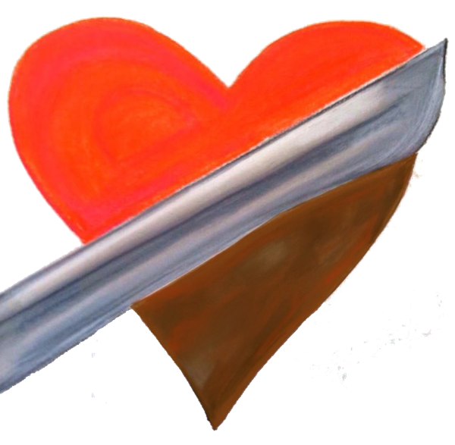
Do You Pass the Test of Circumcision?
-Are you gaining a life of victory & holiness?
-Are you loving God more & hating every sin?
-Do you sing/play music only for God’s praise?
-Do you practice what you preach?
CHRIST CAN CIRCUMCISE OUR HEART!

Slide 41
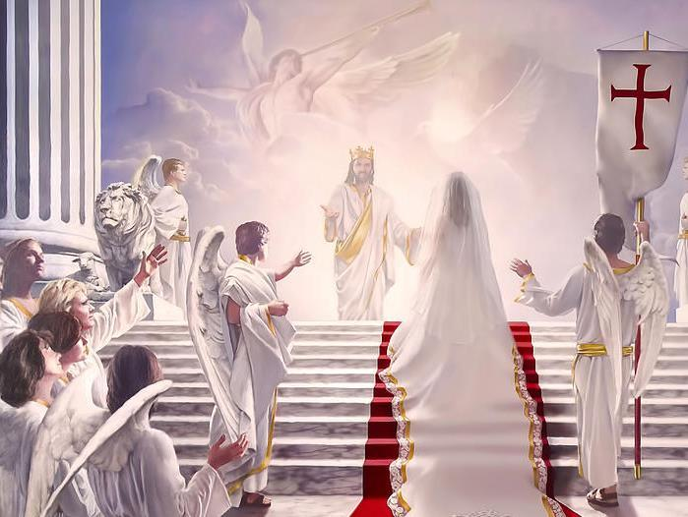
The Church, the Bride of Christ, is to be clothed in fine linen, which is the righteous acts of the saints (Rev.19:8)
“And His wife has
made herself
ready”–Rev.19:7

Slide 42
May Your Path in Life Shine Brighter and Brighter, Abiding in More & More of His Love, and Grace, and Holiness!

