Slide 1
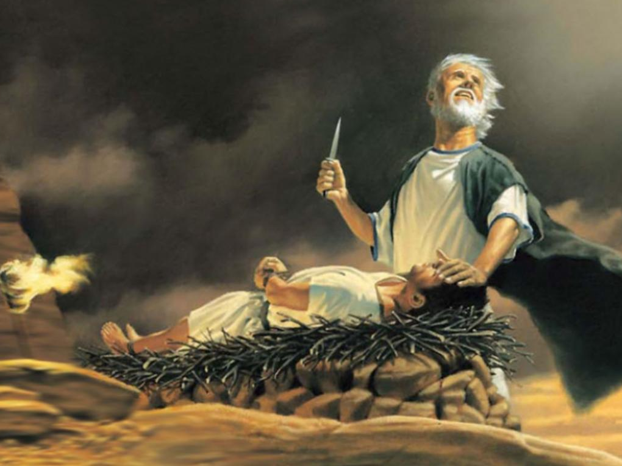
THE TESTINGS
OF GOD

Slide 2
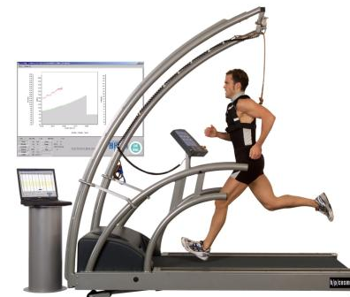
LIFE IS A CONTINUING PROGRESSION OF GROWTH
Our growth in life
is repeatedly tested & evaluated.

Slide 3
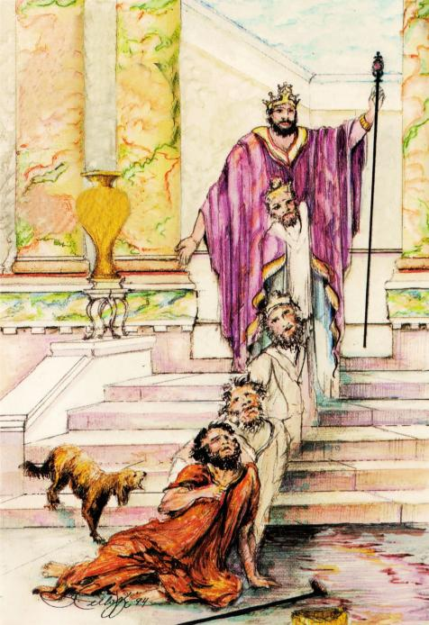
OUR SPIRITUAL LIFE SHOULD ALSO BE A PROGRESSION OF GROWTH:
We are to be changed from glory to glory, to become more like Christ, 2 Cor. 3:18.
We are to go from strength to strength, until we all appear before God in Zion,
Ps. 84:7.

Slide 4
The Lord wants us to go on into full spiritual maturity, 1 John 2:12-14 From little children, to young men (victory), into becoming spiritual fathers and mothers (mature leaders)
HOWEVER, to go on we must first pass
each grade- then we are permitted
to step up to the next level!

Slide 5
GOD GIVES US SPIRITUAL TESTINGS:
ABRAHAM: “Now it came to pass after these things that God tested Abraham…” Gen. 22:1
THE ISRAELITES: “Then the Lord said to Moses, ‘Behold, I will rain bread from heaven for you…. that I may test them’” Ex.16:4
GIDEON’S SOLDIERS: “But the LORD said to Gideon, "The people are still too many; bring them down to the water, and I will test them for you there” Jdg. 7:4

Slide 6
GOD GIVES US SPIRITUAL TESTINGS:
KING HEZEKIAH: “God withdrew from him, in order to test him” 2 Chron. 32:31
PETER’S WARNING: “Beloved, do not be amazed and bewildered at the fiery ordeal which is taking place to test your quality,” 1 Peter 4:12 AMPLIFIED BIBLE

Slide 7
GOD’S TESTS ARE DIFFERENT THAN MAN’S TESTS, ISAIAH 55:8-9
Man tests our outward abilities
GOD TESTS OUR INNER CHARACTER! (1 Sam.16:7)
Man’s tests are announced in advance
GOD’S TESTS OFTEN COME UNANNOUNCED!
(Gen.24:12-21, Jud.7:4-7)

Slide 8
To see if we are
to be promoted, Heb.3:1-3

Slide 9
GOD DESIRES TO BRING US UP TO HIGHER LEVELS AND TESTS TO SEE IF WE ARE READY!

Slide 10
2. To if there are deficient areas that we need
to correct, Deut. 8:2

Slide 11
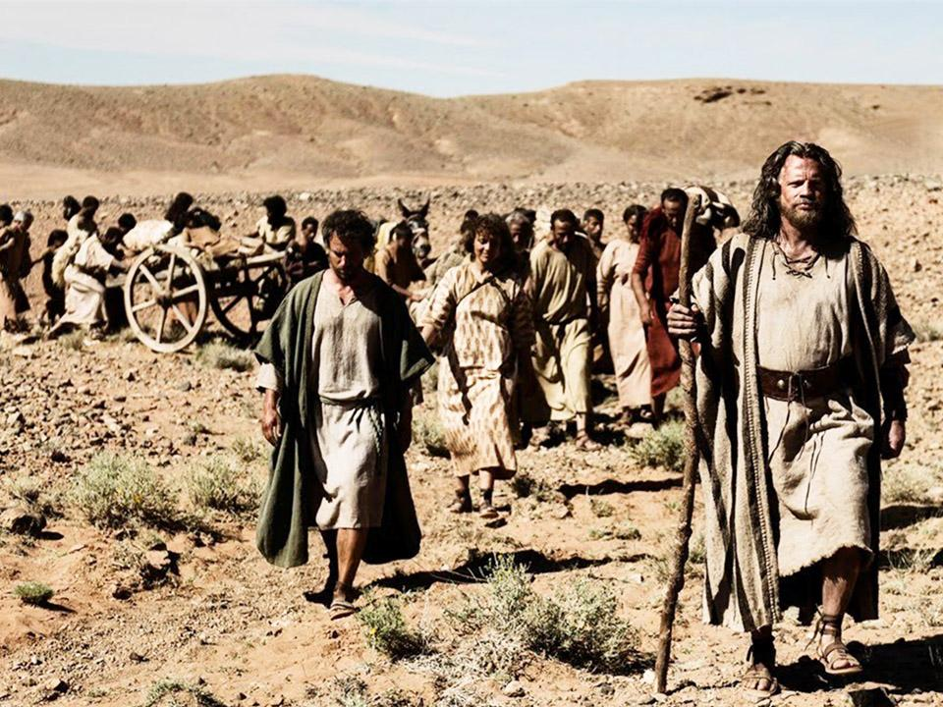
“…the LORD your God led you all the way these forty years
in the wilderness, to humble you and test you, to know what was in your heart.… as a man chastens his son, so the LORD your God chastens you. –Deut. 8:2 & 5
“For whom the Lord loves He chastens, and scourges every son whom He receives….that we may be partakers of His holiness.”-Heb.12:6 & 10

Slide 12
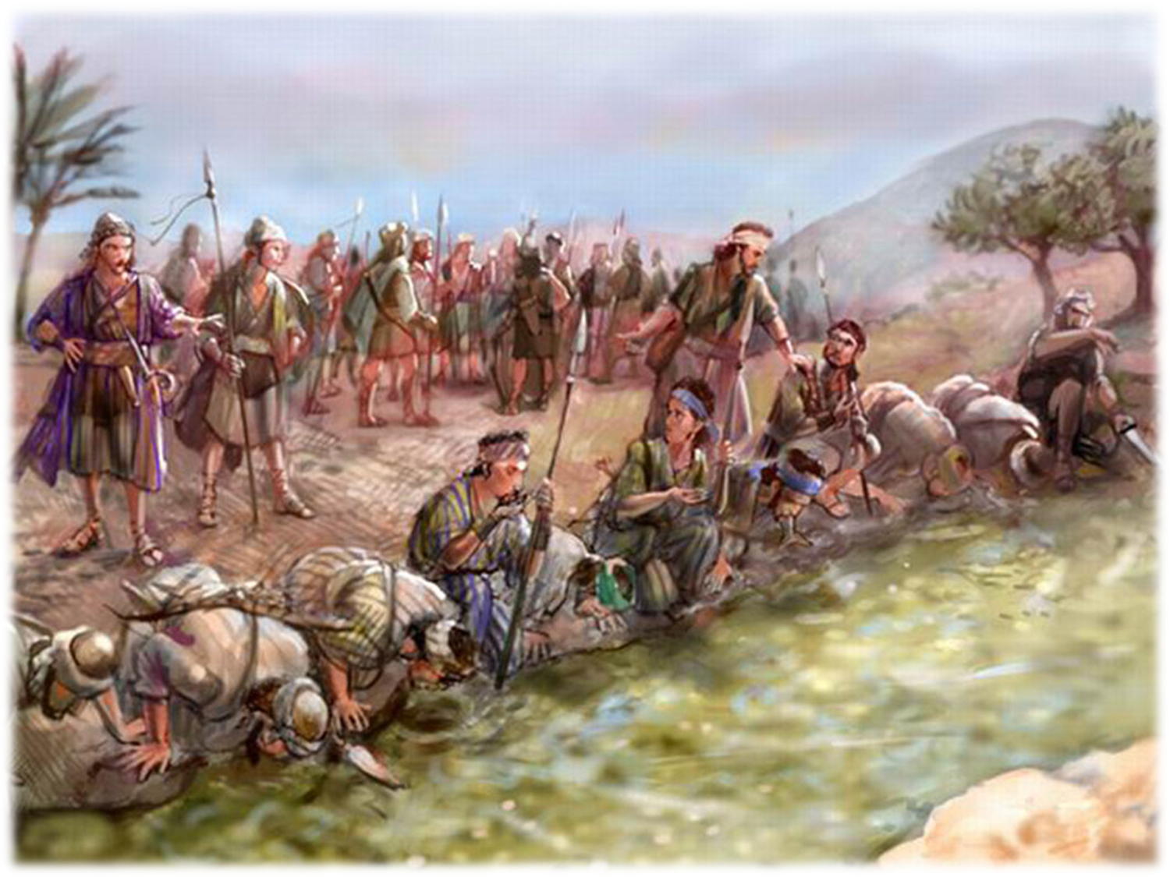
To
overcomers from being hindered or slowed down by the unprepared

Slide 13
Gideon’s Army - 32,000 soldiers: most were unprepared!
- 22,000 fearful soldiers who would retreat
= 10,000 soldiers left
- 9,700 who drank with their heads down
= 300 soldiers left, ready to overcome!
Two tests in Judges 7:2-7
to remove the unprepared!

Slide 14
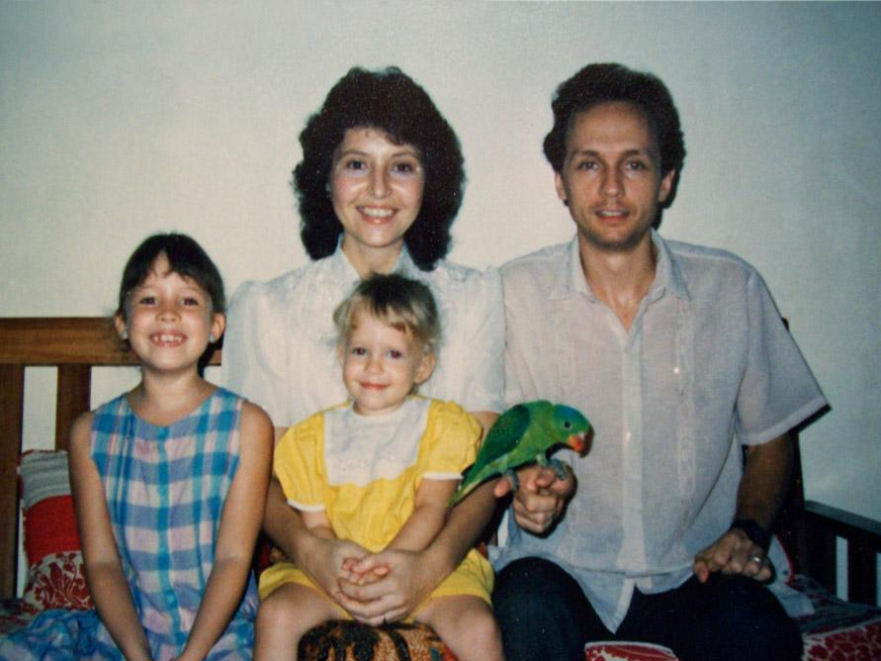
Holmes family in Palawan, 1987

Slide 15
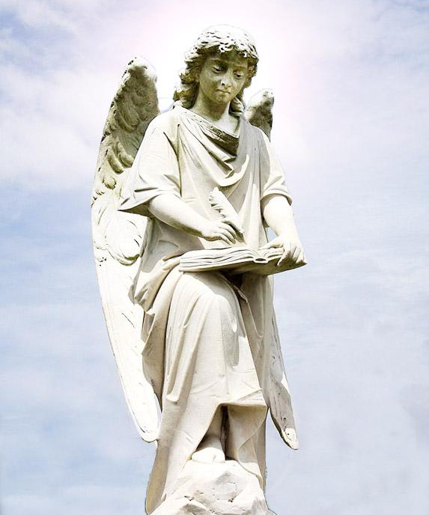
The Angel was writing names down
in the book.

Slide 16
Hebrews 6:1-3
THOSE WHO GOD
WILL PERMIT
TO GO ON

Slide 17
WHAT ARE SOME
OF THE MANY TESTS THAT
GOD CAN
GIVE US?

Slide 18
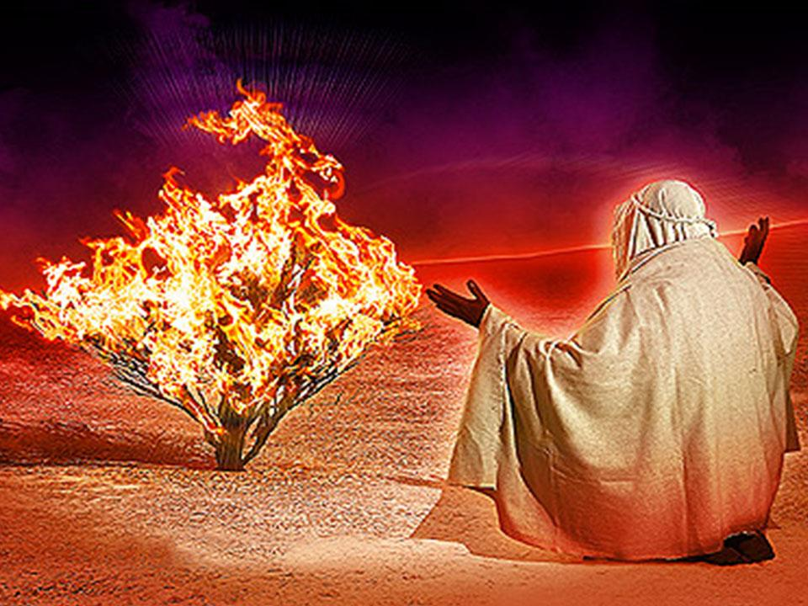
Test #1-“TURNING ASIDE” Ex.3:2-4

Slide 19
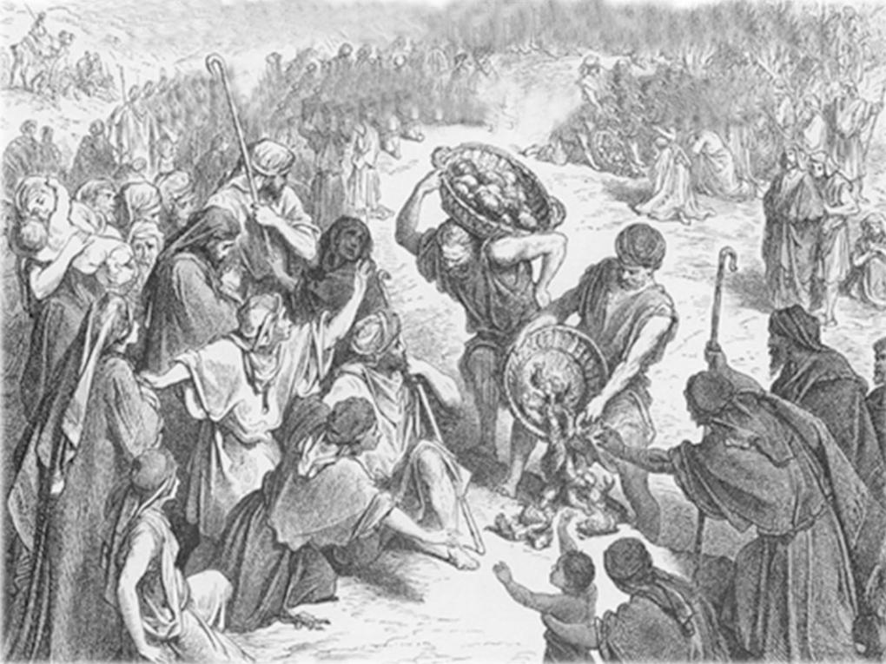
Test #2 – BEING FAITHFUL
WITH LITTLE, LUKE 16:10

Slide 20
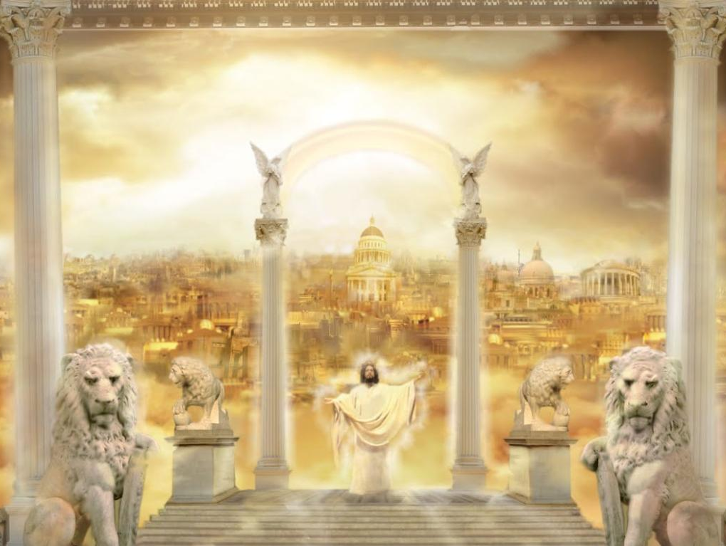
“Who lives in that large mansion?”

Slide 21
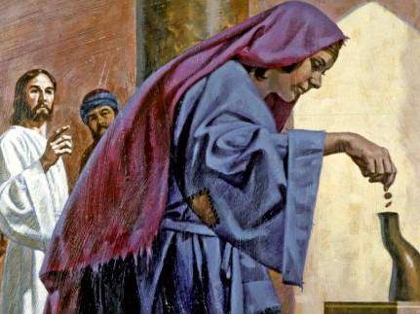
The poor widow who gave
Her only two coins, Luke 21:2

Slide 22
Test #3- VIGILANCE
“BE SOBER,
BE VIGILANT;
BECAUSE YOUR ENEMY,
THE DEVIL,WALKS ABOUT
AS A ROARING LION, SEEKING
WHOM HE MAY DEVOUR” -1 PETER 5:8

Slide 23
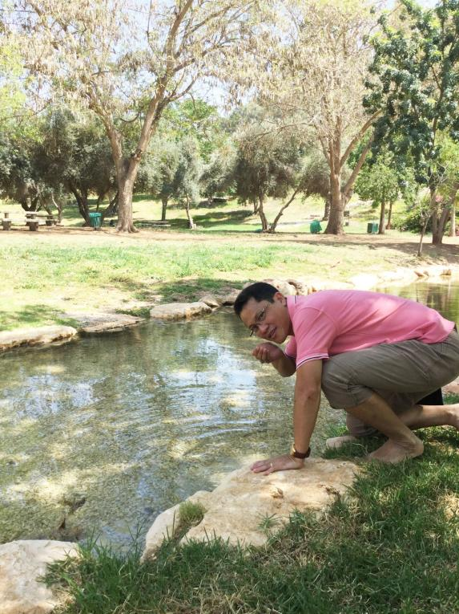
May 16, 2018
Ein Harod, Israel:
There are still
vigilant
soldiers
drinking
from
Gideon’s Pool!

Slide 24
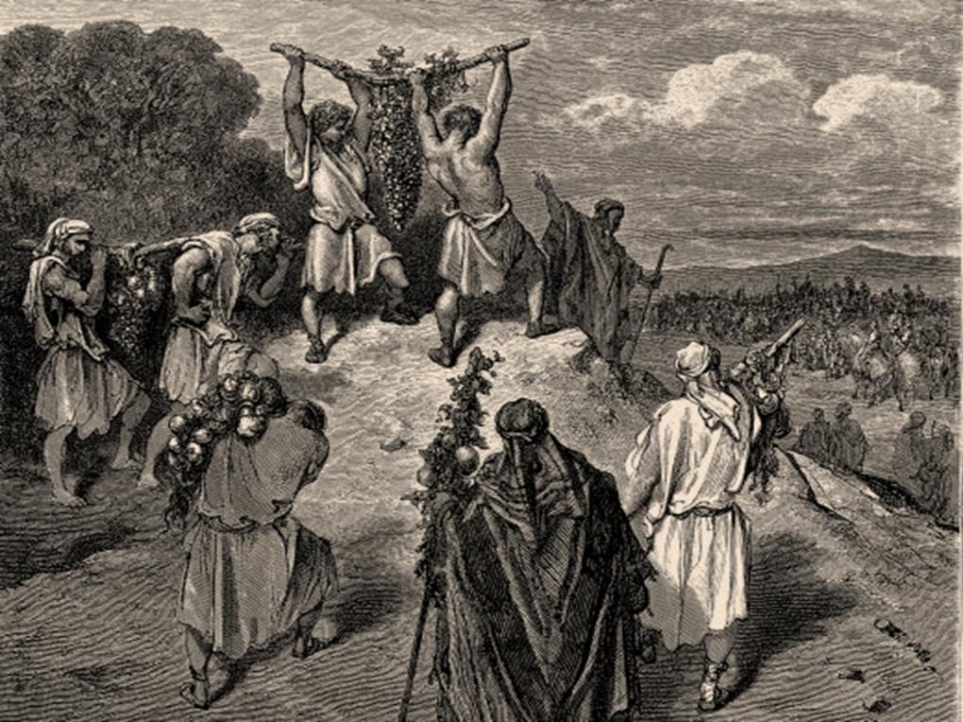
Test #4
THE TEST
OF FAITH

Slide 25
The Word of the Lord, 2008: “Buy land and build!”
Future ZMI property

Slide 26
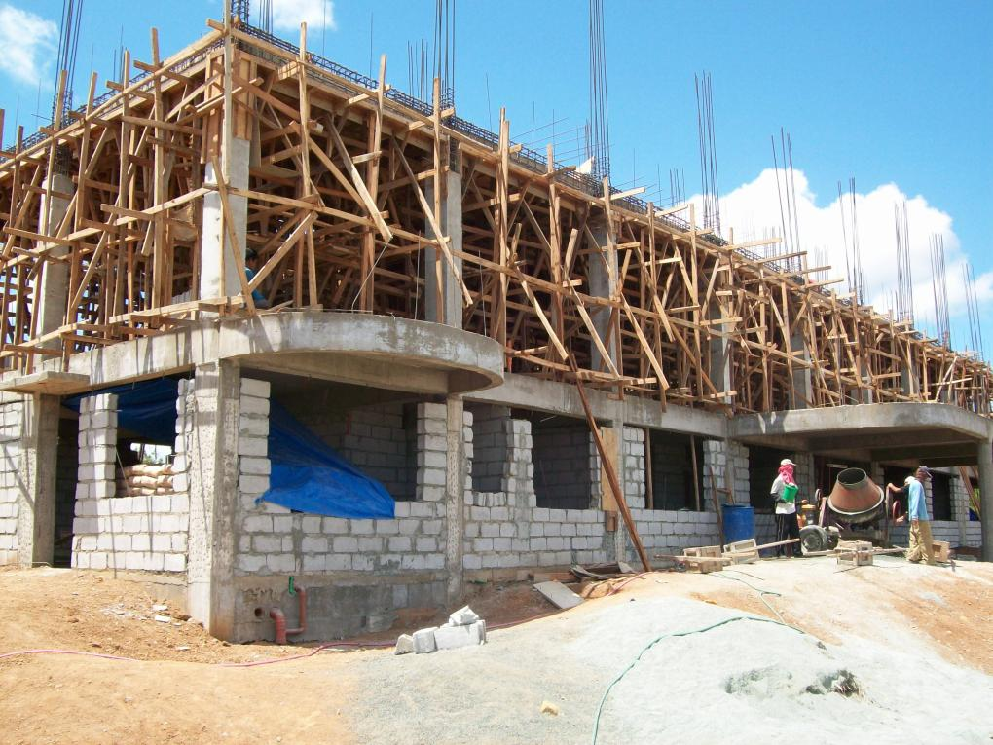
May 2010

Slide 27
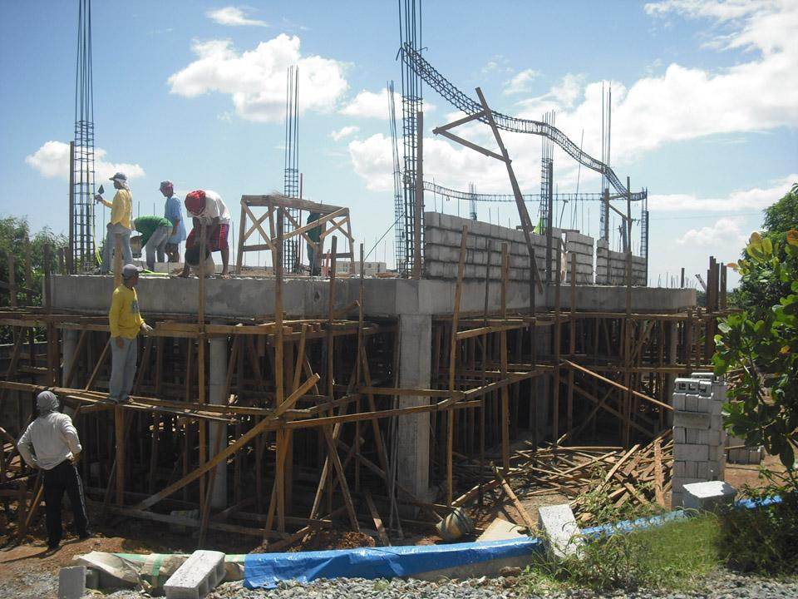
Men’s Dormitory, June 2012

Slide 28
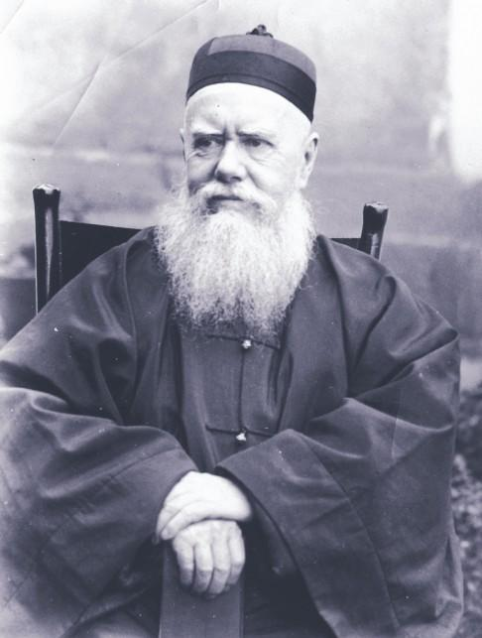
“God’s will,
done God’s way, will have God’s provision”
-Hudson Taylor
Founder of
the China Inland Mission, which spread the gospel throughout China

Slide 29
Let us go on towards spiritual maturity, Heb. 6:1
GOD HAS
GREAT PLANS
FOR YOUR LIFE. PASS YOUR TESTS SO YOU CAN STEP UP TO
THE NEXT LEVELS!

