Slide 2
THE OVERCOMERS
is taught throughout the Bible
from Genesis to Revelation.

Slide 3
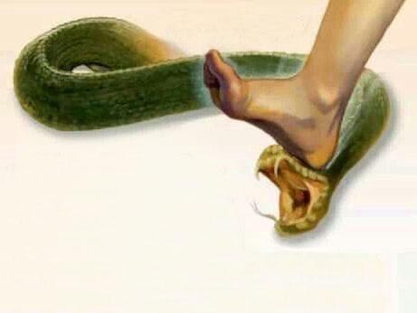
In GENESIS 3:15
God said to the snake
(and to Satan),
"I will place hostility
between you and the woman,
between your offspring
and her offspring.
He will strike you on the head,
and you will strike him on the heel."

Slide 4
THERE WILL ALWAYS BE
HOSTILITY- ENMITY - CONFLICT - WARFARE
Between Satan
and the Offspring of the Woman
(Christ & the Overcomers, Rom.16:20)

Slide 5
When a deliverer was to be born in Egypt, Pharoah had all the male children killed.

Slide 6
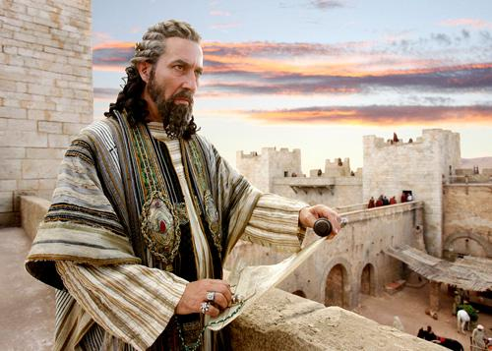
WHEN CHRIST WAS BORN IN BETHLEHEM, KING HEROD HAD ALL THE YOUNG MALE CHILDREN KILLED

Slide 7
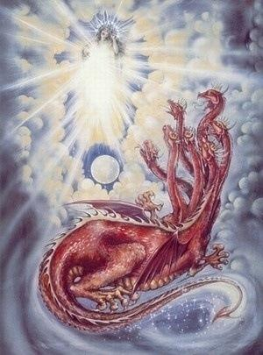
This conflict will come to its fullness in the Last Days!
Revelation 12:1-5 tells us about a woman giving birth, while the dragon (Satan) sought to devour the child- but failed.

Slide 8
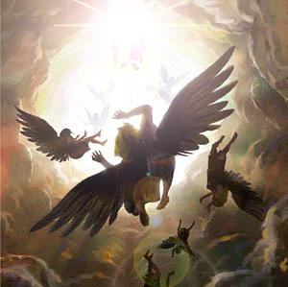
Rev. 12:9-12 tells us: “And the great dragon was cast out, the old serpent called Devil, and Satan…. And I heard a great voice saying in Heaven….the accuser of our brothers is cast down, who accused them before our God day and night. And they overcame him because of the blood of the Lamb, and because of the word of their testimony…. Therefore rejoice, O heavens, and those who tabernacle in them.

Slide 9
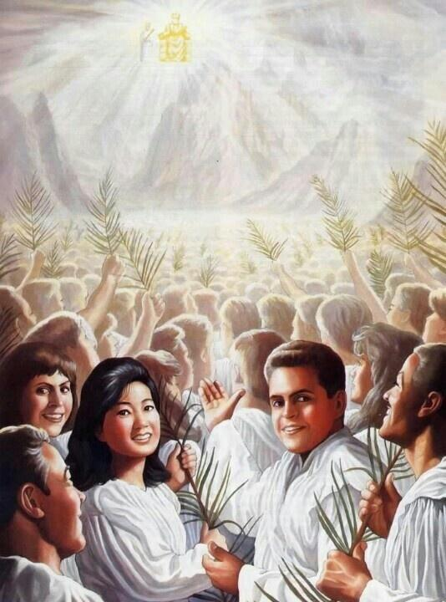
REJOICE,
YOU WHO DWELL (TABERNACLE) IN THE HEAVENS!
This is written about the Last Days before the 2nd Coming - the
overcoming saints who enter into the Feast of Tabernacles and are abiding in heavenly places
with Christ will be rejoicing, and also victorious over Satan!

Slide 10
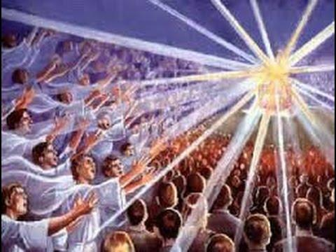
THOSE WHO TABERNACLE IN THE HEAVENLIES WILL OVERCOME THE SERPENT/ THE DRAGON/ SATAN/

Slide 11
Christ the head
in heaven
Ephesians 1:20-23 tells us that
the body of Christ, the Church,
is to be seated in heavenly places above all the principalities
and powers
of Satan, with Satan under
our feet
The BODY OF CHRIST, Eph.1:20-23
Satan under
our feet

Slide 12
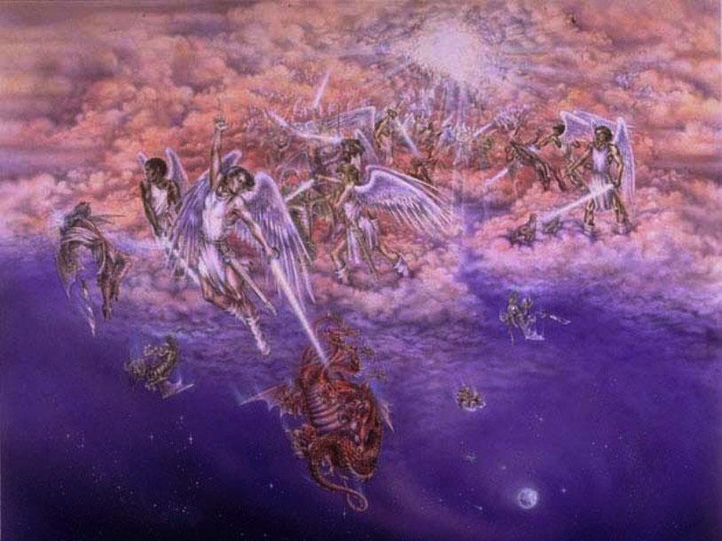
Rev.12:12 REJOICE, THOSE IN THE HEAVENS
-BUT WOE TO THOSE ON THE EARTH!
The Devil has come down
to the earth
(cast down by Michael & the holy angels, Rev.12:7)

Slide 13
Satan
will be
very angry! Desperate!
His time
will be short!
His last
opportunity
to win!

Slide 14
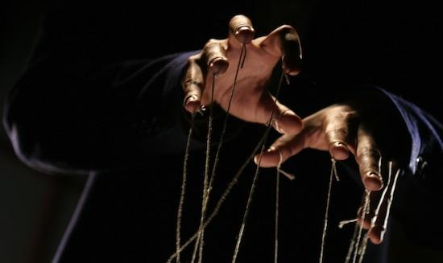
IN THE LAST DAYS THE FORCES OF SATAN WILL SEEK TO CONTROL THE WORLD.
THEY WILL TEMPORARILY OVERCOME THE SAINTS DWELLING ON THE EARTH!
“It was granted to him to make war with the saints, and to overcome them. –Rev.13:7

Slide 15
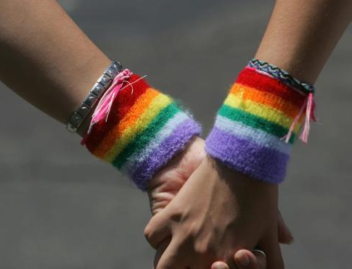
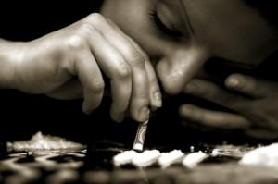
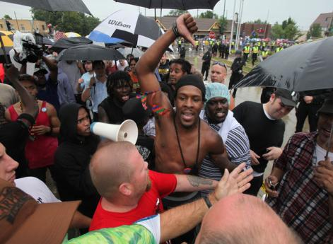
As we enter deeper into the Last Days,
conflict is increasing around the world-
terrorism,
drug addiction,
moral corruption, financial collapse,
interracial conflicts,
political instability, etc.

Slide 16
WE MUST OVERCOME SIN & SATAN
OR WE WILL
BE OVERCOME
BY SIN & SATAN!

Slide 17
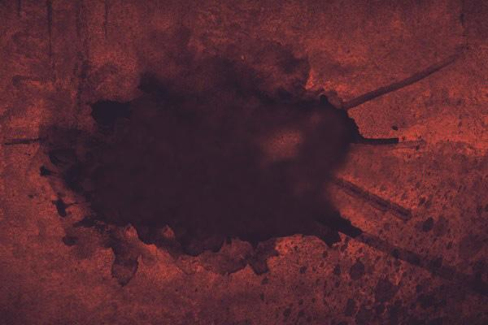
A QUESTION:
Why has God allowed Satan to repeatedly attack the saints?

Slide 18
A QUESTION: Why has God allowed Satan to repeatedly attack the saints?
-Satan attacked Adam & Eve, Gen. 3:1-6
-Satan attacked Job, Job 1:8-12 & 2:4-7
-Satan attacked David, 1 Chron. 21:1
-Satan attacked Peter, Luke 22:31
-Satan attacks the Last Days Church, Rev. 12 & 13
-Satan will attack the multitudes near the end
of the Millennium, Rev. 20:7-8

Slide 19
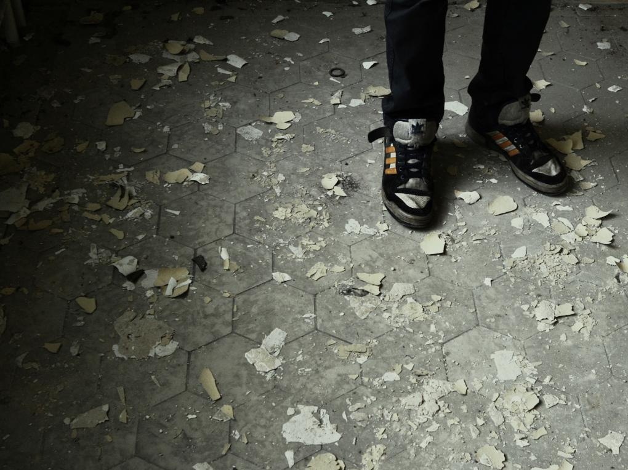
IN THIS EVIL,
FALLEN WORLD,
WE EACH HAVE
THE CHALLENGE,
THE OPPORTUNITY,
THE NECESSITY
OF OVERCOMING
SIN & SATAN!

Slide 20
God wants His sons & daughters to
GROW UP
and not remain
like babies!

Slide 21
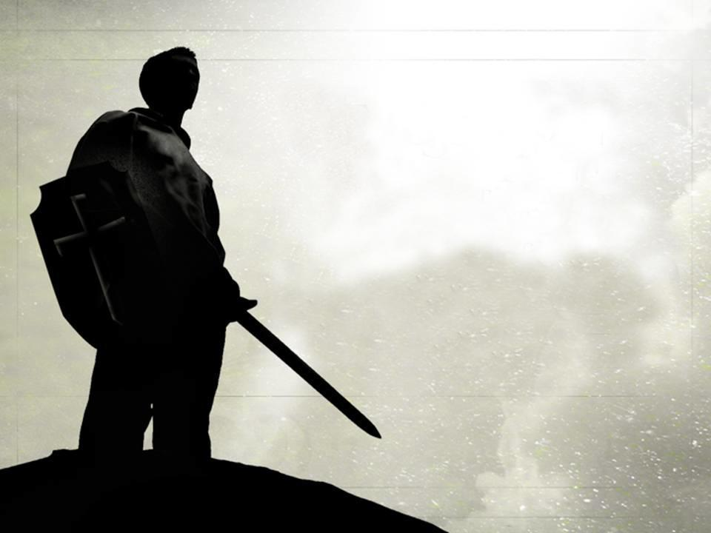
In 1 John 2:12
immature Christians are compared to babies,
but in 1 John 2:14
maturing Christians
are like young men
who are ready to fight
and overcome.

Slide 22
GOD WANTS
HIS SONS & DAUGHTERS
TO GROW UP
& OVERCOME
SIN AND
SATAN!

Slide 23
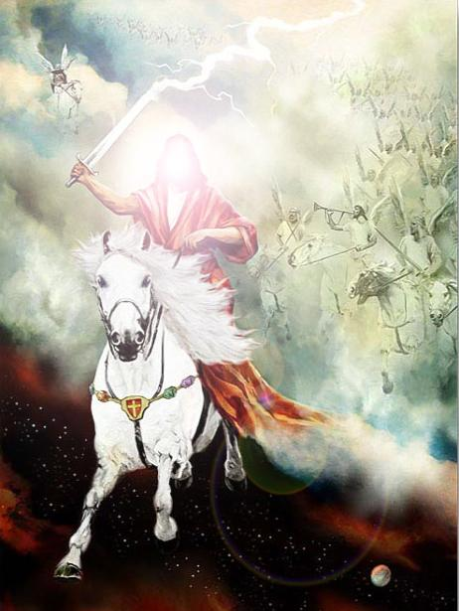
Exodus 15:3
“The Lord is a Man of War”
–to become more like God, we need to become good soldiers of Christ!

Slide 24
But a soldier must be able to endure great difficulties!
Babies can be lazy
- do nothing!

Slide 25
WE MUST OVERCOME OR WE WILL BE OVERCOME!
-VICTORS or VICTIMS!
“It was granted to him to make war with the saints and to overcome them. And authority was given him over every tribe, tongue, and nation” –Rev.13:7

Slide 26
TWO CHAPTERS OF THE BIBLE
MOST CLEARLY TEACH US
HOW WE CAN EACH
BECOME OVERCOMERS:
REVELATION 2 & 3
(Christ’s letters to the 7 churches)

Slide 27
To every church, Christ warns them
of their failures and of the
attacks of sin & Satan.
THEN THE RISEN CHRIST
ENCOURAGED EACH
CHURCH TO RISE UP,
BECOME OVERCOMERS,
AND OBTAIN THE GREAT
PROMISES OF GOD!

Slide 28
THE SPIRITUAL CONDITION OF
THE 7 CHURCHES OF REVELATION 2 & 3
REV. 2:1-7 EPHESUS, THE LOVELESS CHURCH
REV. 2:8-11 SMYRNA, THE PERSECUTED CHURCH
REV. 2:12-17 PERGAMOS, THE COMPROMISING CHURCH
REV. 2:18-29 THYATIRA, THE CORRUPT CHURCH
REV. 3:1-6 SARDIS, THE DEAD CHURCH
REV. 3:7-13 PHILADELPHIA, THE MISSIONARY CHURCH
REV. 3:14-22 LAODICEA, THE LUKEWARM CHURCH

Slide 29
THESE ARE THE CHALLENGES THAT
THE OVERCOMERS MUST ACCOMPLISH:
RESTORING OUR FIRST LOVE (Ephesus)
ENDURING PERSECUTION (Smyrna)
REJECTING COMPROMISE (Pergamos)
JUDGING CORRUPTION (Thyratira)
SURVIVING DEAD CHRISTIANITY (Sardis)
BECOMING MISSIONARIES (Philadelphia)
OVERCOMING BEING LUKEWARM (Laodicea)

Slide 30
THE REWARDS FOR THE OVERCOMERS ARE MUCH GREATER THAN THE TRIALS!

Slide 31
PAUL SAID IN ROMANS 8:18
“For I consider that the
SUFFERINGS OF THIS PRESENT TIME
are not worthy to be compared
with the GLORY
which shall be revealed
in us.”

Slide 32
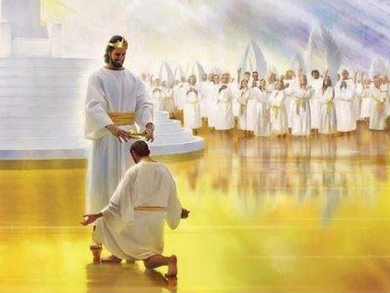
GOD HAS EVALUATED THAT ALL THE SUFFERINGS OF THE WORLD FOR
THOUSANDS OF YEARS
CANNOT BE COMPARED WITH THE POSITIVE RESULTS THAT THE OVERCOMERS WILL GAIN FOR
ALL ETERNITY!

Slide 33
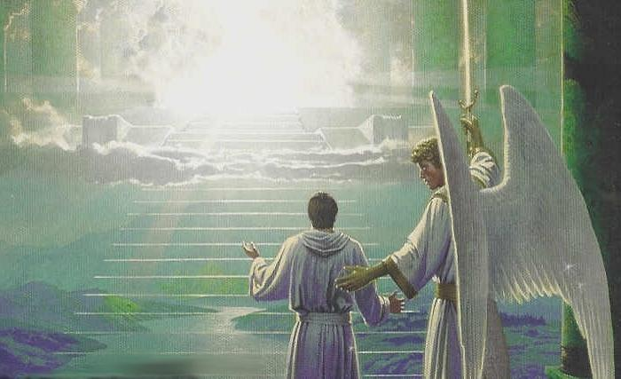
MAY WE SEE A CLEAR VISION OF GOD’S PROMISES-
AND THE FUTURE REWARDS AWAITING
THE OVERCOMERS!

