Slide 1
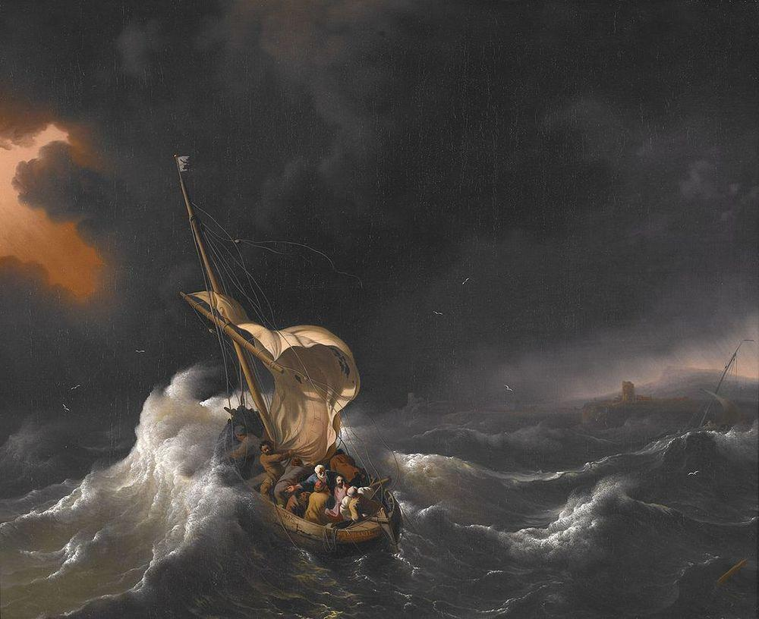
Through Dark Storms

Slide 2
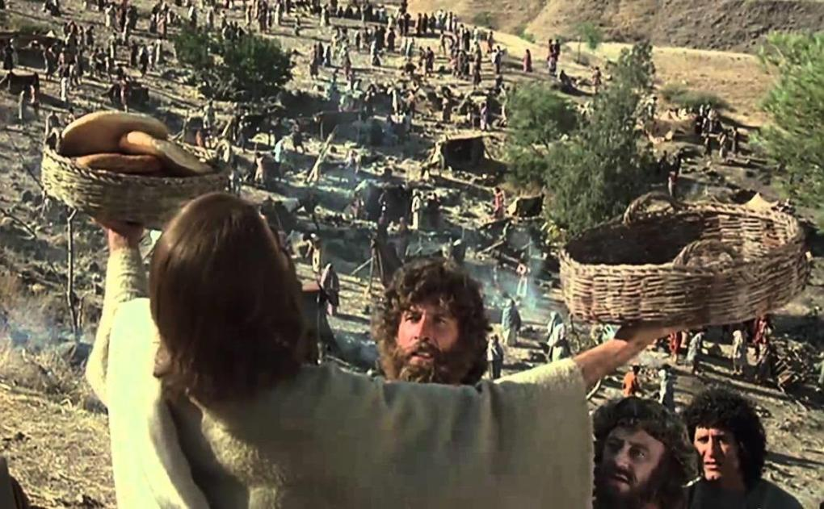
When Jesus miraculously fed the 5,000 they wanted to crown Him as king, Jn.6:15

Slide 3
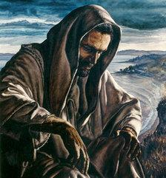
But Jesus did not let the people crown Him as king- instead, He sent His disciples away in a boat, while He went alone up on a mountain to pray

Slide 4
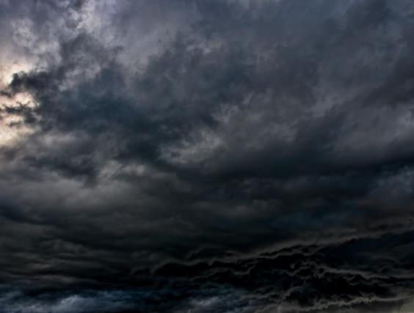
Jesus Sent His disciples away from the blessing and “revival” –into a dark storm!
Sometimes the Lord sends us into darkness and storms, and Christ does not seem to be with us!

Slide 5
But Jesus was up on the mountain praying for them- and by the Spirit, “He saw them straining at rowing” –Mk 6:48
If we feel alone in a dark storm, Jesus is in heaven where He is watching us and praying for us, Heb.7:25

Slide 6
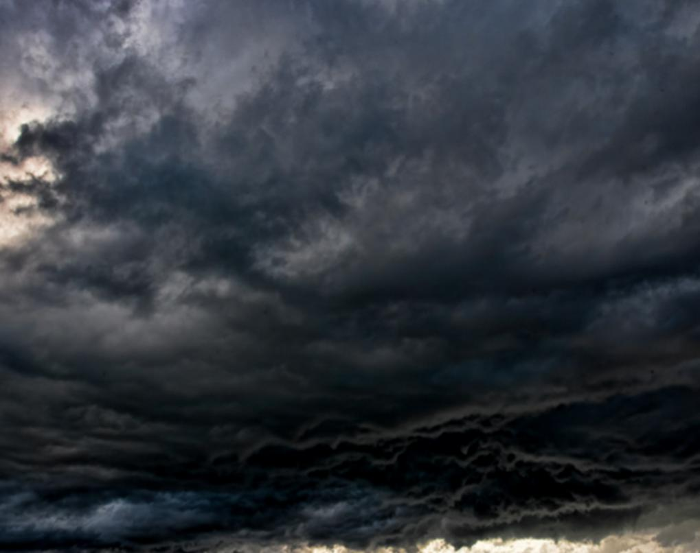
God has purposes for sending us into darkness and storms!
PURPOSE # 1- TO TEACH US
TO TRUST & OBEY
“Who among you fears the Lord?
Who obeys the voice of His Servant?
Who walks in darkness and has no light?
Let him trust in the name of the Lord
and rely upon His God” –Is.50:10

Slide 7
PURPOSE # 2- TO BEGIN A NEW DAY FOR OUR LIVES
“So the evening and the morning were the first day… were the second day… were the third day…” Gen. 1:5, 8, & 13

Slide 8
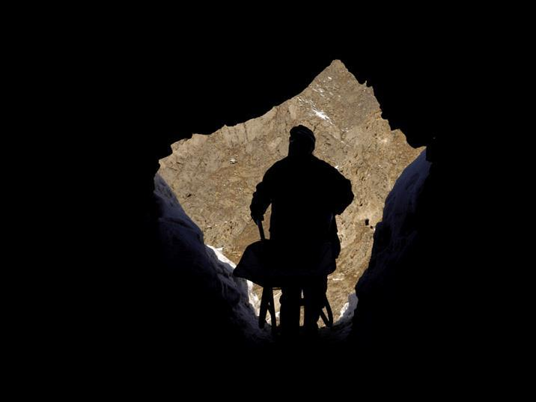
PURPOSE # 3- TO GIVE US THE
TREASURES OF DARKNESS
“And I will give you the treasures of darkness,
and hidden riches of secret places” – Is.45:3

Slide 9
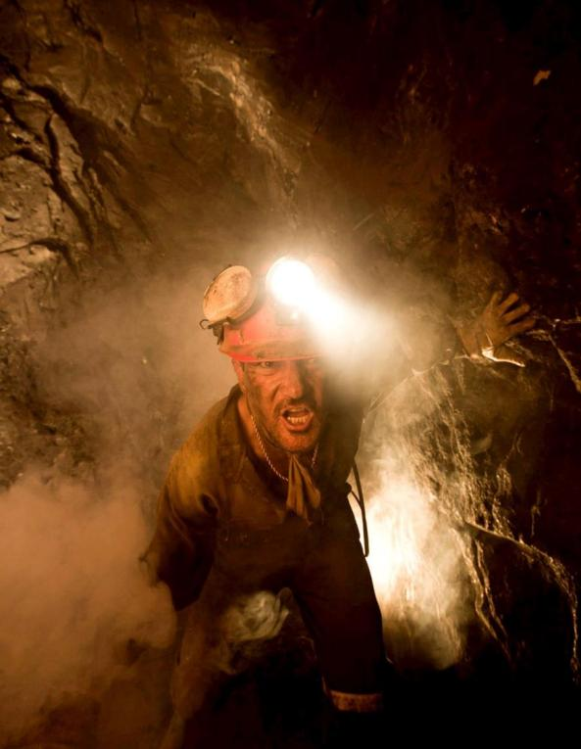
All the world has heard the story of the 33 miners in Chile who were trapped underground in 2010 for more than two months

Slide 10
In that dark time they read their Bibles and had two prayer services every day

Slide 11
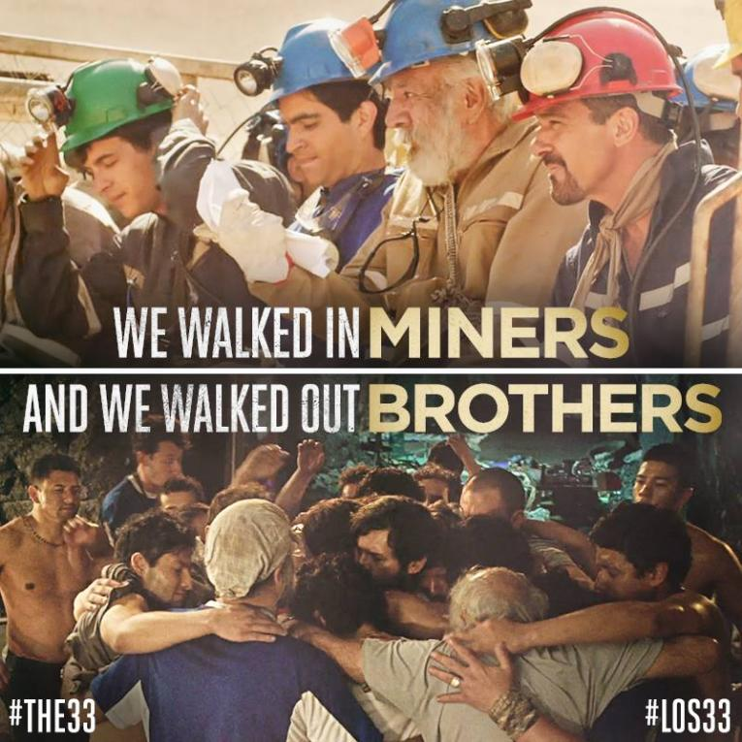
They gained many treasures in that dark time

Slide 12
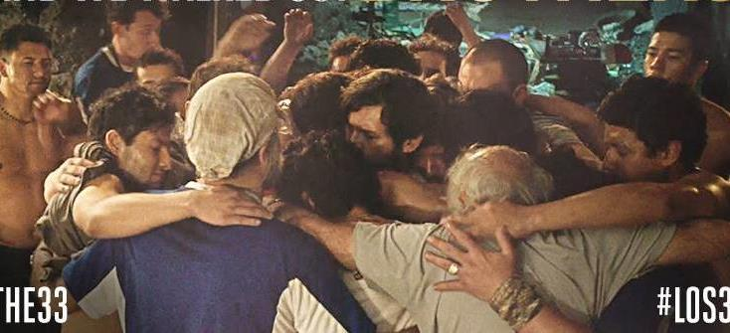
Paul said that the Lord comforts us in our trials, so that we can give that comfort to others in their time of need

Slide 14
Through their dark storm, the disciples knew Christ in a greater way!

Slide 15
As Peter saw Christ in a greater way, his own faith was built up

Slide 16
Peter learned how important it was to always keep looking to Jesus!

Slide 17
Peter learned how to walk on the water
-and in dark and stormy times, Christ can teach us how to walk above the difficulties!

Slide 18
In times of darkness and storms, the Lord is able to reveal Himself to us as the LORD of ALL! “THEN HIS DISCIPLES WORSHIPED HIM, SAYING, ‘TRULY, YOU ARE THE SON OF GOD.’” -MAT.14:33

Slide 19
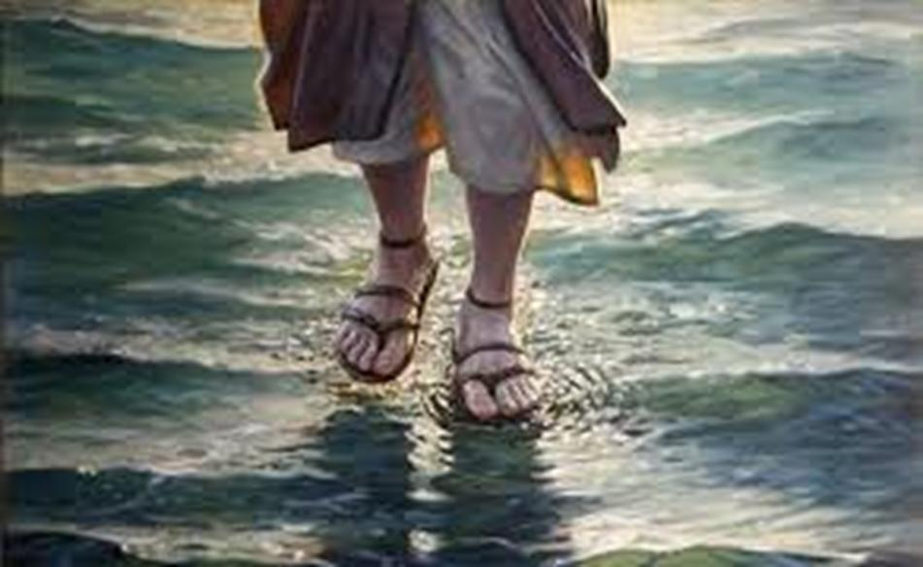
Let us trust the Lord that He will meet with us in times of darkness & storm; and cause us to gain victory over all our difficulties & trials

