Slide 1
In the Old Testament there were two generations that brought God’s people into fulfilling God’s plans:
The Moses Generation- started God’s plans, by saving God’s people out of Egypt’s slavery
- The Joshua Generation- completed God’s plans, by entering and conquering the Promised Land

Slide 2
During the New Testament Church Age, there will be a final generation that will complete the evangelism of the world and will see the Second Coming of Christ:
Jesus said, “This gospel will be preached in all the world for a witness, and then the end will come.” –Mat.24:14

Slide 3
This generation that completes the Great Commission and sees the coming of God’s Kingdom can be called the New Testament
“Joshua Generation”

Slide 4

Jesus Christ gave a prophetic key that declared when the Joshua Generation would begin:

Slide 5
But when you see Jerusalem surrounded by armies, know that its desolation is near….
And they will fall by the edge of the sword, and be led away captive into all nations. And Jerusalem will be ruled over by the Gentiles until the times of the Gentiles are fulfilled….
Assuredly, I say to you, this generation will not pass away until all these things are fulfilled. –Luke 21:20, 24, & 32

Slide 6
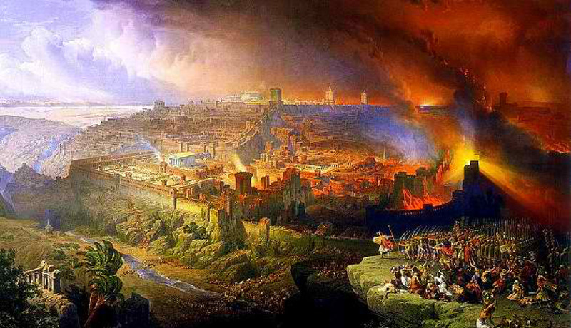
Christ’s prophecy of the destruction of Jerusalem was fulfilled in 70 A.D. when the Roman army of General Titus destroyed Jerusalem.

Slide 7
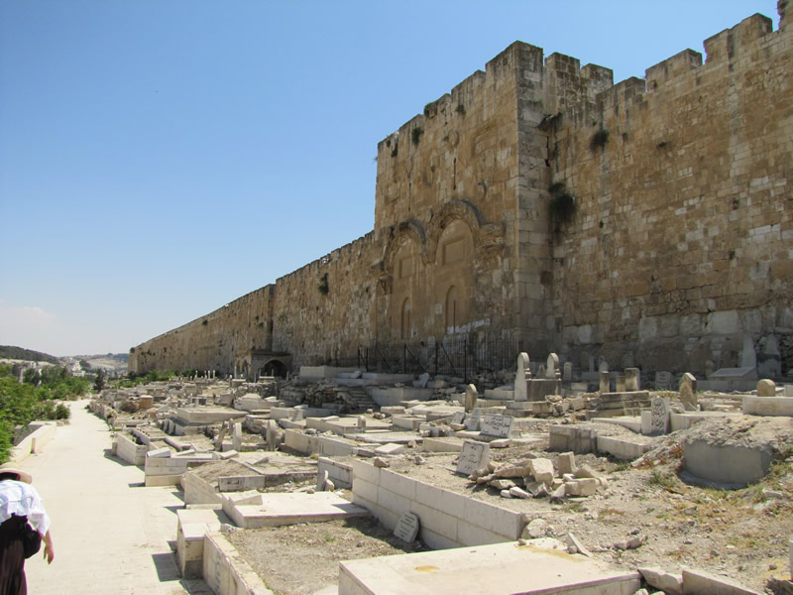
Jerusalem was then ruled for almost
1900 years by Gentile (foreign) nations

Slide 8
The Gentiles that ruled over Jerusalem, 70 - 1967 AD
70-324 Roman Period
324-638 Byzantine Period
638-1099 First Muslim Period
1099-1187 Crusader Period
1187-1917 Second Muslim Period
(Ayyubid, Mamluk, and Ottoman rule)
1917-1948 British Period
1948-1967 Jordan ruled 3/4ths of Jerusalem

Slide 9
It was only in 1967 with the Six Day War that the Jews began to again rule over all Jerusalem.
This signifies that “The Times of the Gentiles,” or the Church Age, is now drawing to a close!

Slide 10
Jesus said “this generation” –the generation that would again see Jerusalem ruled over by the Jews- would see the fulfillment of His 2nd Coming. Those born in 1967 and after are the Joshua Generation!
So how can we help prepare the Joshua Generation that will complete the Great Commission of the Church?

Slide 11
#1
Renewed Minds
and Hearts of Faith
Numbers 14:6-9

Slide 12
Of the 12 spies, only Joshua and Caleb believed God would help them conquer the promised Land. All the rest of Moses’ generation died in the wilderness, missing God’s best.

Slide 13
Differences between
the Moses Generation
and the
Joshua Generation:

Slide 14
MOSES GENERATION
JOSHUA GENERATION
Slave mentality
Ex. 14:10-12
(Bondage is security.)
Soldier mentality
Num. 14:609
(Trust and obey!)
Reactive (worry, fixing problems)
Proactive (faith, forward goals)
God parted the waters, israel escaped
God parted the waters, israel attacked!
Died in the wilderness
Conquered the promised land
Fell short of god’s plans, heb. 3:16-4:2
Full overcomers

Slide 15
God is raising up
a faith-filled
Joshua Generation
to complete the Great Commission!

Slide 16
Our Lord Jesus said,
“The kingdom of heaven is taken by violence, and the violent take it by force” –Mt.11:12

Slide 17
#2.
We Need Direction from God
Prov.29:18
“Where there is no vision, the people
are unrestrained” – Proverbs 28:19

Slide 18
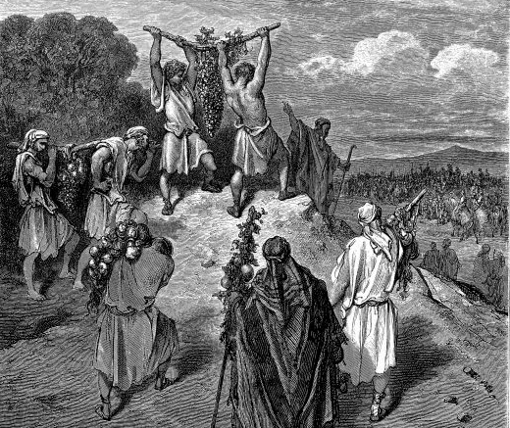
We need to know what we should be aiming to accomplish in life. Otherwise all our activities can be counterproductive!

Slide 19
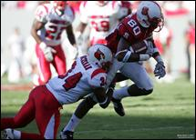

Slide 20
Saul of Tarsus was going the wrong way in his life, Acts 9:1-4
But he turned and became the Apostle Paul: Phil.3:13-14, “ONE THING I do… I press toward the mark”
A correctly focused life will have purpose and power!

Slide 21
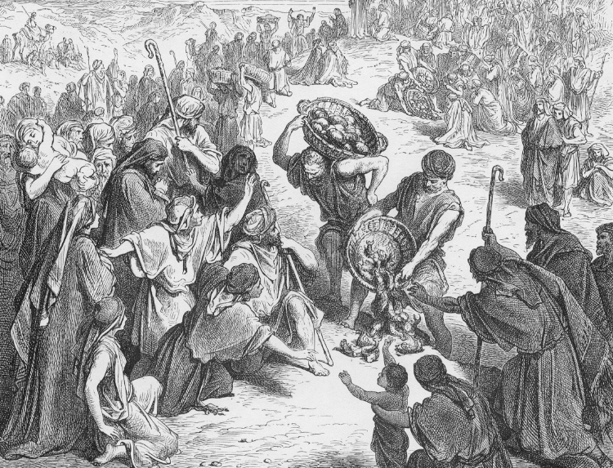
FOLLOWING GOD’S DIRECTIONS WILL RELEASE GOD’S BLESSINGS:
Jesus’ disciples organized the 5000 into groups and distributed the 5 loaves & 2 fish

Slide 22
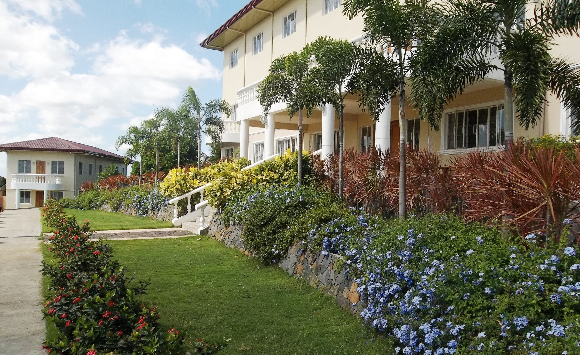

Zion Ministries | Antipolo, Philippines

Slide 23
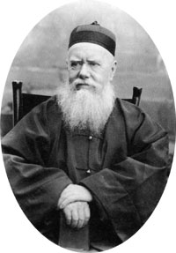
“God’s will
done God’s way
will have God’s provision.”
Hudson Taylor

Slide 24
#3
We Must “Cross the Jordan” and come to full Spiritual Maturity

Slide 25
The Journey of Israel from
Egypt to the Promised Land was prophetic of the Christian going from salvation to full spiritual maturity, 1 Cor.10:11 & 15:46

Slide 26
ISRAEL’S JOURNEY: | 1. EGYPT | 2. THE WILDERNESS | 3. THE PROMISED LAND
CHRISTIAN GROWTH: | SALVATION | BAPTISM OF THE HOLY SPIRIT | SPIRITUAL MATURITY
1 JOHN 2:12-14 | LITTLE CHILDREN | YOUNG MEN | FATHERS
MOSES’ TABERNACLE: | OUTER COURT | HOLY PLACE | HOLY OF HOLIES
Levels of Fruitfulness: (Mat.13:23) | 30-fold | 60-fold | 100-fold

Slide 27
Many Believers do not “Cross the Jordan,” into full maturity & fruitfulness
The Moses Generation died in the Wilderness and never crossed the Jordan
2 ½ of the 12 tribes led by Joshua went to live on the wrong side of the Jordan
The Hebrew Christians after many years remained spiritual babies, Heb.5:12-13
Many believers mature partway to become teachers but not spiritual fathers, 1 Cor.4:15
We can only go into the Promised Land- into maturity & perfection- if God permits, Heb.6:1-3.

Slide 28
#4
We Must Exercise Faith to Press Forward!
“And Caleb stilled the people before Moses and said, “Let us go up at once and possess it, for we are well able to overcome it.”
Numbers 13:30

Slide 29
The Early Church stayed in Jerusalem for several years, blessed and very loving…
Acts 2:44-46
but they ignored the Great Commission until God pushed them out of Jerusalem through persecution!
Acts 8:1

Slide 30
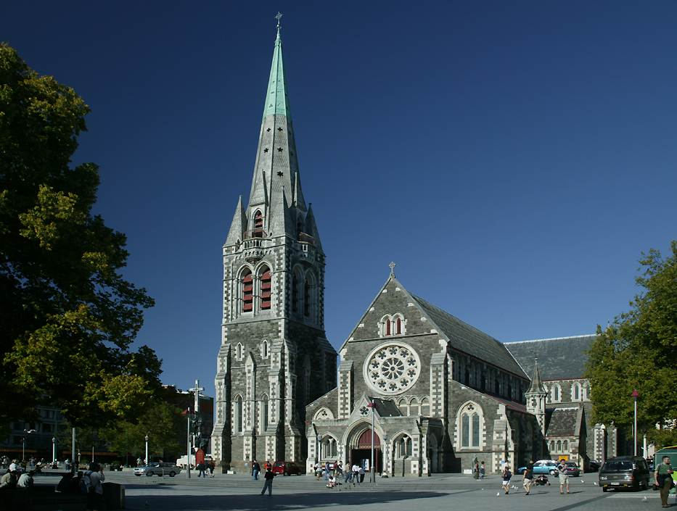
Christchurch Cathedral

Slide 31
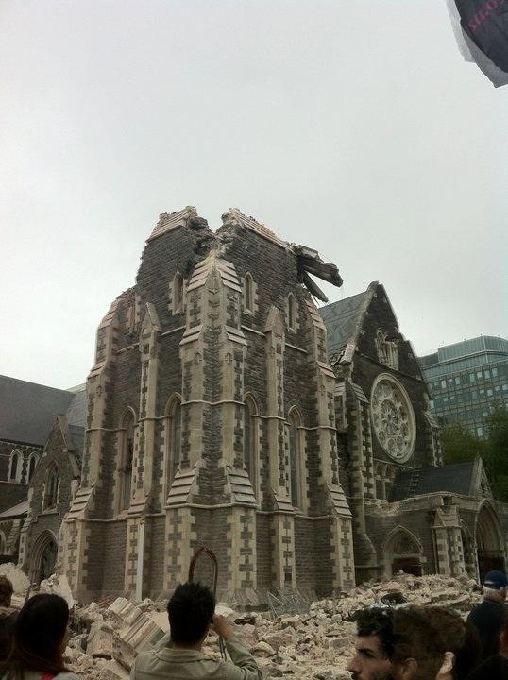
Christchurch Cathedral
after the second earthquake

Slide 32
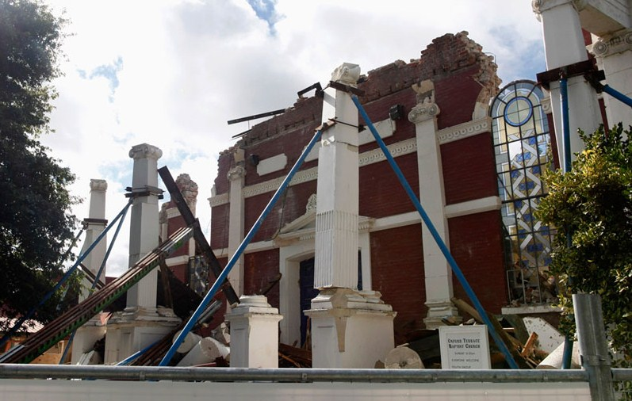
What happened in Christchurch, New Zealand is a sign from God for Christ’s Church around the world, Heb.12:26-27, Hag.2:6-7. Shaking will come!

Slide 33
Will we rise up in faith to spread the gospel
and complete the Great Commission?
Will we obey Acts 1:8, or wait for Acts 8:1?

Slide 34
The promises of Christ will be fulfilled!
The Joshua Generation will arise and complete the Great Commission!

