Slide 1
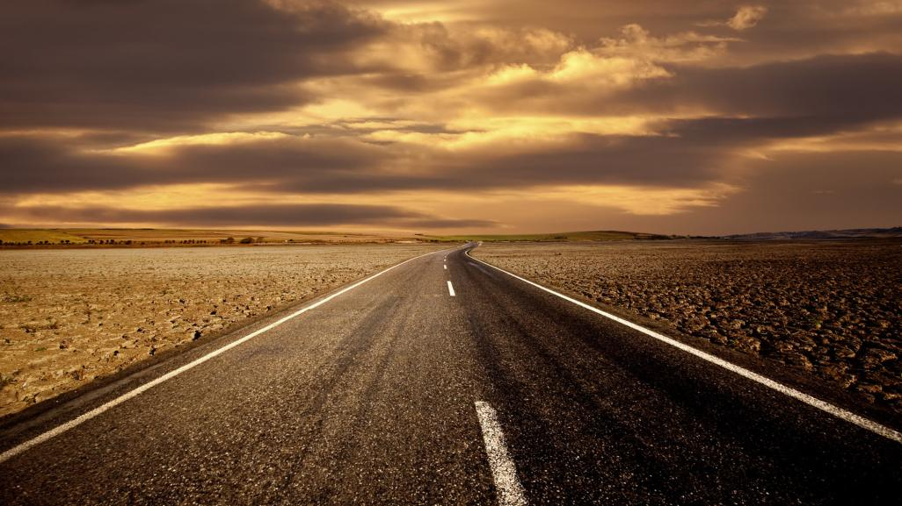
A Roadmap to Revival Isaiah 35:1-10

Slide 2
GOD HAS SPOKEN: THIS YEAR (2020) YOU WILL START TO SEE THE SIGNS OF THE TIMES COMING IN AN ACCELERATED WAY

Slide 3
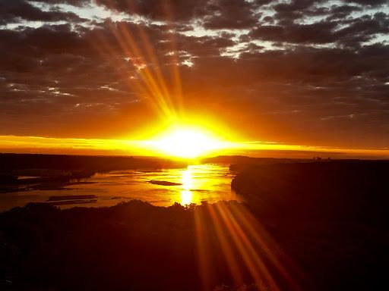
“Arise, shine; for your light has come! And the glory of the Lord is risen upon you. For behold, darkness shall cover the earth, and deep darkness the people; but the Lord will arise over you, and His glory will be seen upon you. The Gentiles shall come to your light, and kings to the brightness of your rising.” -Is.60:1-3
THESE ARE THE DAYS WHEN WE WILL SEE INCREASING TROUBLES IN THE EARTH -THESE ARE ALSO THE DAYS WHEN WE WILL SEE REVIVAL ARISING!

Slide 4
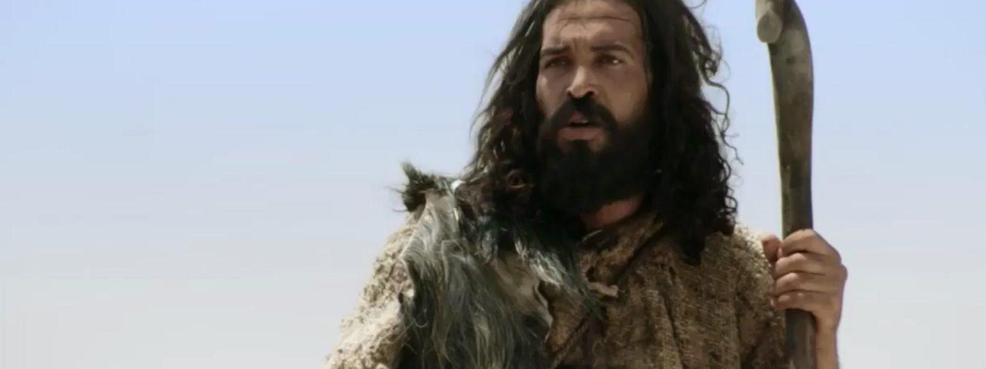
GOD SENT A MESSENGER TO PREPARE THE NATION OF ISRAEL FOR THE 1ST
COMING OF CHRIST- TO
START A REVIVAL!
In our time God will send many messengers, to prepare all the nations for the 2nd Coming of Christ!

Slide 5
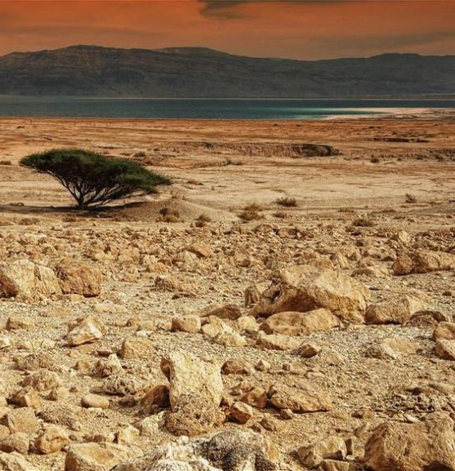
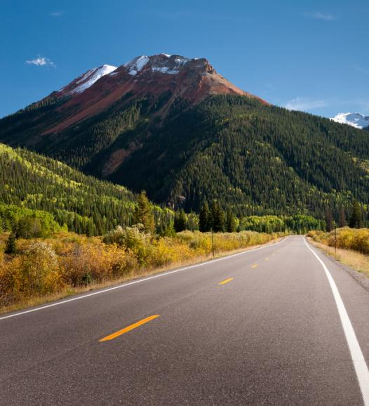
A ROADMAP TO REVIVAL Isaiah 35:1-10 1) FROM THE WILDERNESS, Isaiah 35:1-7
3) UP TO MT. ZION,
Is.35:10
2) Along
a Highway,
Is.35:8-9

Slide 6
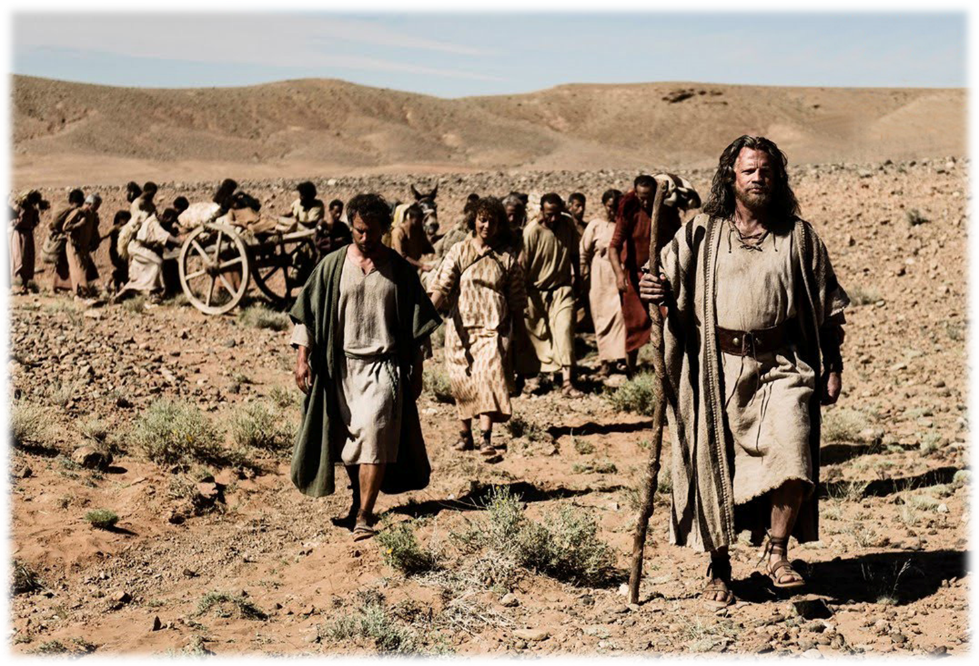
#1) IN VERSES 1-7 GOD’S PEOPLE HAVE BEEN IN THE WILDERNESS
“…to humble you and test you, to know what was in your heart” - Deut.8:2

Slide 7
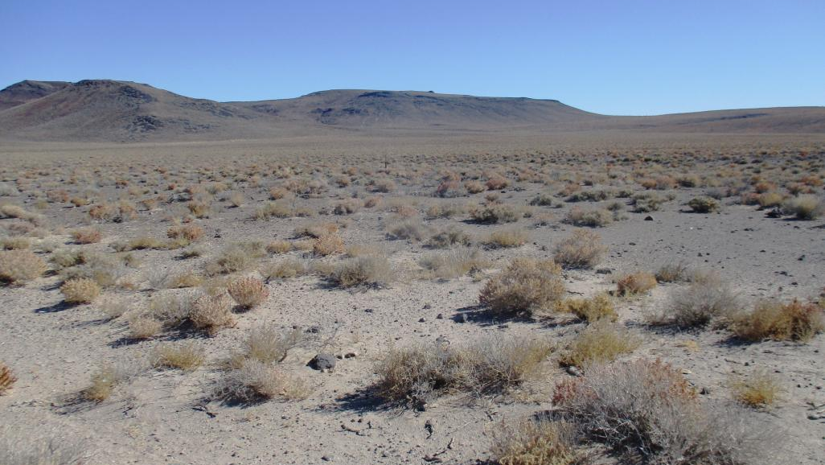
BUT GOD WILL COME TO VISIT HIS PEOPLE WANDERING IN THE WILDERNESS!
“The desert and the parched land will be glad; the wilderness will rejoice and blossom like the crocus flower…Strengthen the feeble hands, steady the knees that give way; say to those with fearful hearts, "Be strong, do not fear; your God will come… He will come to save you." –Is.35:1-4

Slide 8
God sent His messenger, John the Baptist: “The voice of one crying in the wilderness, ‘Prepare the way of the Lord, make straight a highway in
the desert for our
God.’” –Is.40:3
Today, God’s prophetic voice is again telling all of God’s people in the wilderness: GET READY! PREPARE A HIGHWAY! MOVE ON!

Slide 9
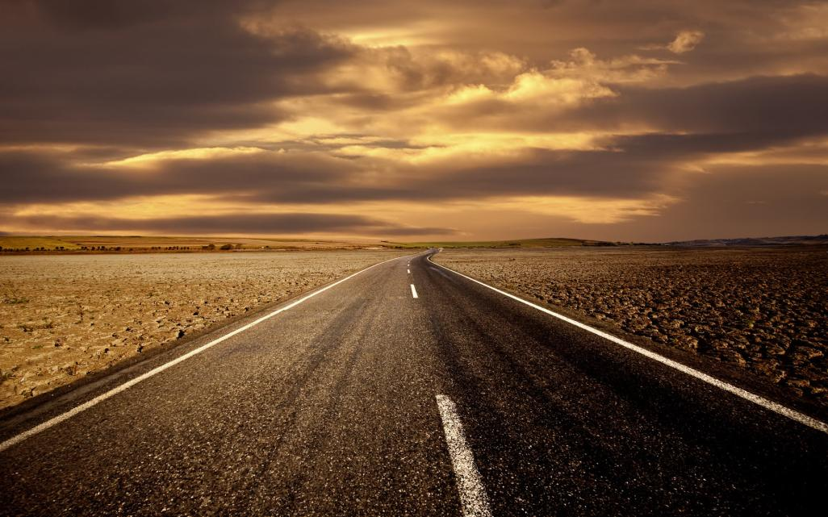
#2) IN VERSES 8-9 A HIGHWAY
IS SEEN IN THE WILDERNESS
“And a highway will be there; it will be called the Highway of Holiness. The unclean will not journey on it; it will be for those who walk in that way; wicked fools will not go about on it….But only the redeemed will walk there”

Slide 10
John the Baptist called out in the wilderness that it was time for God’s people to prepare a highway
Now the Holy Spirit wants to speak through every dedicated Christian the message: PREPARE THE HIGHWAY OF HOLINESS!

Slide 11
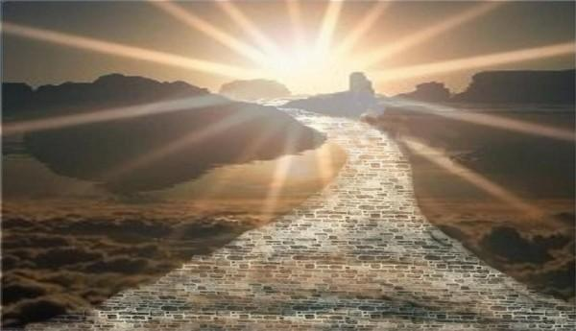
3) IN ISAIAH 35 VERSE 10, THE HIGHWAY
IS TO LEAD US UP TO MT. ZION!
“And the redeemed of the LORD shall return, and come to Zion with singing, with everlasting joy on their heads. They shall obtain joy and gladness, and sorrow and sighing shall flee away.” is.35:10

Slide 12
SPIRITUAL MT. ZION IS THE GOAL
OF THE CHURCH- IT IS THE
HIGH CALL FOR OUR LIVES!
Heb 12:22-23 “But you have come to Mount Zion and to the city of the living God, the heavenly Jerusalem, to an innumerable company of angels, to the general assembly and church of the firstborn”

Slide 13
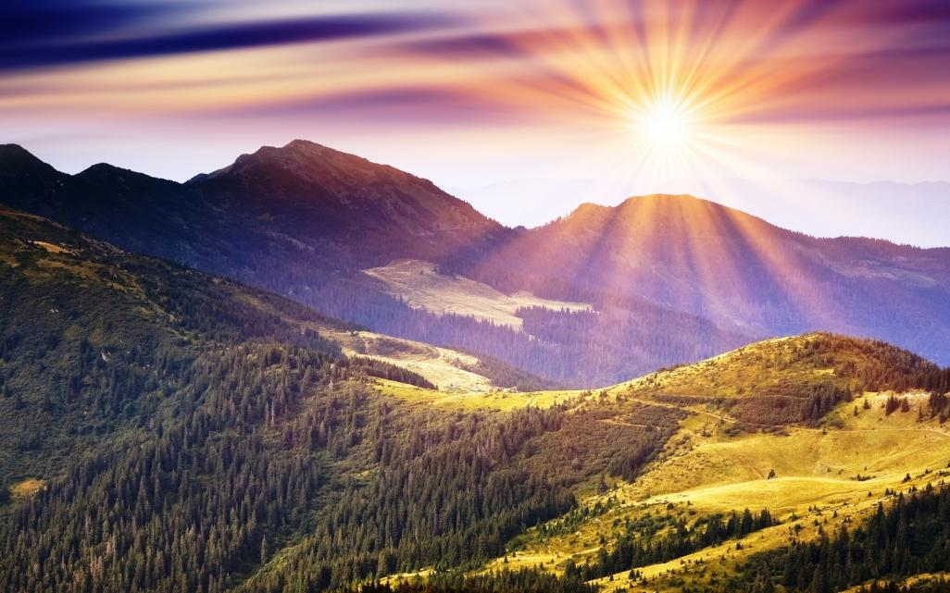
MT. ZION IS THE PLACE
TO WORSHIP IN GOD’S PRESENCE!
(Rev 14:1-3) “Then I looked, and there before me was the Lamb, standing on Mount Zion, and with him 144,000…. They sang as it were a new song before the throne, before the four living creatures, and the elders”
THERE IS A PLACE IN HEAVEN AT THE THRONE OF GOD, CALLED MT. ZION!

Slide 14
MT. ZION IS THE PLACE
OF AUTHORITY!
(Ps.110:2) “The LORD shall send the rod of Your strength out of Zion. Rule in the midst of Your enemies!”
-The throne of King David was established on Mt Zion in Jerusalem- but now, the throne of Jesus, the Son of David, is on Mt. Zion in Heaven! And those who are spiritually seated with Christ will gain His authority, Rev.3:21

Slide 15
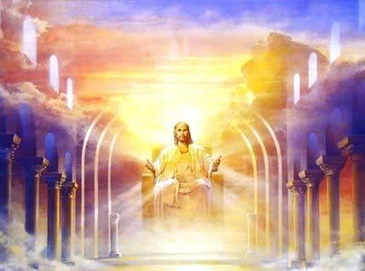
To him who overcomes I will grant to sit with Me on My throne, as I overcame and sat down with My Father on His throne” –Rev.3:21

Slide 16
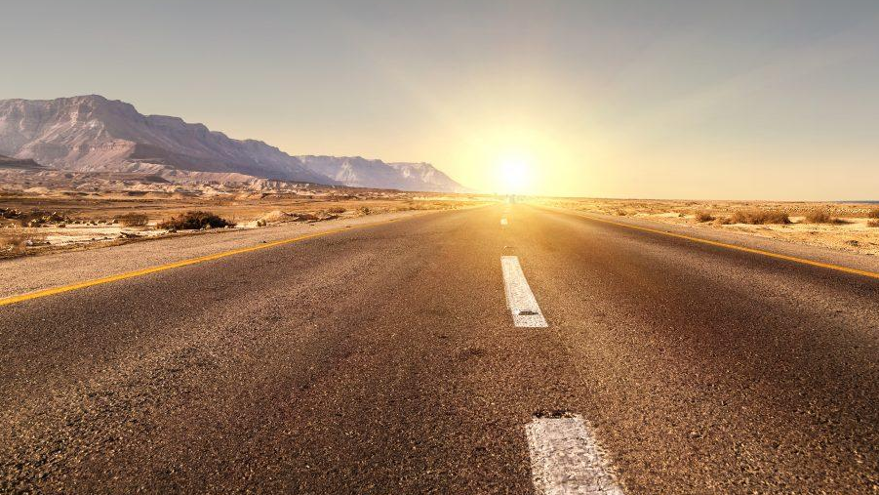
SO HOW DO WE BUILD
A HIGHWAY OF HOLINESS?
PSALM 84:4 TELLS US IN THE NASV TRANSLATION, “BLESSED IS THE MAN WHOSE STRENGTH IS IN YOU,
IN WHOSE HEART ARE THE HIGHWAYS TO ZION.”
-THIS IS A ROAD TO BE BUILT IN EACH OF OUR HEARTS!!

Slide 17
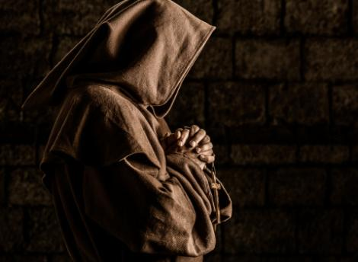
Holiness is NOT: - A RELIGIOUS RITUAL - SADNESS & FALSE PIETY - FOR ONLY A CHOSEN FEW

Slide 18
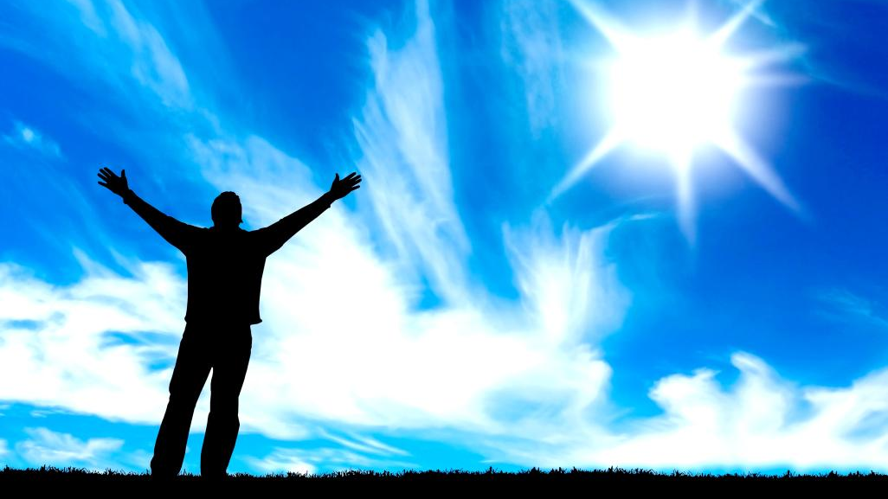
Holiness IS:
PROTECTION FROM
FROM EVIL SPIRITS! Isaiah 35:9

Slide 19
Holiness IS:
HEALTHY!
1 Cor. 6:19-20

Slide 20
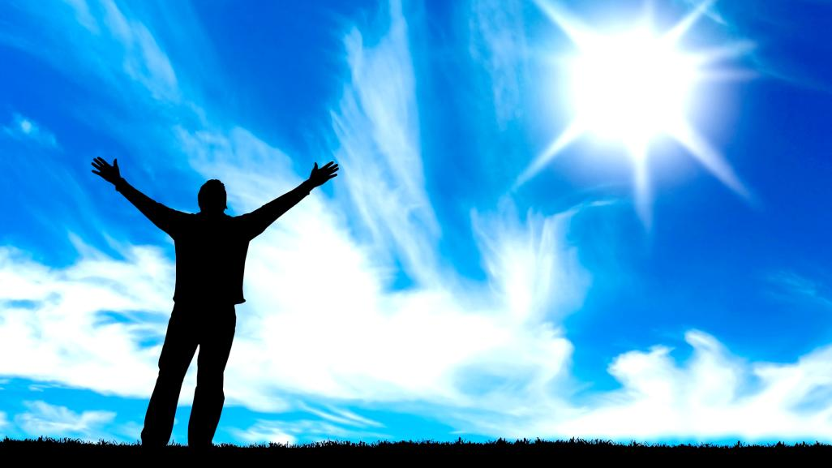
Holiness IS:
-PRACTICAL!
Eph.4:22-24

Slide 21
Holiness IS:
FOR ALL
OF GOD’S PEOPLE
1 Pet.1:16

Slide 22
Holiness IS:
PREPARES US FOR
THE SECOND COMING
OF CHRIST Rev. 19:7-8

Slide 23
HOW ARE WE
TO PREPARE THE WAY?
BUILD THE HIGHWAY OF HOLINESS,
AND GET CLOSER TO GOD!

Slide 24
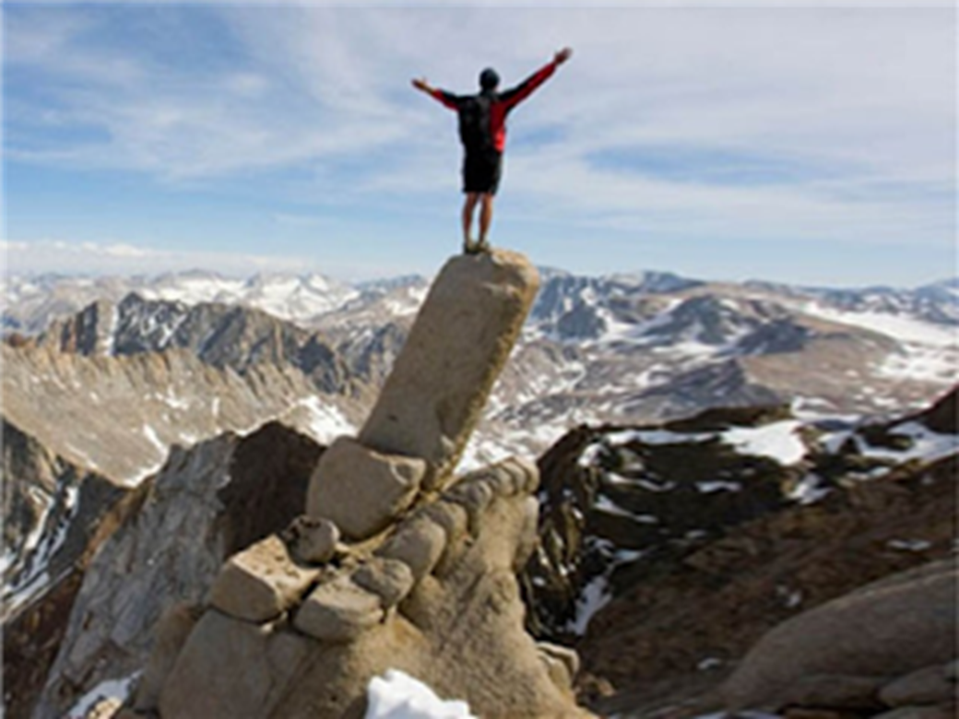
Psalm 24 tells us there are four requirements of holiness to visit God, to ASCEND up Mt Zion
“Who will ascend into the hill of the Lord? Who may stand in His holy place?” Ps.24:3

Slide 25
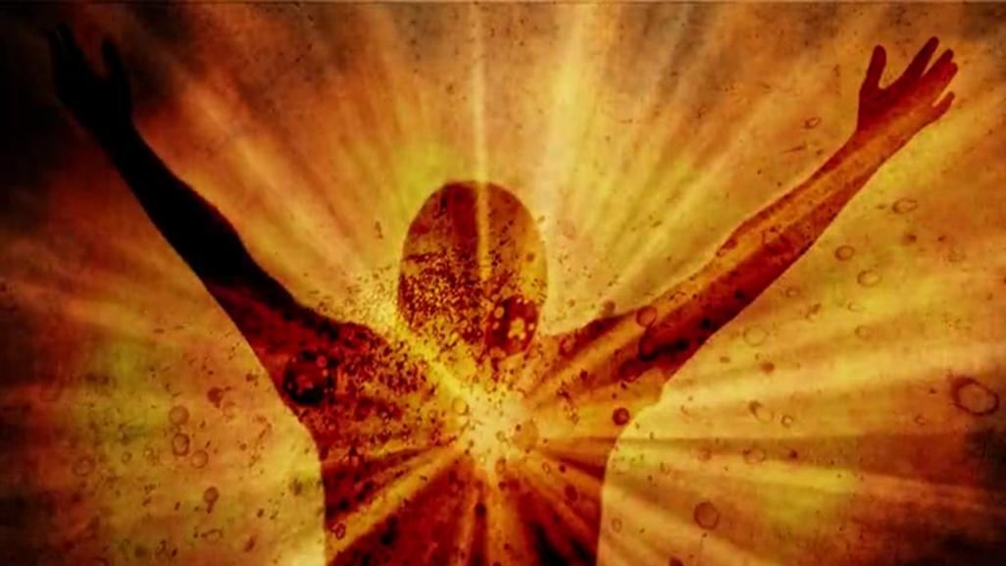
Psalm 15 tells us there are 11 requirements of holiness to abide, to LIVE on Mt Zion!
“Lord, who may abide in Your tabernacle? Who may dwell in Your holy hill?” –Ps.15:1

Slide 26
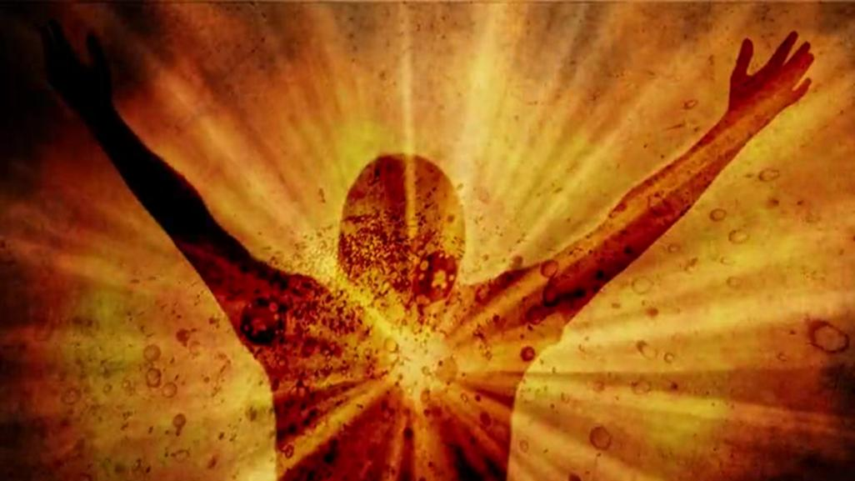
HOW CAN WE FACE THESE DAYS
OF DARKNESS?
GET MORE FILLED WITH THE LIGHT OF GOD! WITH HIS HOLINESS! GET FILLED WITH
GOD’S PURITY AND POWER!

Slide 27
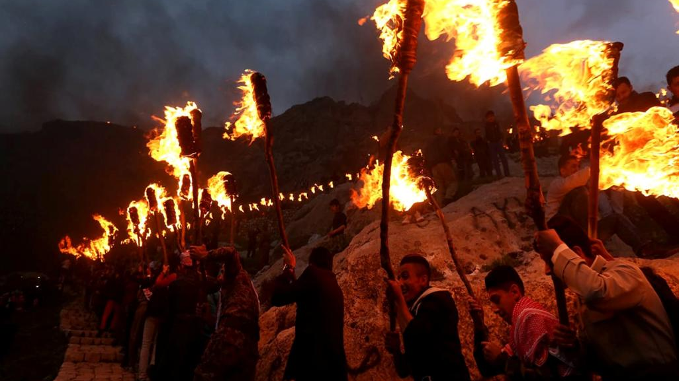
OB.21 - DELIVERERS
WILL ASCEND UP ON MT ZION,
AND THE KINGDOM
WILL BE THE LORD’S.

Slide 28
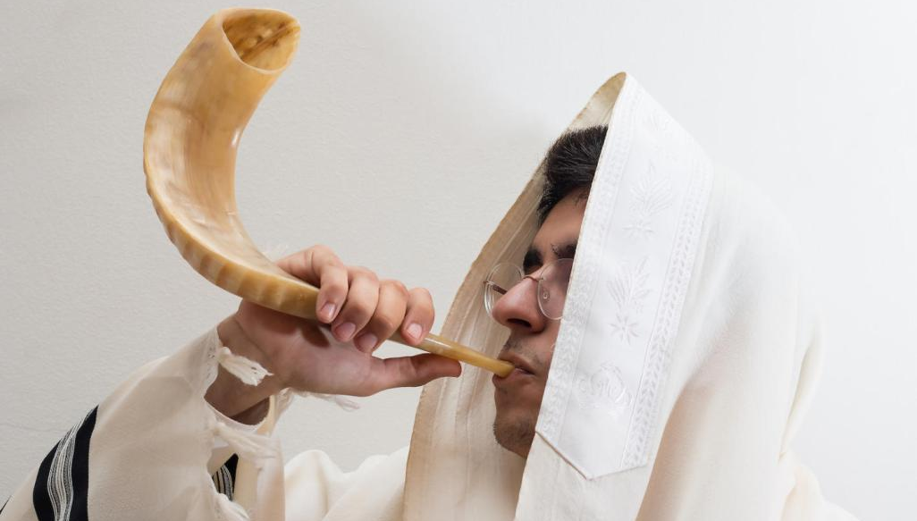
CHURCH, LET’S GET READY
-PREPARE THE WAY!
IT IS TIME TO MOVE ON-
OUR CALLING IS TO MT. ZION!

