Slide 1
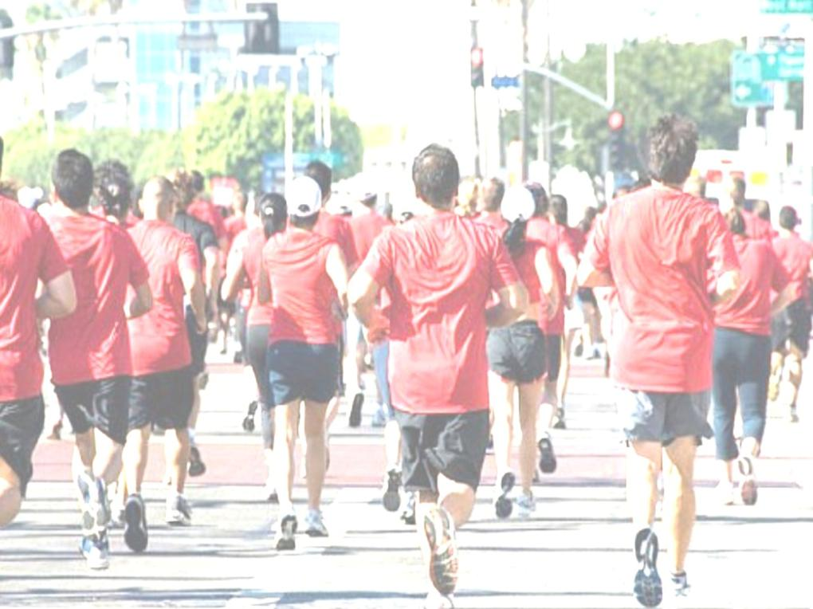
LET US RUN THE RACE SET BEFORE US

Slide 2
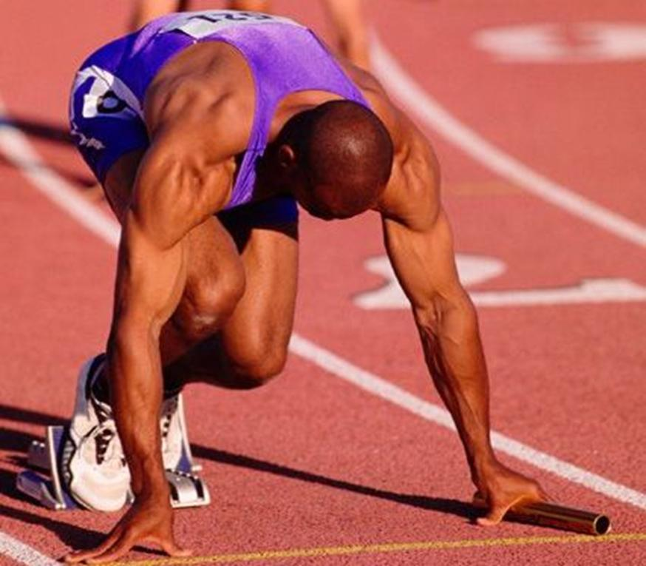
There is a race: a holy purpose, a high calling for each of our lives

Slide 3
God wants to set our race before us- show us our calling!
“Write the vision,
and make it plain,
that he may run
who reads it.” -Hab.2:2

Slide 4
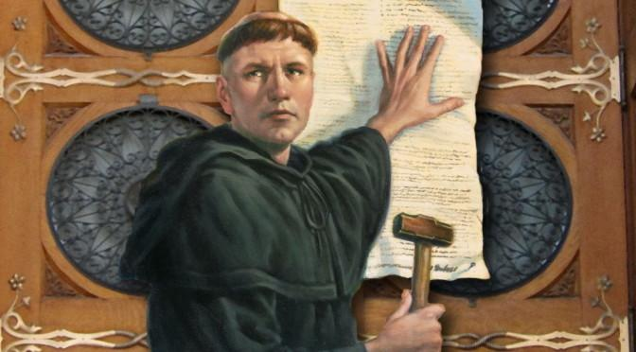

Slide 5
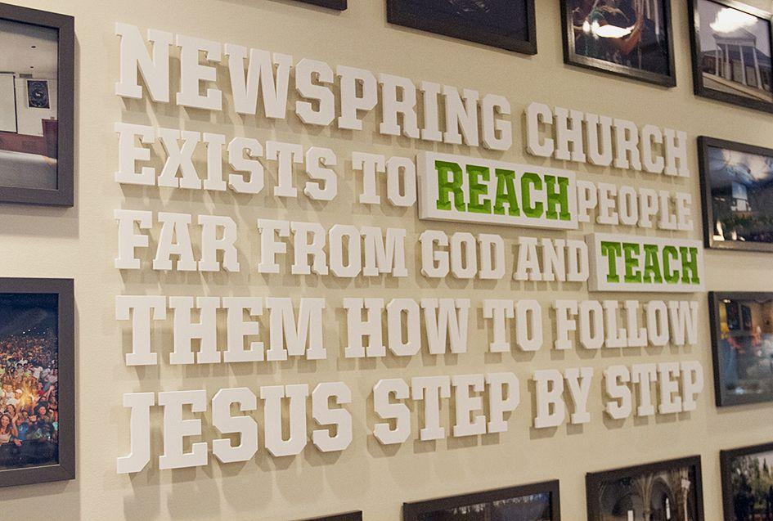

Slide 6
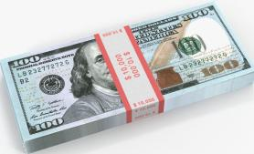

Slide 7
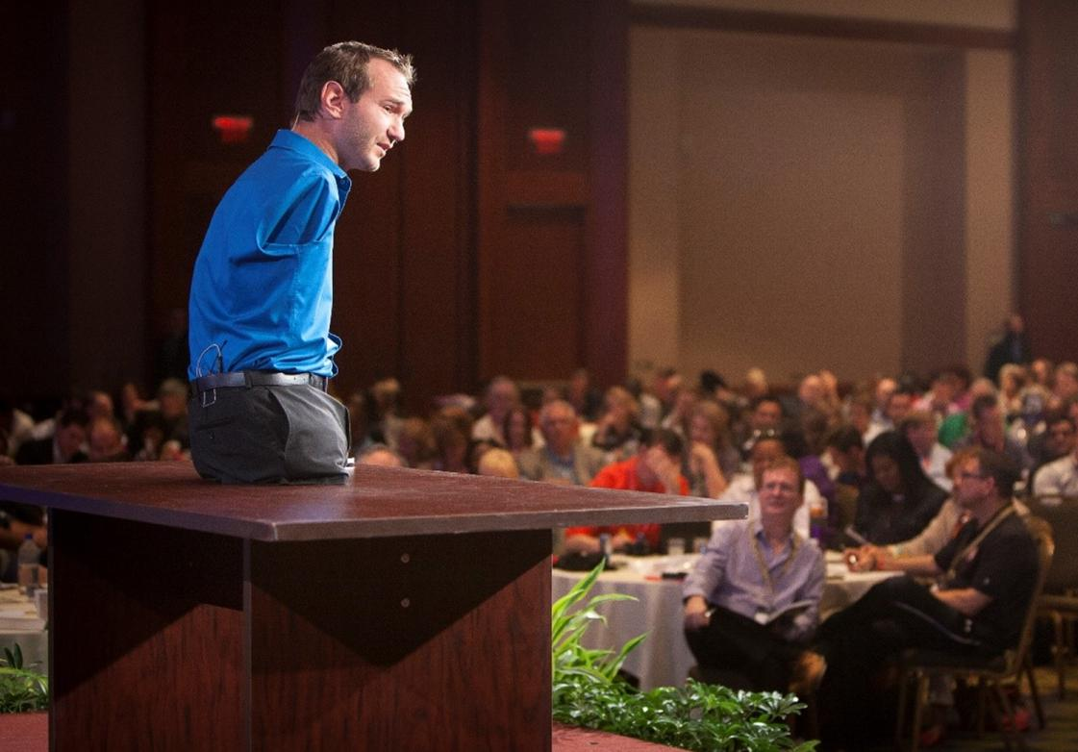
Nick Vujicic: famous motivational speaker
& Christian evangelist

Slide 8
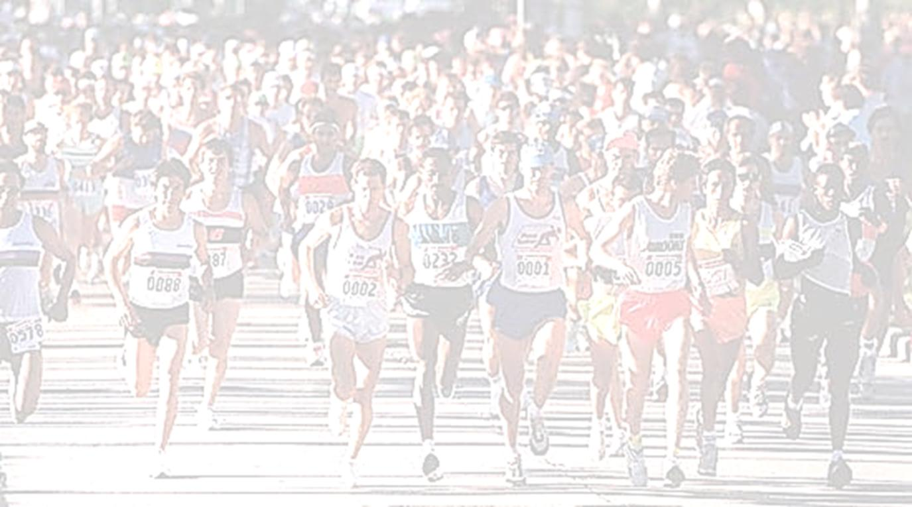
Let US run THE race set before US
Let us run the Races set before us
Let us each run our own race
THERE IS ONE RACE
THAT WE ARE ALL
RUNNING TOGETHER!

Slide 9
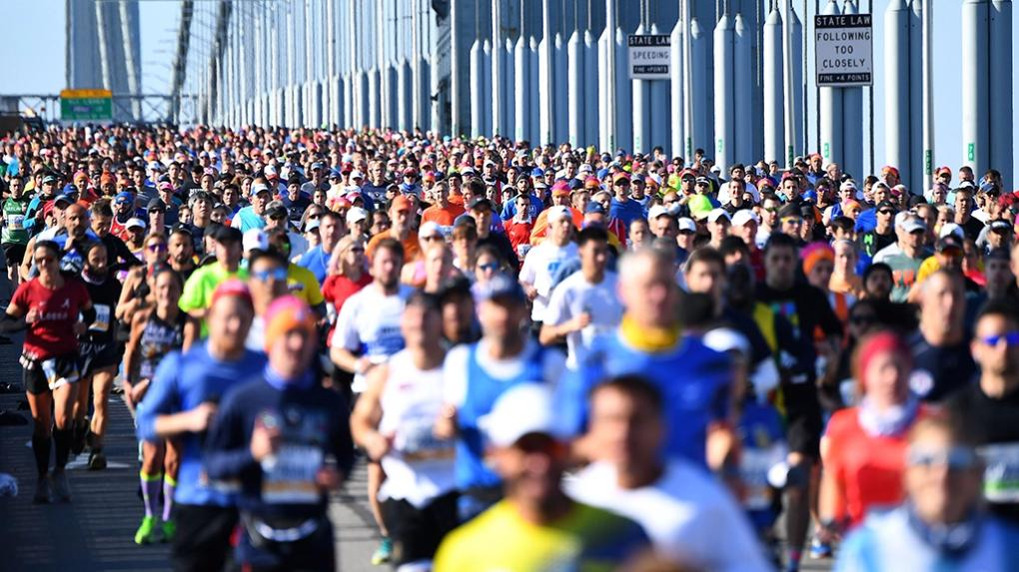
WE HAVE A LONG RACE,
LIKE A MARATHON!

Slide 10
THE CHURCH’S RACE IS ALSO A RELAY RACE

Slide 11
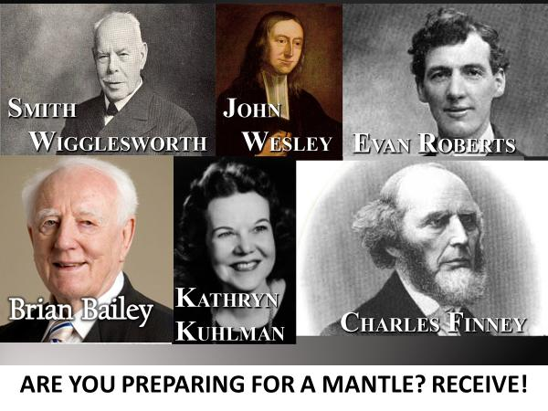
Study the lives of the Heroes of Faith who have gone before us- receive from their fire and their wisdom!

Slide 12
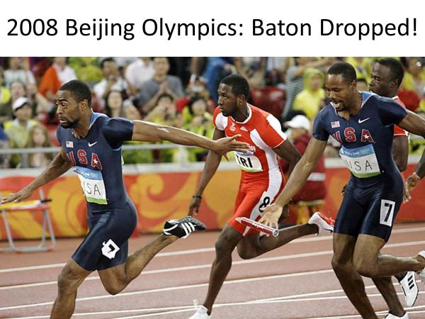

Slide 13
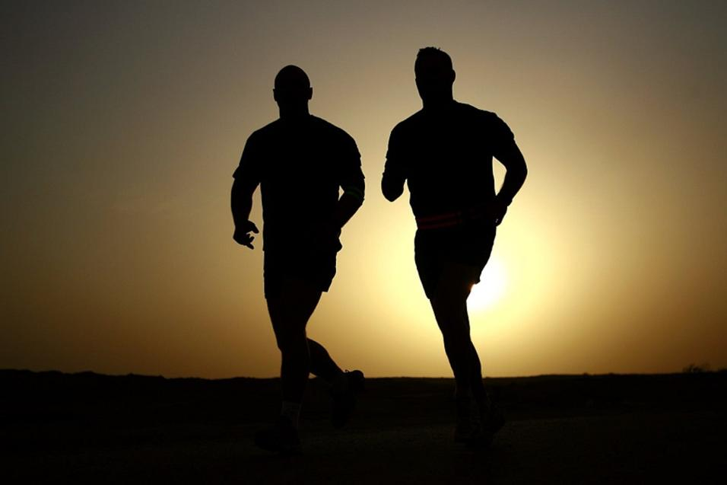

Slide 14
WHAT IS THE ONE RACE,
ONE CALLING FOR THE CHURCH?
-To prepare the bride of Christ!
(AND COMPLETE THE GREAT COMMISSION)

Slide 15
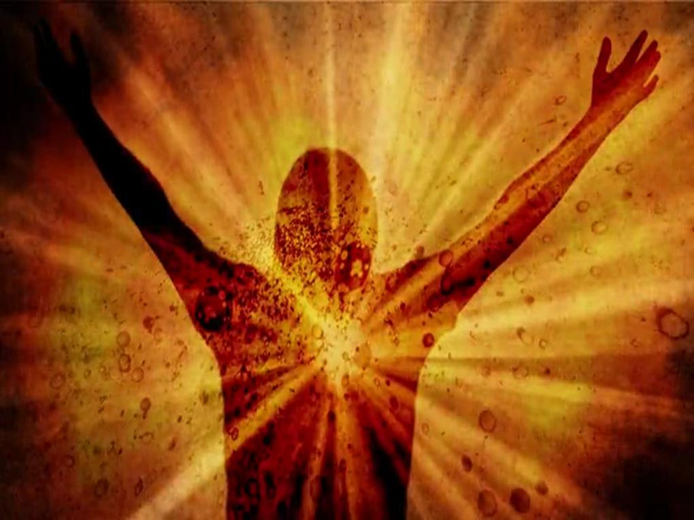
Our ONE CALLING:
* The GLORIOUS & VICTORIOUS CHURCH!
* Christ IN us and THROUGH us
* QUALITY & QUANTITY (The Bride) (Full Harvest)

Slide 16
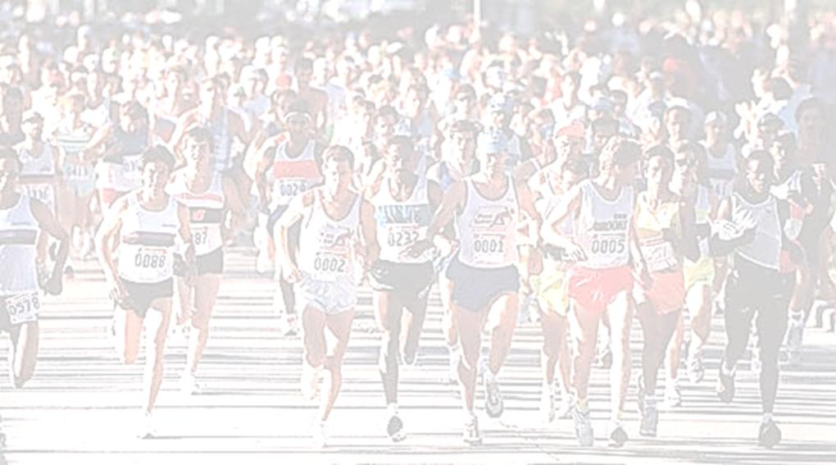
AT THE 1st COMING OF CHRIST THE CHURCH
WAS STARTED - THE RACE BEGAN!
“I will build My church, and the
gates of hell will not prevail against it.”

Slide 17
AT THE 2nd COMING OF CHRIST, THE CHURCH WILL BE COMPLETED- THE RACE WILL BE WON!

Slide 18
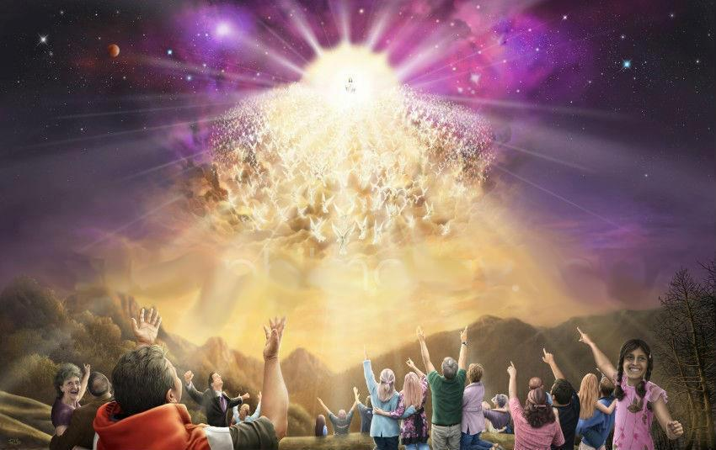
“And the Bride has made herself ready”
– Rev.19:7

Slide 19
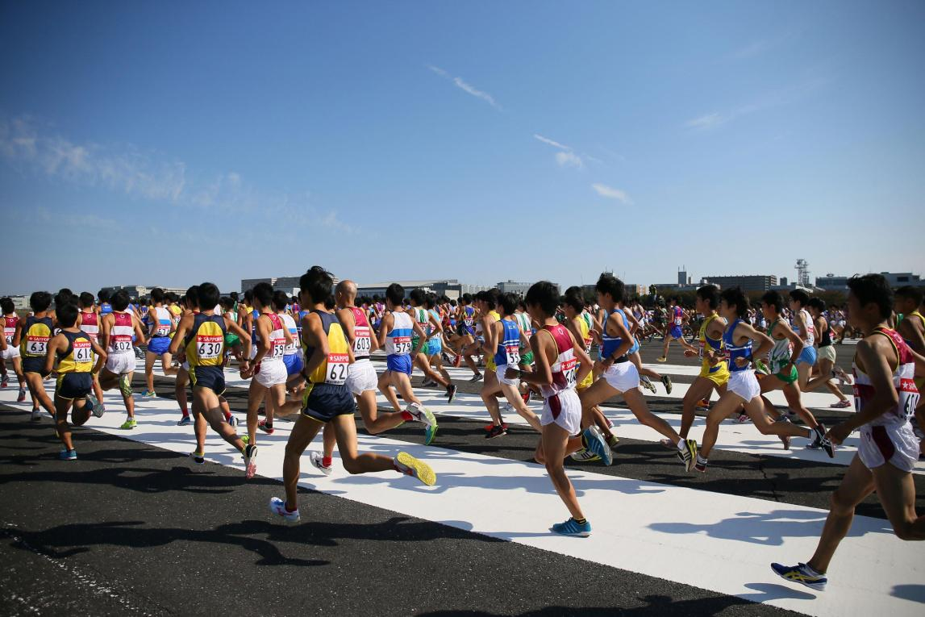
LET US CLEARLY SEE THE RACE WE ARE TO RUN- AND THEN RUN IT WITH ENDURANCE!

