Slide 1

Deception & Discernment in the Last Days
Protection
FROM IMPURE MINISTRIES
AND POLLUTED ANOINTING
Zion Leadership Seminar 2021

Slide 2

2 Thessalonians 2
9 The coming of the lawless one is according
to the working of Satan, with all power, signs,
and lying wonders,
10 and with all unrighteous deception among
those who perish, because they did not receive
the love of the truth, that they might be saved.

Slide 3
2 Thessalonians 2
11 And for this reason God will send
them strong delusion, that they should
believe the lie,
12 that they all may be condemned who
did not believe the truth but had
pleasure in unrighteousness.

Slide 4

01
Deception
will be one of the greatest
challenges the Church is going to
face in the last days.
Protection from Impure Ministries & Polluted Anointing

Slide 5

Matthew 24
Matthew 24
4 And Jesus answered and said to them:
"Take heed that no one deceives you.
5 For many will come in My name, saying, 'I
am the Christ,' and will deceive many.
11 Then many false prophets will rise up
and deceive many.
24 For false christs and false prophets will
rise and show great signs and wonders to
deceive, if possible, even the elect.

Slide 6

2 Thessalonians 2
2 Thessalonians 2
1 Now, brethren,concerning the coming of our
Lord Jesus Christ and our gathering together to
Him, we ask you,
2 not to be soon shaken in mind or troubled,
either by spirit or by word or by letter, as if from
us, as though the day of Christ had come.
3 Let no one deceive you by any means; for that
Day will not comeunless the falling awaycomes
first, and the man of sin is revealed, the son of
perdition,

Slide 7

I Timothy 4:1
1 Now the Spirit expressly says that in latter times
some will depart from the faith, giving heed to
deceiving spirits and doctrines of demons. 2 speaking
lies in hypocrisy, having their own conscience seared
with a hot iron.
[NLT] they will follow deceptive spirits and teachings
that come from demons. 2 These people are hypocrites
and liars, and their consciences are dead.
Protection from Impure Ministries & Polluted Anointing

Slide 8

Protection from Impure Ministries & Polluted Anointing
2 Thessalonians 2:11
And for this reason God will send
them strong delusion, that they
should believe the lie,

Slide 9

Protection from Impure Ministries & Polluted Anointing
Delusion-
something that is believed to
be true or real but that is
actually false or unreal.

Slide 10

What is God’s
provision for us that
we may escape
deception in the last
days?

Slide 11

God’s provision for us to be sure
that we can escape deception these
last days is that we know and apply
the Truth - God’s Word.
Protection from Impure Ministries & Polluted Anointing

Slide 12

02
Be aware
that the enemy will always
attempt to sow mixture in the
work of God.
Protection from Impure Ministries & Polluted Anointing

Slide 13

Don’t be so engrossed with
manifestations of power to the
point that you ignore the bad
elements that are present.
Protection from Impure Ministries & Polluted Anointing

Slide 14

Matthew 13
Matthew 13
24 Another parable He put forth to them, saying:
"The kingdom of heaven is like a man who sowed
good seed in his field;
25 but while men slept, his enemy came and
sowed tares among the wheat and went his way.
26 But when the grain had sprouted and
produced a crop, then the tares also appeared.
27 So the servants of the owner came and said
to him, 'Sir, did you not sow good seed in your
field? How then does it have tares?'

Slide 15
Matthew 13
Matthew 13
28 He said to them, 'An enemy has done this.'
The servants said to him, 'Do you want us then to
go and gather them up?'
29 But he said, 'No, lest while you gather up the
tares you also uproot the wheat with them.
30 Let both grow together until the harvest, and
at the time of harvest I will say to the reapers,
"First gather together the tares and bind them in
bundles to burn them, but gather the wheat into
my barn." ' "

Slide 16
When we are cognizant of
the possibility of mixture
in a ministry we can pray
for protection and make
better spiritual judgment.
Protection from Impure Ministries & Polluted Anointing

Slide 17

1 Thessalonians 5:21
Test all things; hold fast what is good.
[AMP] But test and prove all things
[until you can recognize] what is
good; [to that] hold fast.
Protection from Impure Ministries & Polluted Anointing

Slide 18
If those leading the work of God are
not completely surrendered to Jesus,
the enemy will take advantage of the
“cracks” in their lives and infiltrate
the work of God.
Protection from Impure Ministries & Polluted Anointing

Slide 19

Psalm 86:11
Teach me Your way, O Lord; I will
walk in Your truth; Unite my heart
to fear Your name.
Protection from Impure Ministries & Polluted Anointing

Slide 20
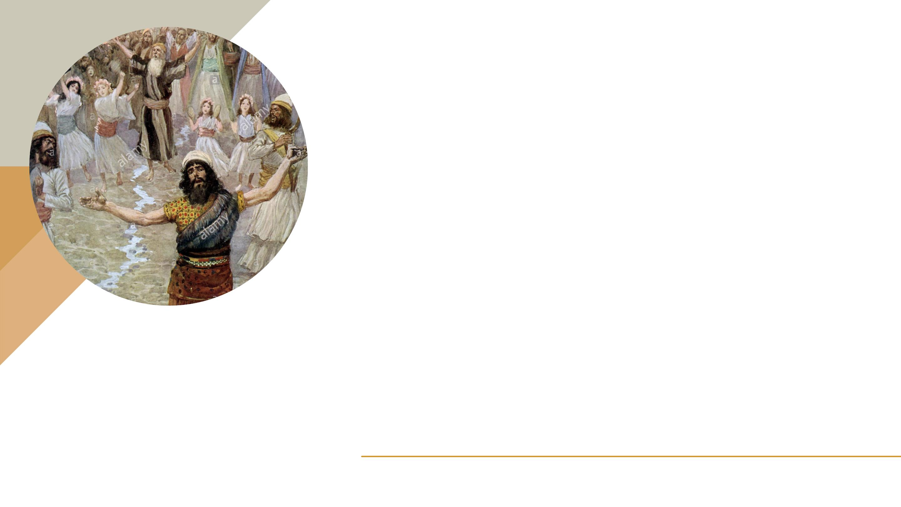
1 Samuel 10:10
10 When they came there to the hill,
there was a group of prophets to meet
him; then the Spirit of God came upon
him, and he prophesied among them.
Protection from Impure Ministries & Polluted Anointing

Slide 21

1 Samuel 18:10-11
10 And it happened on the next day that the
distressing spirit from God came upon Saul, and he
prophesied inside the house. So David played music
with his hand, as at other times; but there was a spear
in Saul's hand.
11 And Saul cast the spear, for he said, "I will pin David
to the wall!" But David escaped his presence twice.
Protection from Impure Ministries & Polluted Anointing

Slide 22

Isaiah 44:3-4
3 For I will pour out water to quench
your thirst and to irrigate your
parched fields. And I will pour out My
Spirit on your descendants, and My
blessing on your children. 4 They will
thrive like watered grass, like willows
on a riverbank. NLT.
Protection from Impure Ministries & Polluted Anointing

Slide 23

03
Be discerning
as to who is receiving
the glory.
Protection from Impure Ministries & Polluted Anointing

Slide 24
When the Holy Spirit is at work,
it is the Father and the Son that
is glorified.
Protection from Impure Ministries & Polluted Anointing

Slide 25
When another spirit is at work
man and/or organization is
wrongly exalted.
Protection from Impure Ministries & Polluted Anointing

Slide 26

Acts 3
Acts 3
11 Now as the lame man who was healed held on to
Peter and John, all the people ran together to them in
the porch which is called Solomon’s, greatly amazed.
12 So when Peter saw it, he responded to the people:
“Men of Israel, why do you marvel at this? Or why look
so intently at us, as though by our own power or
godliness we had made this man walk?
13 The God of Abraham, Isaac, and Jacob, the God of
our fathers, glorified His Servant Jesus, whom you
delivered up and denied in the presence of Pilate,
when he was determined to let Him go.

Slide 27

Proverbs 16:8
Pride goes before destruction,
and a haughty spirit before a fall.
Protection from Impure Ministries & Polluted Anointing

Slide 28

1 Timothy 5
22 Do not lay hands on anyone hastily, nor
share in other people’s sins;
keep yourself pure.
24 Some men’s sins are clearly evident,
preceding them to judgment, but those of
some men follow later.
Protection from Impure Ministries & Polluted Anointing

Slide 29

04
How can we
protect ourselves from
falling prey to impure
ministries and polluted
anointing?
Protection from Impure Ministries & Polluted Anointing

Slide 30

A
Keep a humble
heart.

Slide 31

Protection from Impure Ministries & Polluted Anointing
1 Peter 5
5b and be clothed with humility, for
“God resists the proud, But gives grace
to the humble.”6 Therefore humble
yourselves under the mighty hand of
God, that He may exalt you in due time.

Slide 32

Protection from Impure Ministries & Polluted Anointing
Psalm 25
8 Good and upright is the Lord; Therefore
He teaches sinners in the way.
9 The humble He guides in justice, And
the humble He teaches His way.

Slide 33
Protection from Impure Ministries & Polluted Anointing
Isa. 57:15
For thus says the High and Lofty One Who
inhabits eternity, whose name is Holy:
“I dwell in the high and holy place, With him
who has a contrite [crushed] and humble
spirit, Torevive the spirit of the humble, And
to revive the heart of the contrite ones.

Slide 34

B
Receive the love of the
truth.

Slide 35

C
Cultivate the fear of the
Lord.

Slide 36

WHAT IS THE FEAR OF THE LORD?
The fear of the Lord means to
have a deep respect , reverence
and awe for God’s power and
authority.

Slide 37

Proverbs 19:23
The fear of the Lord leads to life,
And he who has it will abide in satisfaction;
He will not be visited with evil.

Slide 38
Protection from Impure Ministries & Polluted Anointing
2Corinthians
Therefore, having these promises, beloved,
7:1
let us cleanse ourselves from all filthiness of
the flesh and spirit, perfecting holiness in
the fear of God.

Slide 39

D
Surrender selfish ambition;
embrace the crucified life.

Slide 40

2Corinthians 12:20
For I fear lest, when I come, I shall not find you such
as I wish, and that I shall be found by you such as
you do not wish; lest there be contentions,
jealousies, outbursts of wrath, selfish ambitions,
backbitings, whisperings, conceits, tumults.
Protection from Impure Ministries & Polluted Anointing

Slide 41

James 3:16
For where envy and self-seeking
exist, confusion and every evil
thing are there.
Protection from Impure Ministries & Polluted Anointing

Slide 42
Galatians 2:20
I have been crucified with Christ; it is no
longer I who live, but Christ lives in me; and
the life which I now live in the flesh I live
by faith in the Son of God, who loved me
and gave Himself for me.
Protection from Impure Ministries & Polluted Anointing

Slide 43

Galatians 5:24
And those who are Christ’s have crucified
the flesh (Adamic nature) with its passions
and desires.
Protection from Impure Ministries & Polluted Anointing

Slide 44

Luke 9:23
Then He said to them all,
“If anyone desires to come after Me,
let him deny himself, and take up his
cross daily, and follow Me. “
Protection from Impure Ministries & Polluted Anointing

Slide 45
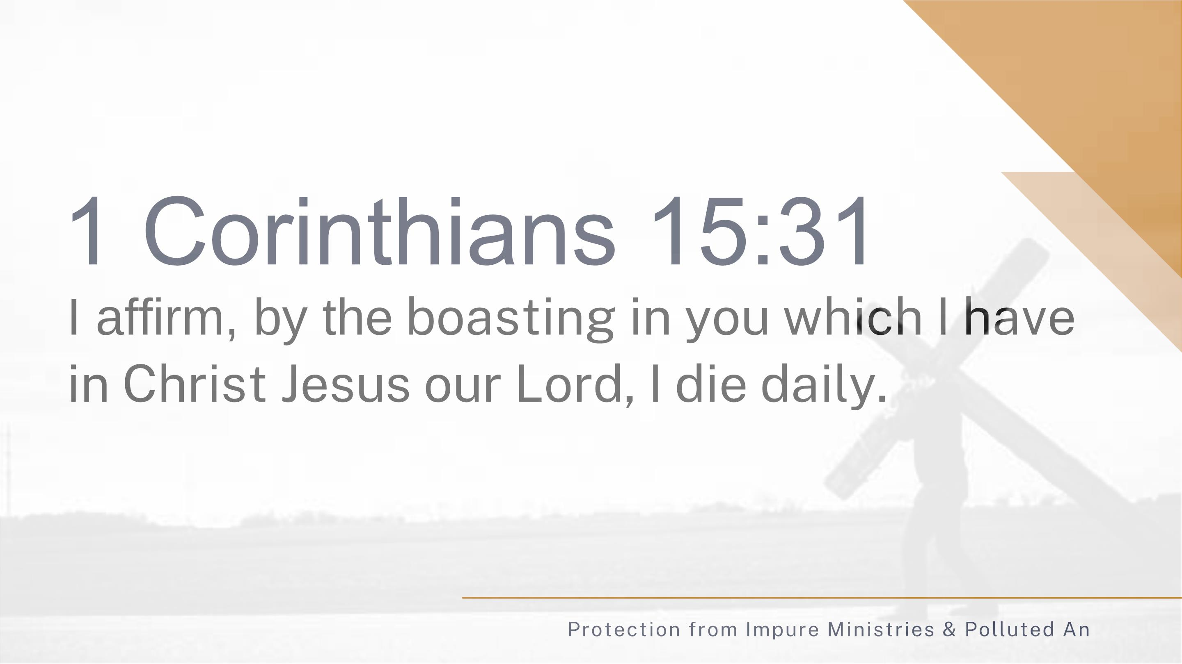
ointing

